Slide 1
Aircare International Supporting Strong Cultures of Safety and Quality in Business Aviation
January 18, 2017
Teterboro Users Group
Jake Paini, Sales Associate and Medical Instructor

Slide 2
Who We Are
Products and Services focus on safety and people
The flight department and the passengers
We provide Highly Specialized Products and Services that result in safer flight organizations and better crews
Over 35 years of trusted training programs and services
Our services focus on flight departments that seek top-tier safety cultures

Slide 3
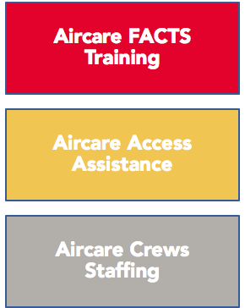
What We Do

Slide 4
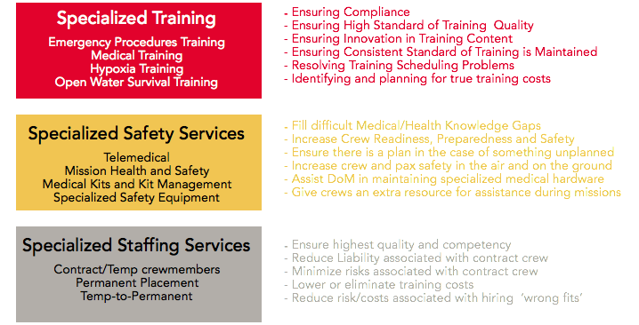
What We Do

Slide 5
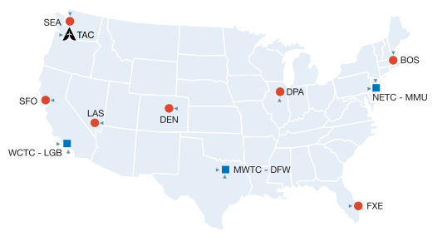
Where We Are

Slide 6
Train to Save. Train to Survive.™

Slide 7
Aircare Core Training Objectives
Achieve maximum knowledge retention & skills proficiency
Continuous improvement & challenge to trainee regardless of prior training and experience
Consistently increase Crew Coordination and CRM
Identification of personal/operational shortfalls in emergency situations
Reinforcement of effective problem-solving in stressful situations & environments

Slide 8
Training Approach
Human Factors-based training
We all learn different ways: Cognitive (thinking), Affective (emotion/feeling) and Kinesthetic (physical/psychomotor) domains

Slide 9
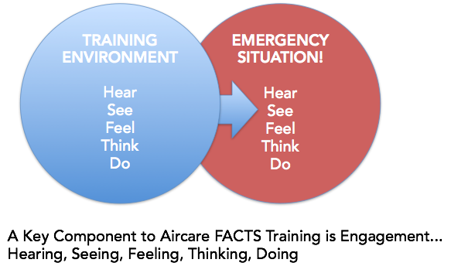
Training Approach

Slide 10
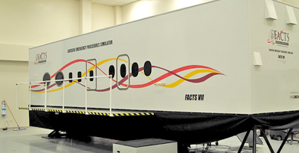
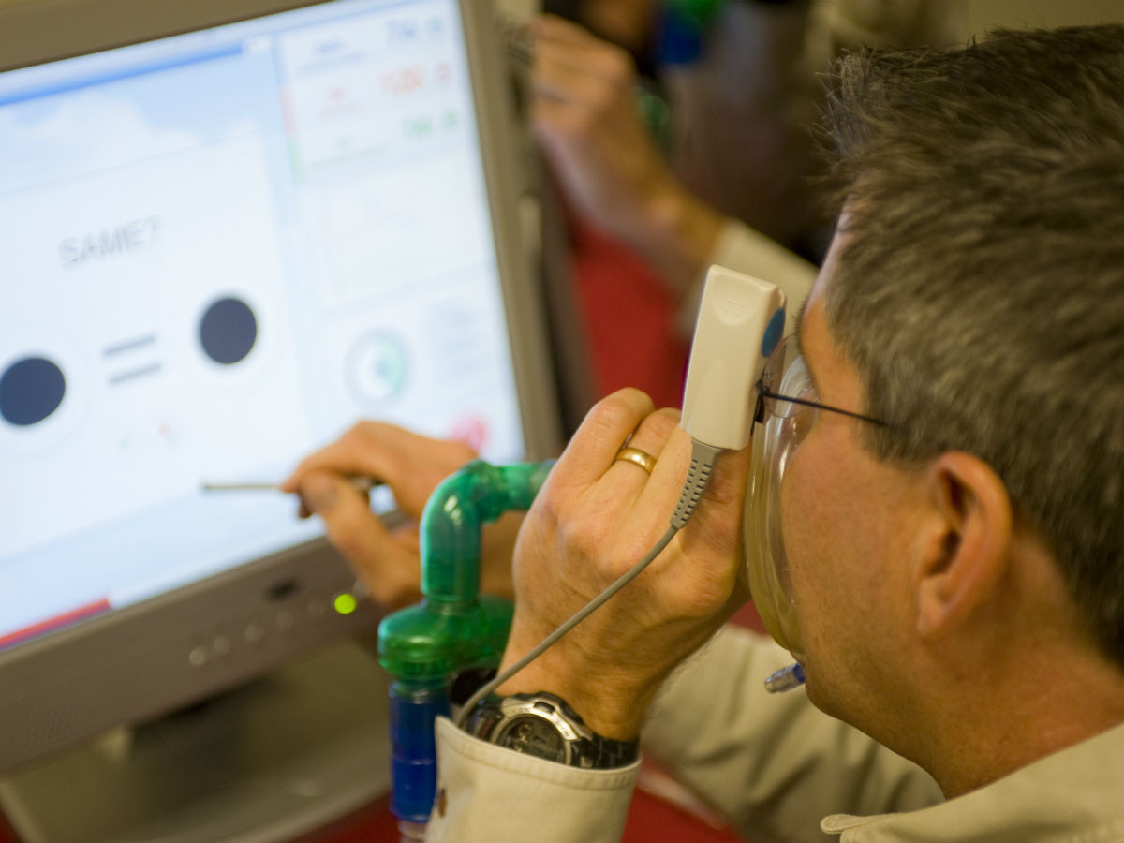
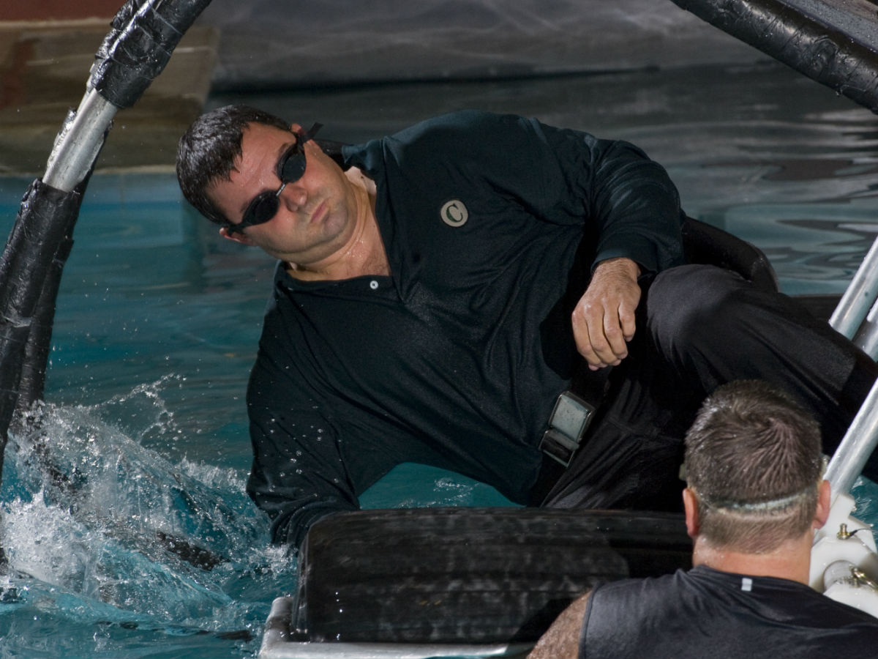
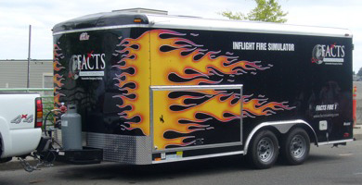
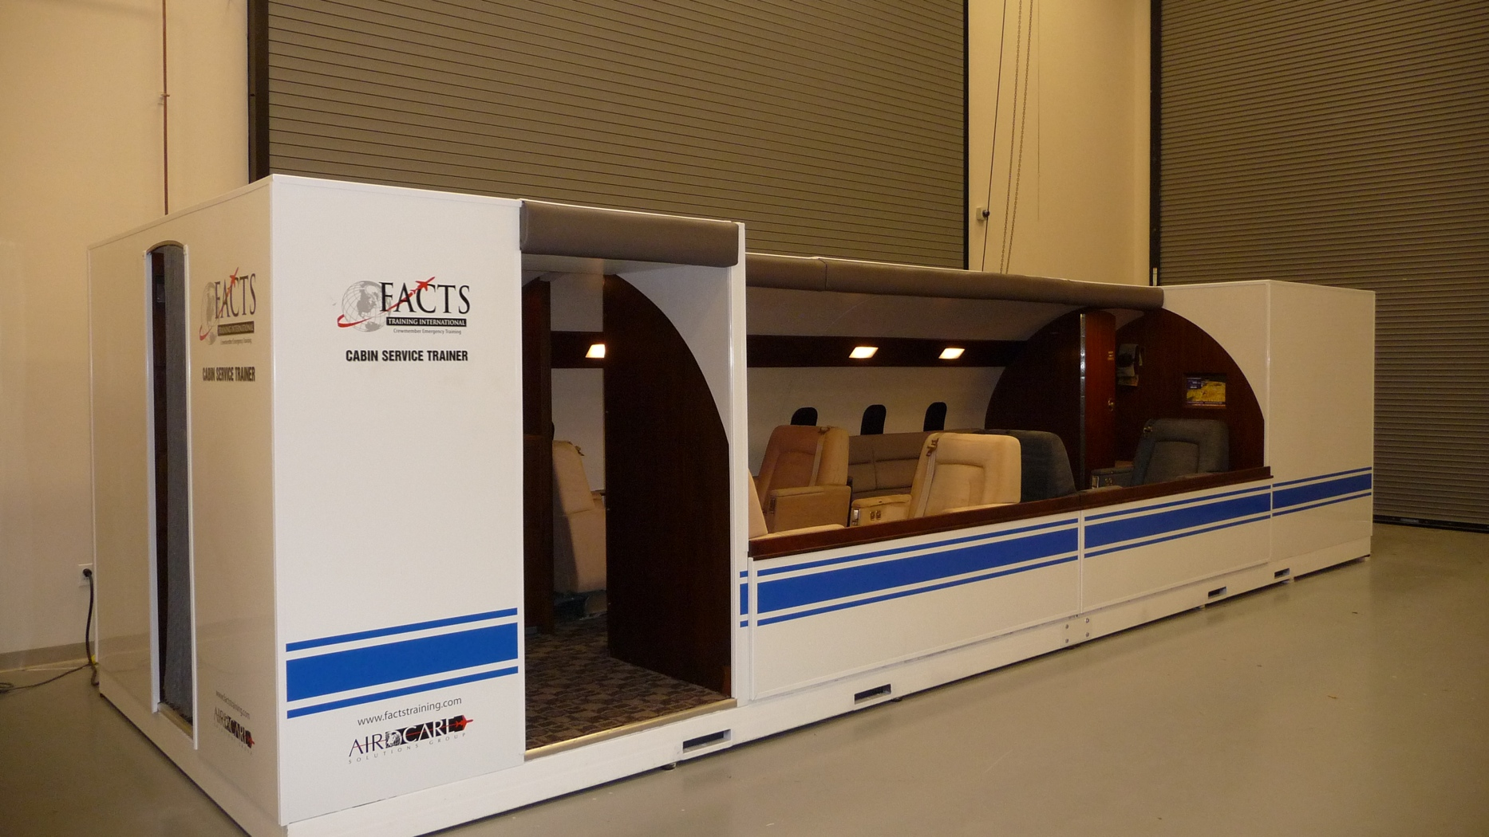
Training Tools
HAT Machines
7 Full-Motion Cabin Simulators (5 Mobile)
Underwater Egress Dunkers
Service Trainer
4 Walk In Fire Trainers (Galley, Seat, Lav)
Winslow Rafts

Slide 11
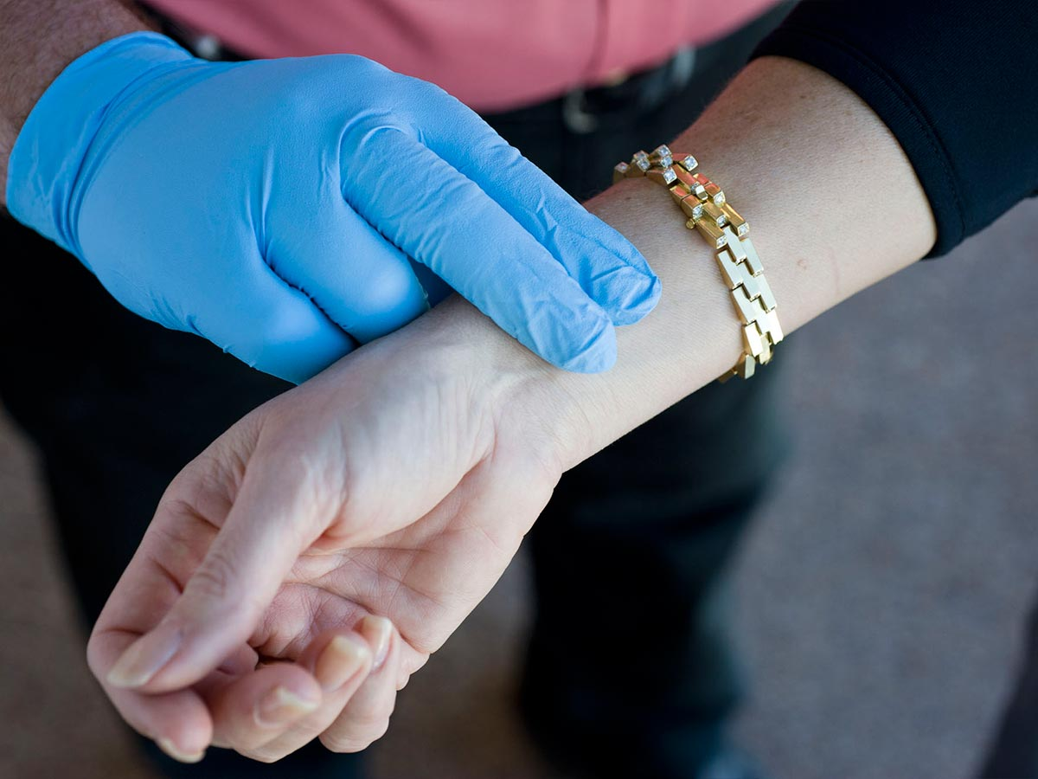
Training Offerings
Full FACTS Training
5 Days of Training (2+3)
18 Different Modules
Service Training
Emergency Procedures
For all crew members
50+ Regularly Scheduled Classes per year
Meets or exceeds CFR Parts 91, 91k, 125, 135, Public Aircraft, JAR OPS1, CARS and IS-BAO standards.

Slide 12
Training Offerings
Full FACTS Curriculum Includes:
Pre-course On-Line Study – Required
Medical Precourse
Emergency Equipment
Dangerous Goods
Surface Contamination
DAYS 1 and 2 (Optional Service Training)
Business Aviation Indoctrination
Food Handling Safety
Trip Planning / Catering
Stowage
Service SOPs
VIP Service Techniques
Tricks of the Trade
Troubleshooting
Wine Service
Practical Service Scenarios
DAY 3 – Required, Initial Starts
Aviation Basics
Intro to CRM & Human Factors
Crew Coordination & Pax Briefings
Emergency Evacuation Land & Water
Simulator Drills
DAY 4 – Required, Recurrent Starts
Intro/BTF Review/Test
Aircare Access Medical BBP/CPR/AED
Hypoxia Awareness
Survival Search and Rescue
Ditching Pool Drills
DAY 5 – Required
CRM 2 & Fatigue
Security
Evacuation Review
Simulator Drills
Inflight Fire & Smoke Procedures
Live Fire Training
Final Exams

Slide 13
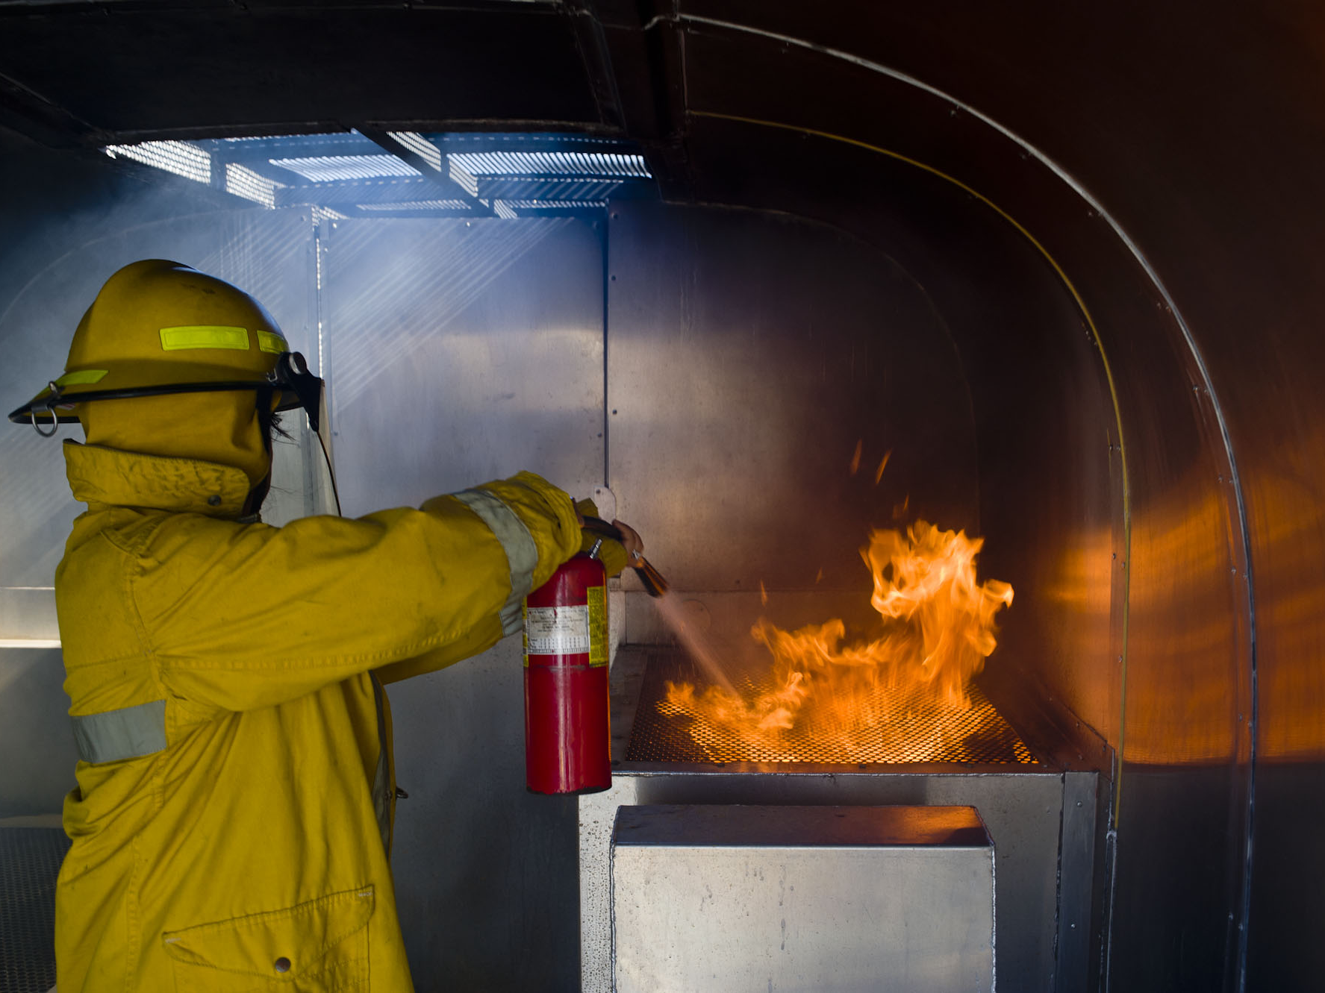
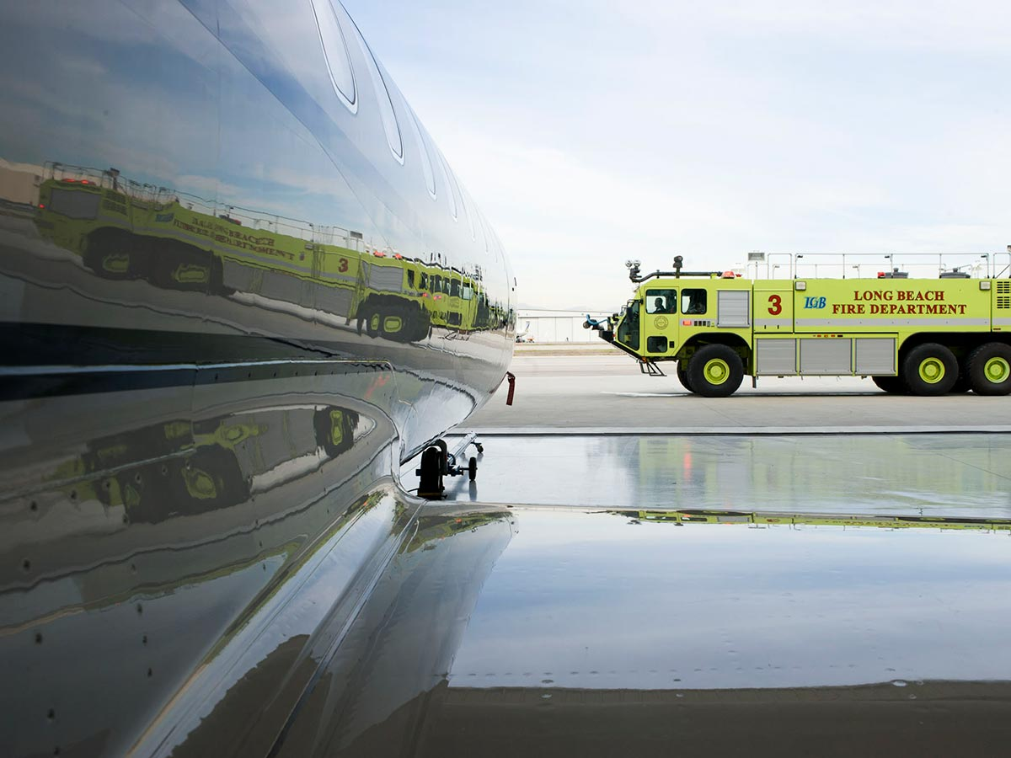
Training Offerings
One Day Pilot Training
1 Day of Training
4 Subjects – Emergency Land and Water Evacuation, HAT and Decompression, In-flight Fire and Smoke, Survival Search and Rescue
Only for Pilots
DFW or Morristown 2x/week
Sundays and Thursdays
Meets or exceeds CFR Parts 91, 91k, 125, 135, Public Aircraft, JAR OPS1, CARS and IS-BAO standards.

Slide 14
Training Offerings
ODP Curriculum Includes:
Pre-course On-Line Study – Required
Emergency Evacuations
Land and Water
Unwarranted Evacs, Rapid
Deplanements, Emergency Evacs
TEST-PREP Procedures
PIC and FO Duties,
Responsibilities and Commands
Aircare FACTS Simulator Training
Live Drills and Instruction
Doors, Overwing Exits, Smoke
Land and Wet ditching procedures
Decompression - Hypoxia
Awareness Training (HAT)
Incident Reviews
Physiology
Experience Symptoms of Hypoxia
with HAT Equipment
Inflight Fire and Smoke
Fire Science
Sources
Equipment
PIC and FO Duties,
Responsibilities and Commands
Live Fire Drills
Survival - Search and Rescue
Incident Review
Equipment (Vests, Rafts, Survival
Equipment
PIC and FO Duties,
Responsibilities and Commands
Post-Evac Survival
Ditching Drills
Pool – Rafts, Egress Dunker,
Leadership and Survival
Considerations

Slide 15
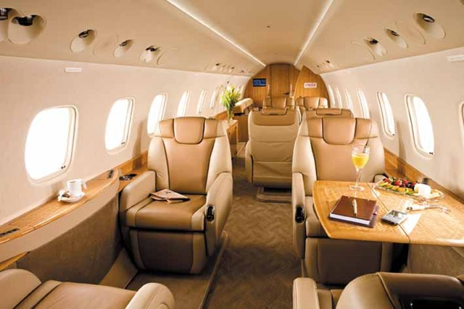
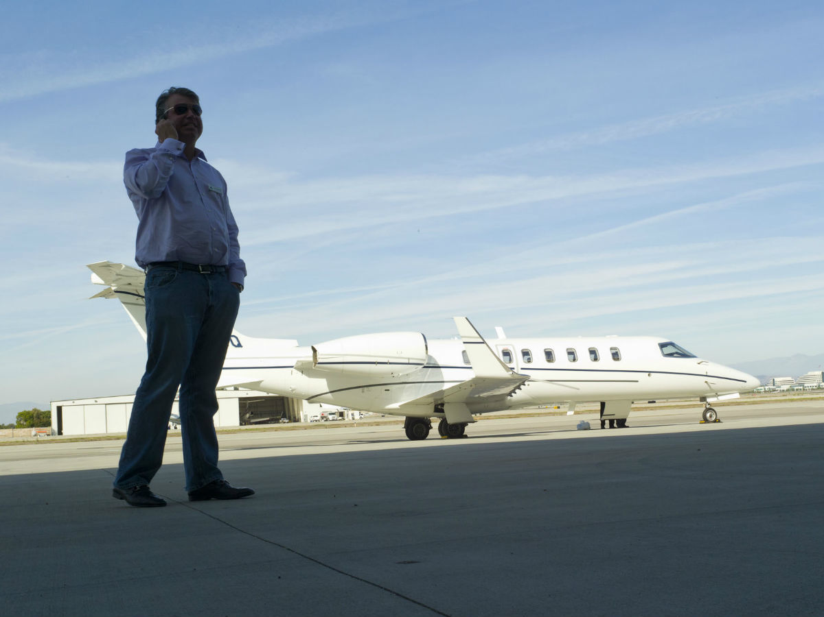
Other Training Available
Aircraft Familiarization
Cabin Systems, Amenities, Safety and Emergency Equipment
Executive Frequent Flyer
Principals, Family, Frequent Travelers
Safety and emergency procedures
Open Water Wet Ditching
Custom Events – ASSET, ONSITE
In-flight Medical Training (CPR/AED/BBP)

Slide 16
A Plan for the Unplanned™

Slide 17
Aircare Access® Assistance
Aircare Access®-- focused dedication to Business Aviation
Urgent-care Telemedicine: Board Certified Physicians who understand Business Aviation
Partnership with George Washington University Hospital and AXA Global Medical Network – 41,000 facilities in over 200 countries
In-flight Medical Training is included in Access Subscription
Medical Kits Supply and Service program

Slide 18
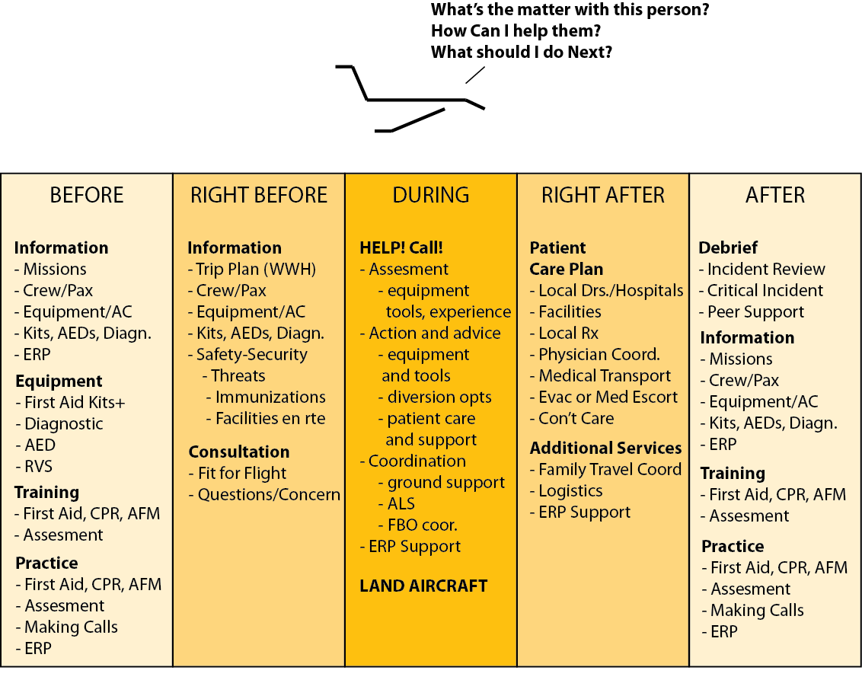
Aircare Access® Assistance
Notes:
JDR v 2.2—Progressive Slides 15-17

Slide 19
Aircare Access® Assistance
Aircare Access is:
Tracking flight* - Aware of flight is en route and any special
needs of crews, passengers.
Aircare Access is:
Recalling information on flight, pax, tools - Communicating with crew/1st responder - Providing data to crew for diversion options based on location, patient circumstances and physician recommendations.
Aircare Access is:
Recalling information to help Phys.
Advising on tools/treatments available
Capturing information relayed to
and from aircraft
Helping set up RVS session if needed
Aircare Access is:
Coordinating ALS and communicating with FBO - Pulling up data on regional facilities
- Collecting data to help make diversion decision - Helping prepare for arrival of patient
Aircare Access is:
Coordinating Physician to Physician communication
- Coordinating Follow-up and patient care plan
Aircare
Access
Physician
FBO, ALS, ER . .
Notes:
JDR v2.2--Make progressive slide… look at this in slideshow mode to see progression

Slide 20
Non Emergency Services
Crew Support Services
Safety
Safety and Security Briefs and Updates
Medical
Questions, concerns, prescriptions, clinics
Non-Medical
Lost luggage, documentation, travel support
Concierge
Logistics

Slide 21
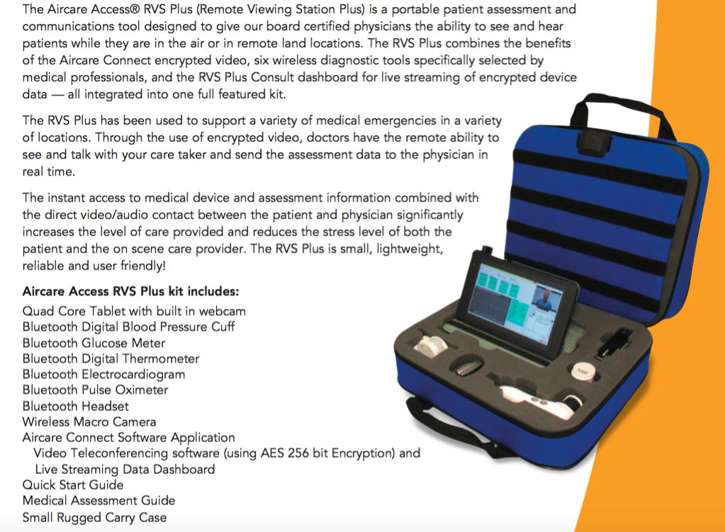
Aircare Access® RVS+

Slide 22
Reliable, Highly-Qualified Staffing that Business Aviation Trusts!

Slide 23
Overview
Top priority is to solve a flight department’s “people problems” with highly qualified pilots and flight attendants.
Operate at competitive rates.
Maintain a flexible staff as your services grow, but also able to transition to full-time employees if needed.

Slide 24
Staff Qualifications
Handpicked, interviewed, pre-screened, and trained according to our rigorous standards of quality and excellence in safety and service.
Aircraft Emergency Situation Training, In-Flight Emergency Medical (CPR/AED/BBP) Training, corporate aviation experience, drug tested.
Flight Staff is experienced and type-rated in virtually all corporate aircraft.
BBJ, Boeing 737, Beechjet, Citation, Challenger, Falcon, Global Express, Gulfstream, Hawker, Lear, Legacy, B747, B757, B767, and A340

Slide 25
Other Products
Aircare FireSock
Spectrum Fx Firebane
Defibrillators
Smoke Hoods
Online Store

Slide 26
Questions?
Open-door policy at our classes – we love to host visitors!
www.aircareinternational.com
Contact me with any questions:
Jake Paini, Sales Associate and Medical Instructor
jake.p@aircareintnl.com
(208) 360-3554 or (888) 754-9805

