Slide 1
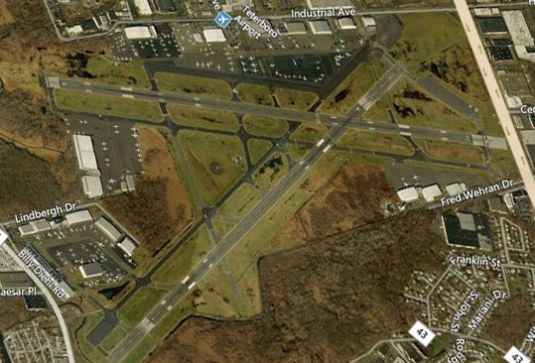
Teterboro Issues
Safety by Design
Teterboro Users Group
July 17th , 2013

Slide 2
Jaike 3 Arrival….. Busting altitude restrictions……

Slide 3
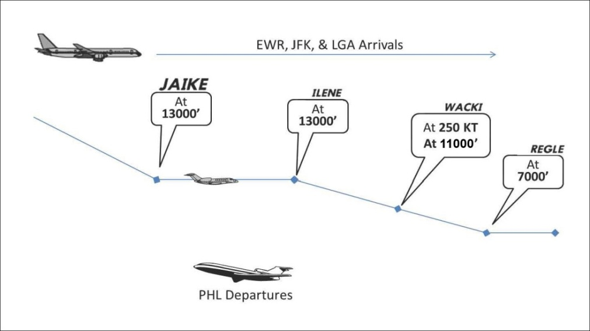
NBAA:
New York Metro Airspace Overview
JAIKE Three RNAV STAR
July 6, 2012
The JAIKE RNAV STAR serves arrivals into Teterboro, NJ (TEB) and Morristown, NJ (MMU) airports. These RNAV STARs are specifically designed to take advantage of the lateral and vertical navigation capabilities of today’s modern RNAV-equipped aircraft.
The complexities of the Northeast US terminal airspace necessitate airplanes entering and exiting airspace boundaries at specific points and altitudes. The JAIKE Three’s vertical descent profile is design to separate inbound TEB & MMU arrival traffic with other New York arrival traffic passing overhead and with Philadelphia departure traffic passing beneath. The vertical separation requirements between these flows within this area are very tight.
During a recent controller shift, 4 out of 7 airplanes (57%) failed to comply with the “at” 13,000 restriction at ILENE (i.e. descended early after passing JAIKE at 13,000’. This is an unacceptably high pilot deviation rate for this procedure.

Slide 4
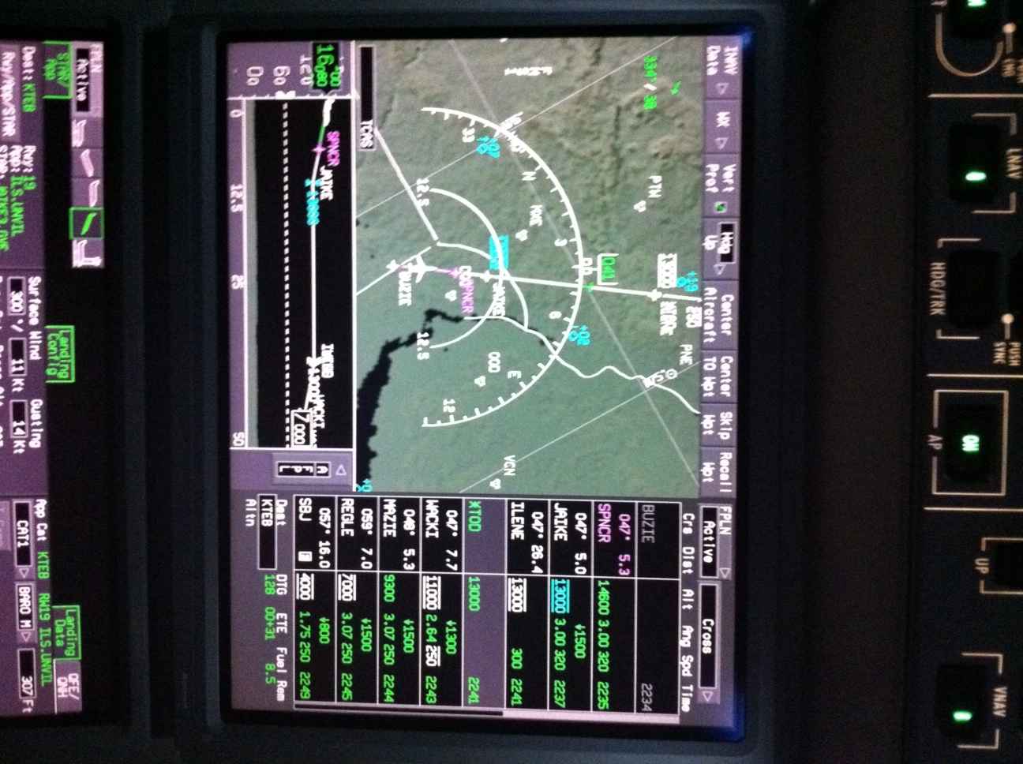
In a Falcon EASy Cockpit we can “see” the restrictions and our Path…..
Top of Descent after ILENE

Slide 5
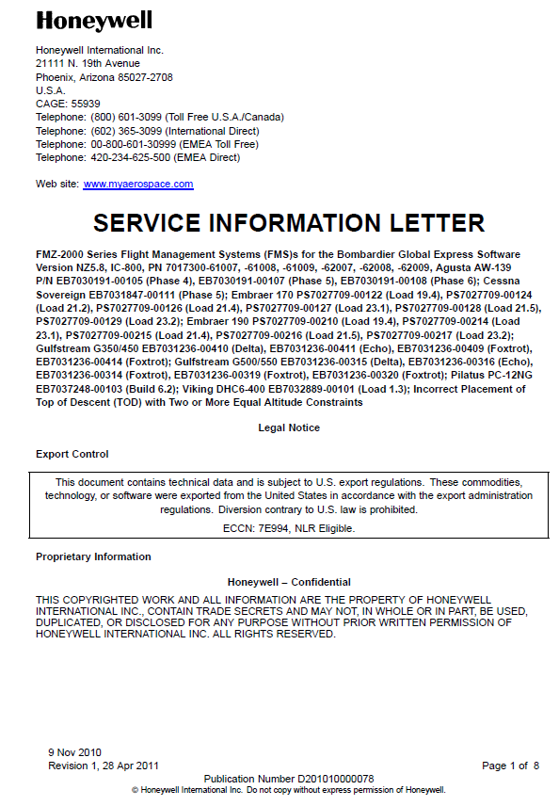
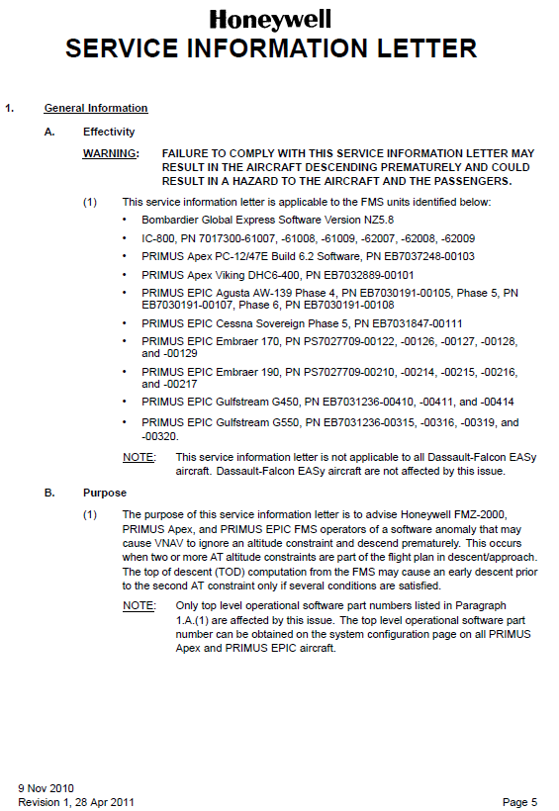

Slide 6
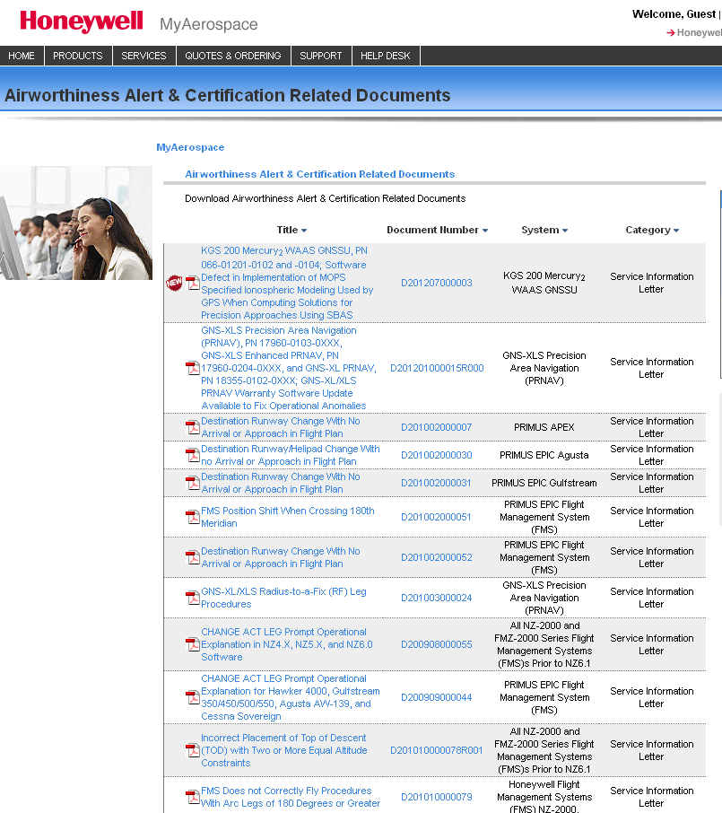
Check on the Honeywell Portal for these types of issues

Slide 7
Localizer and Glide Slope Issues

Slide 8
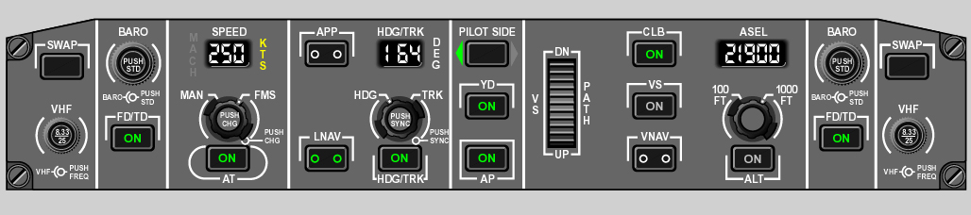
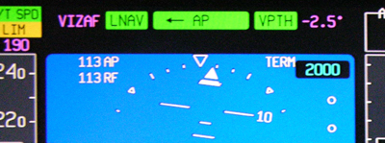
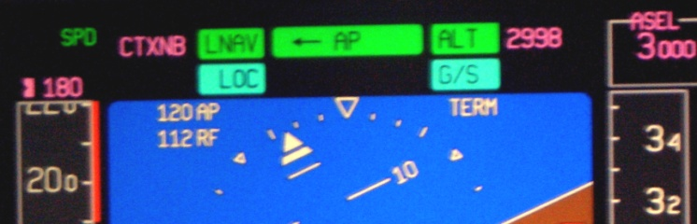
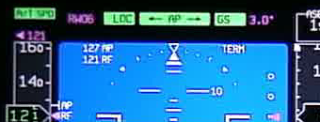
If I hear “Cleared for the Approach” should I always hit the APP button??
Nav to Nav Pre-select
Once you’ve “armed” the approach, you’re telling the system to capture the localizer and glide slope whenever it can…. Ready or not….
Automation can bite you sometimes

Slide 9
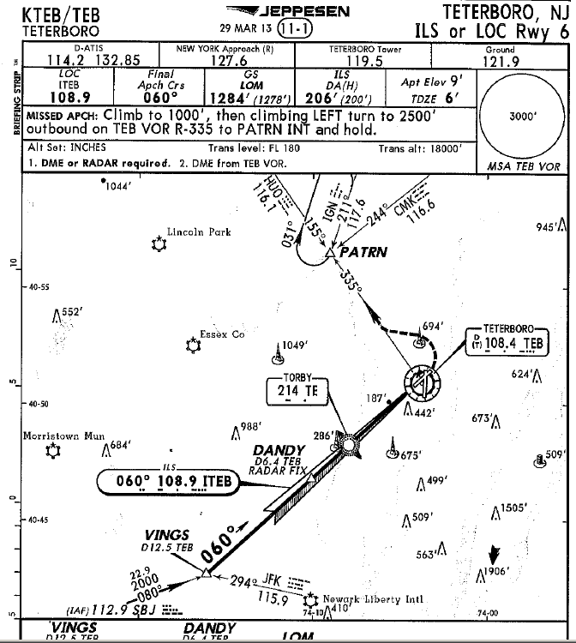
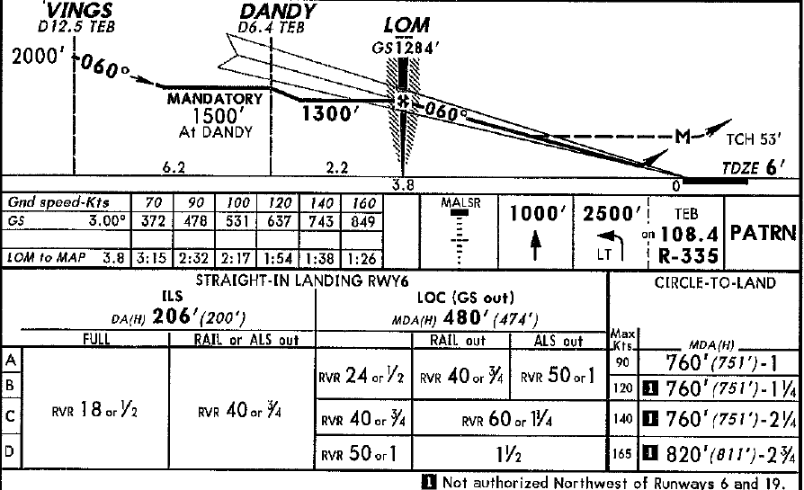
Hitting the APP button too soon
– example #1 KTEB ILS 6
Falcon xxx, cross DANDY at 1500’ cleared for the ILS 6 approach at Teterboro
x

Slide 10
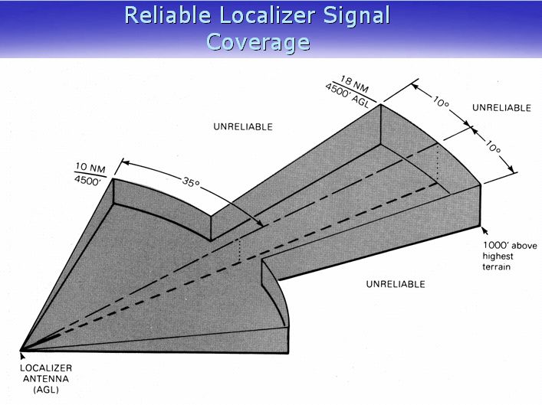
Example 2: Hitting the APP button too soon
False Localizer Capture

Slide 11
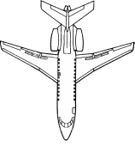
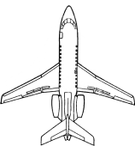
Conclusion: Don’t push APP button until within ~ 8⁰ of Inbound Loc Course

Slide 12
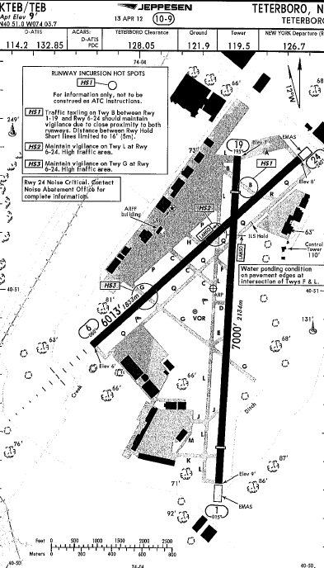
The Help Desk had a Falcon that claimed his ILS didn’t work correctly at KTEB
We had a complaint about a Falcon … they were complaining the ILS capture didn’t work correctly…. Full scale deflections on downwind…. ????

Slide 13
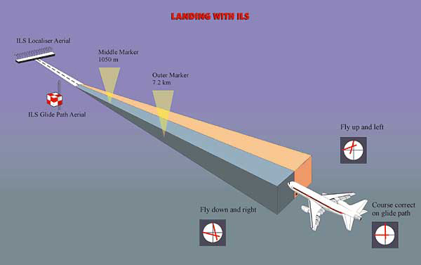
How does the ILS (Instrument Landing System) work ??
Two Antennas Used

Slide 14
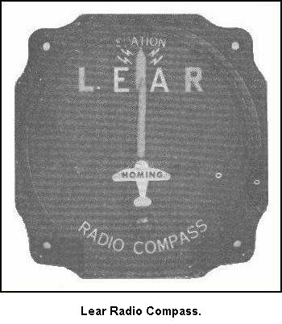
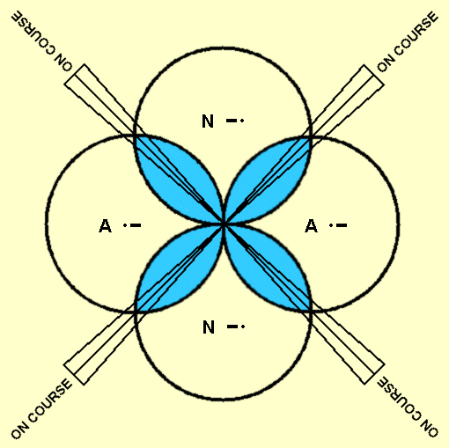
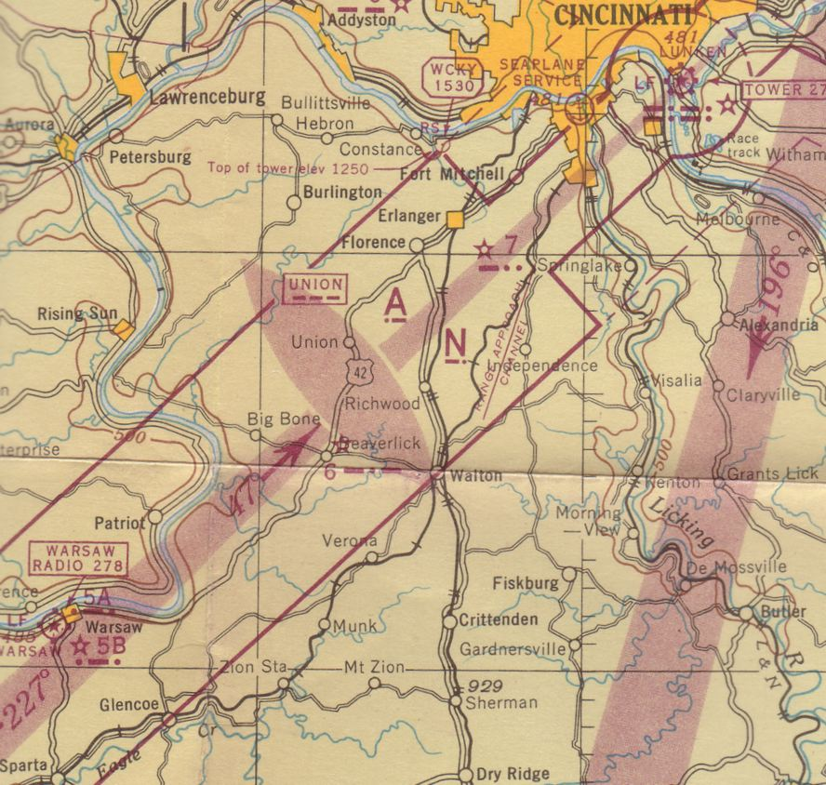
Remember the old, old A-N radio range?
On course with equal “amounts” of A & N
1944 chart

Slide 15
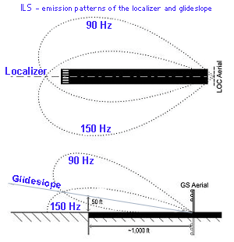
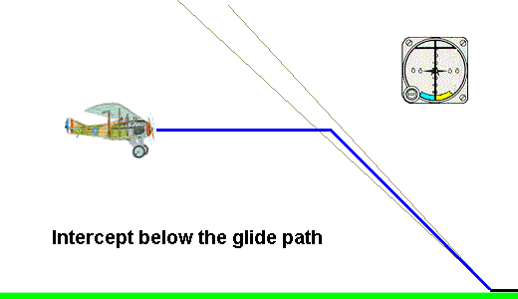
Rather than A – N, the ILS works with 90 Hz – 150 Hz
The Localizer antenna is centered on the runway but beyond the end ….
If more 90 Hz than 150 Hz… fly right to center
The Glide Slope turns the antenna on it’s side and bounces the beams off the ground
Why?
If more 90 Hz fly down, more 150 Hz go up

Slide 16
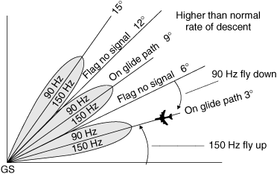
False Glide Slopes
False signals may be generated along the glide slope in multiples of the glide path angle, the first being approximately 6º degrees above horizontal. This false signal will be a reciprocal signal (i.e. the fly up and fly down commands will be reversed). The false signal at 9º will be oriented in the same manner as the true glide slope. There are no false signals below the actual slope. An aircraft flying according to the published approach procedure on a front course ILS should not encounter these false signals.
This is because of a radiation pattern of the antenna and the ground reflection of some of the transmitted energy, resulting in more than one overlapping lobe.

Slide 17
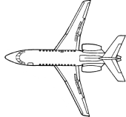
How low can you follow the GS ?
NOTE- Unless otherwise coordinated through Flight Standards, ILS signals to Category I runways are not flight inspected below 100 feet AGL. Guidance signal anomalies may be encountered below this altitude.
TCH: 50’
100’ AGL
250’ – 650’
GS Antenna
200’
Caution about following the GS !

Slide 18
Did you ever see this type of warning ? AP NA with about 400’ to go
960’-576’= 384’

Slide 19
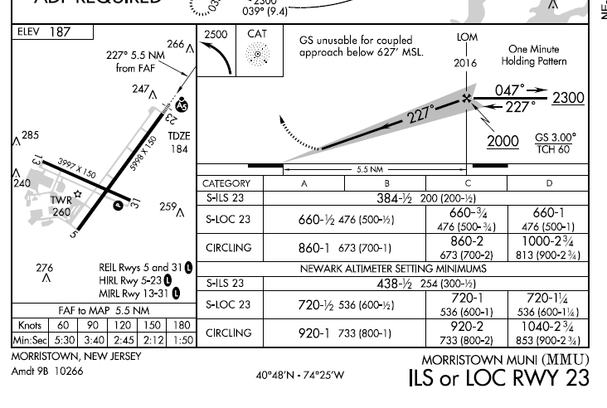
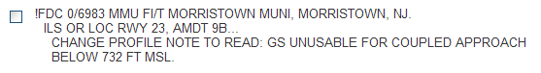
What’s the issue here: KMMU ILS 23
627’ – 384’ = 243’ to go
Notam:

Slide 20
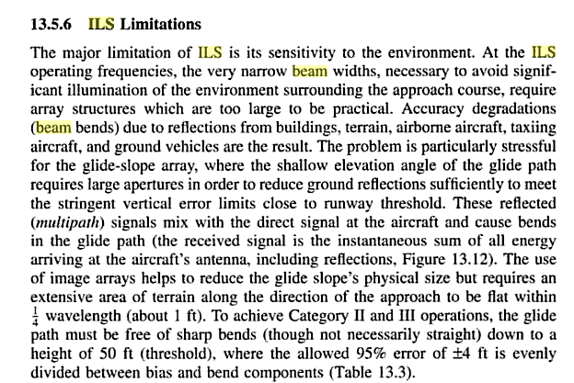

Slide 21
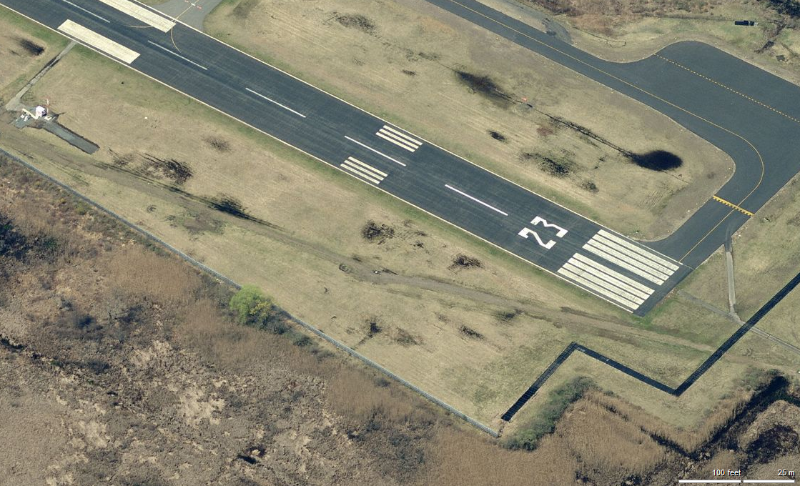
KMMU Critical Area not “smooth” and is on a swamp!
GS Antenna

Slide 22
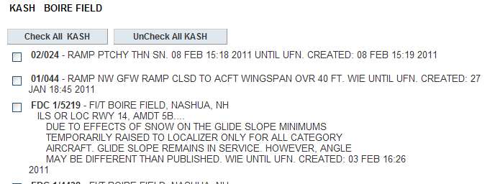
Check Notams: Snow Banks deflecting GS Beam

Slide 23
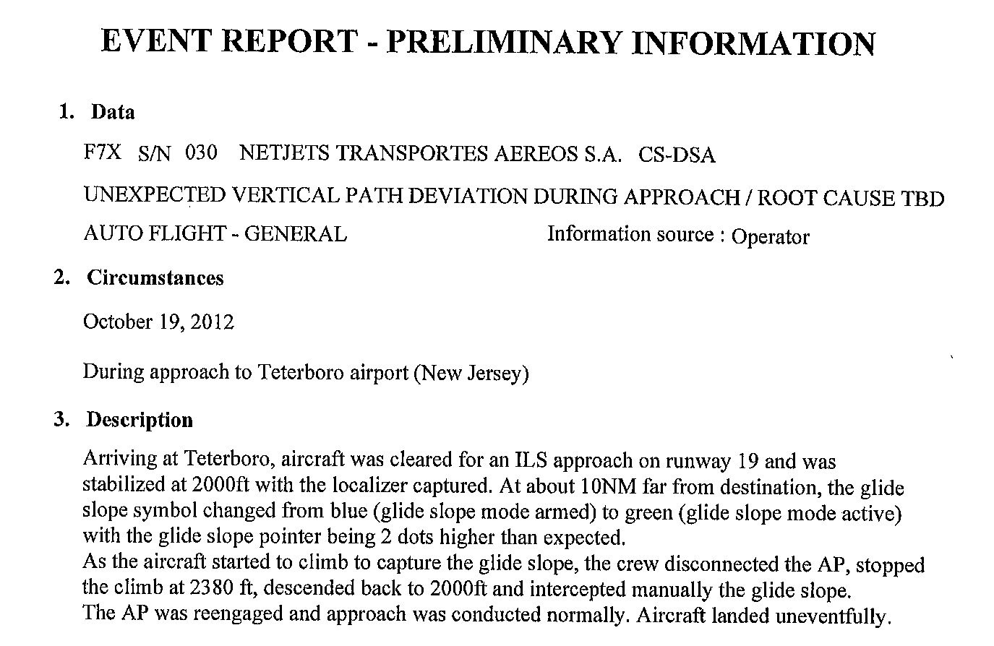
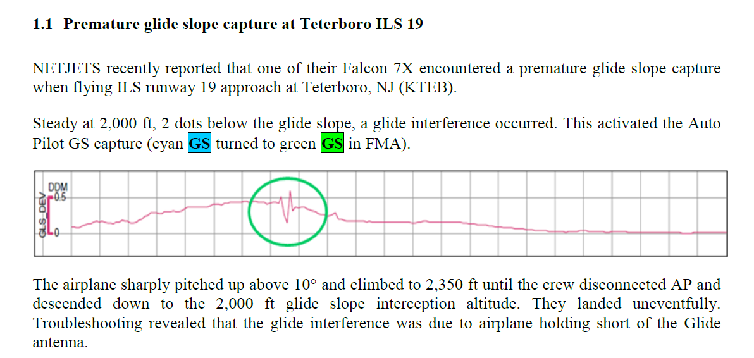
Issue with KTEB ILS 19

Slide 24
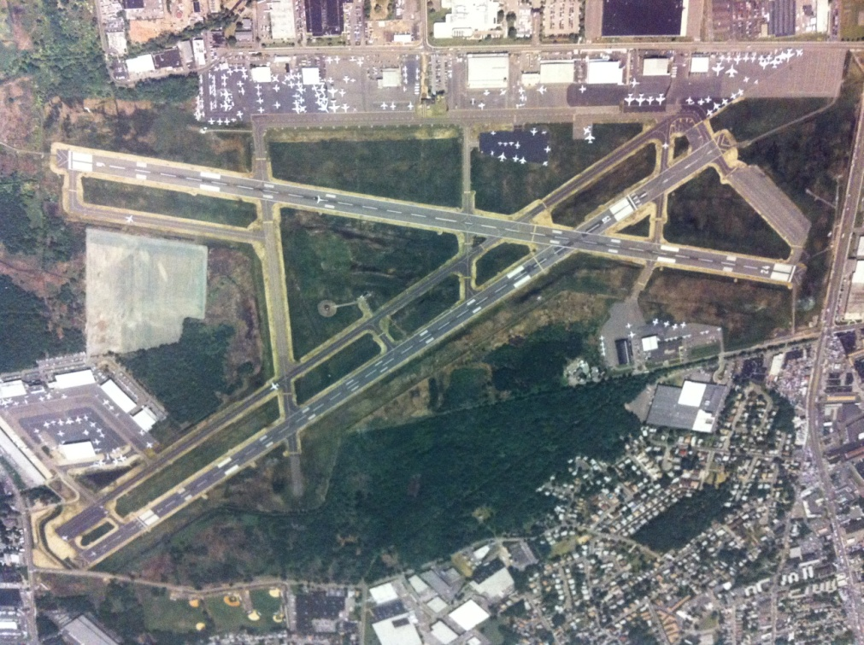
Unexpected Consequences
Teterboro Airport- Taxiway Q Expansion
GS
GS

Slide 25
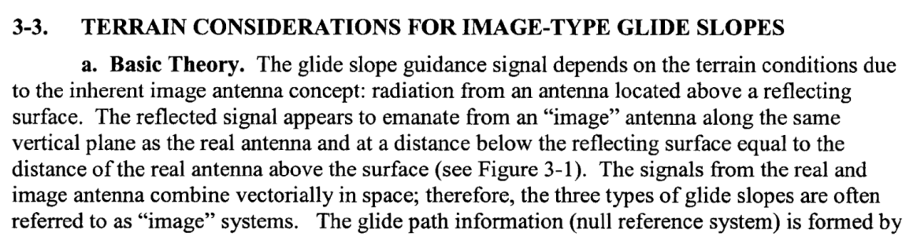
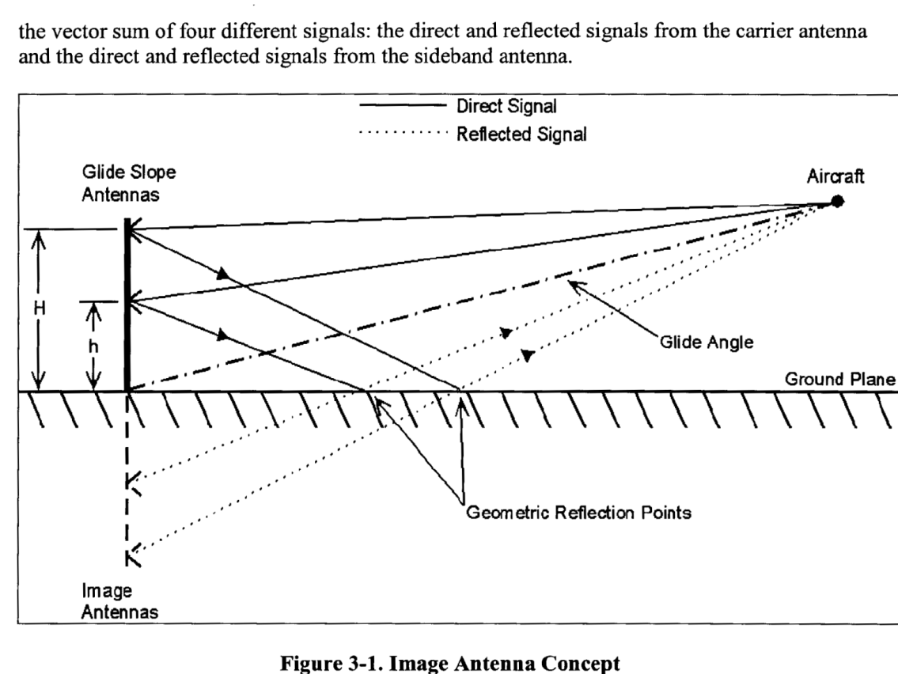
Glide Slope antenna uses ground to bounce half of the signals up
But what if reflected portion is blocked ?

Slide 26
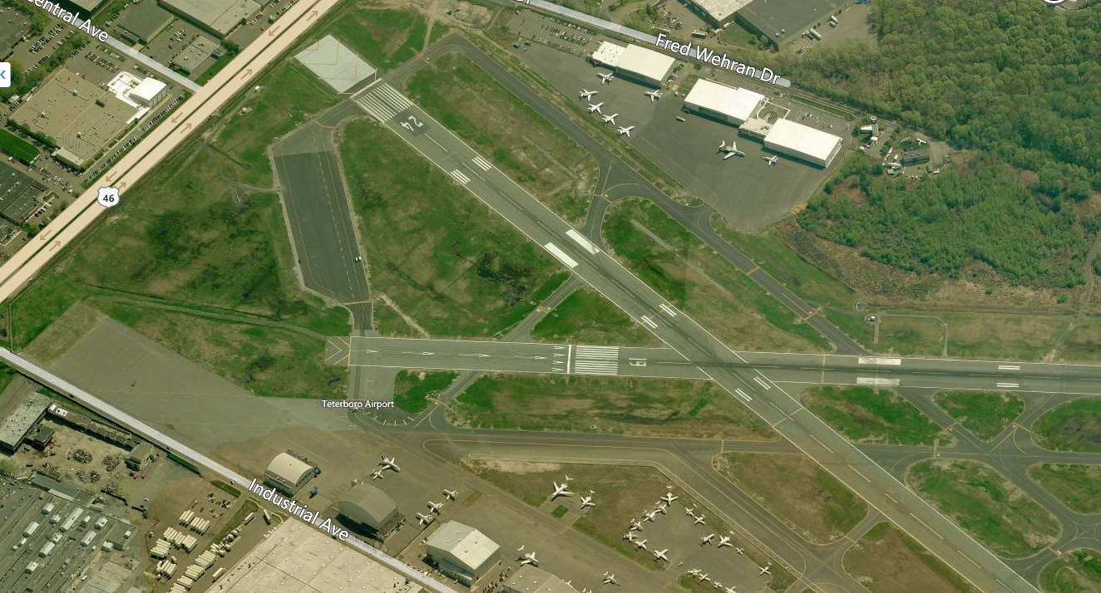

Taxiway Q Interference for ILS 19 Glide Slope
G/S 19
Taxi Q

Slide 27
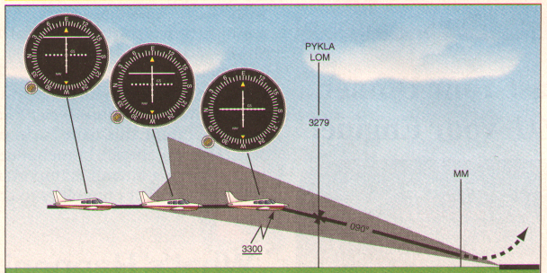
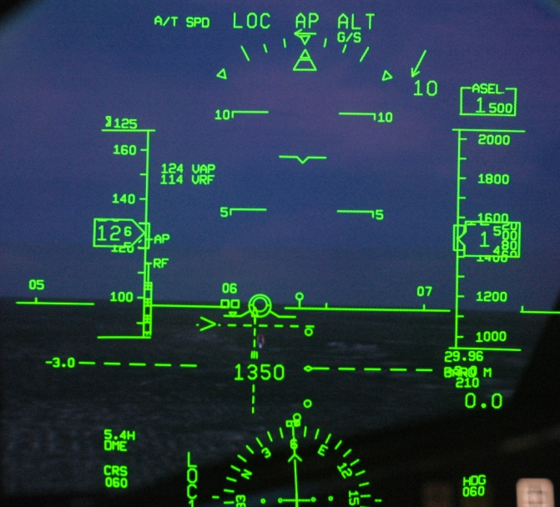
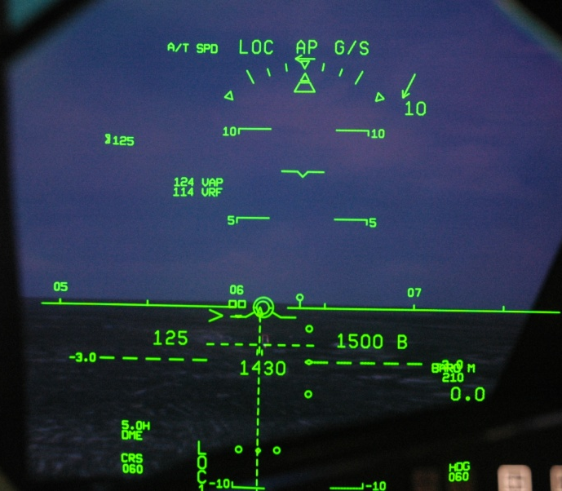
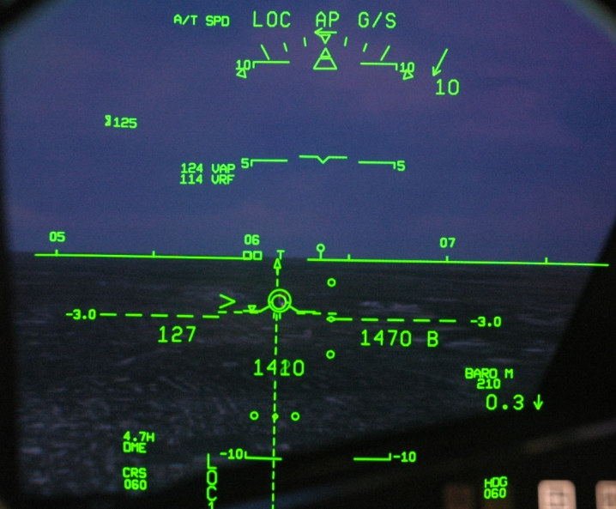
Normal Glide Slope – Intercept from below
Airplane blocks signal- receiver thinks its’ on GS- ALT mode goes to GS
Blocking airplane moves away… now in loc/gs, airplane sees glide slope above pitches up to recapture….
Loc Captured GS Armed
G/S Captured
On Loc and G/S

Slide 28
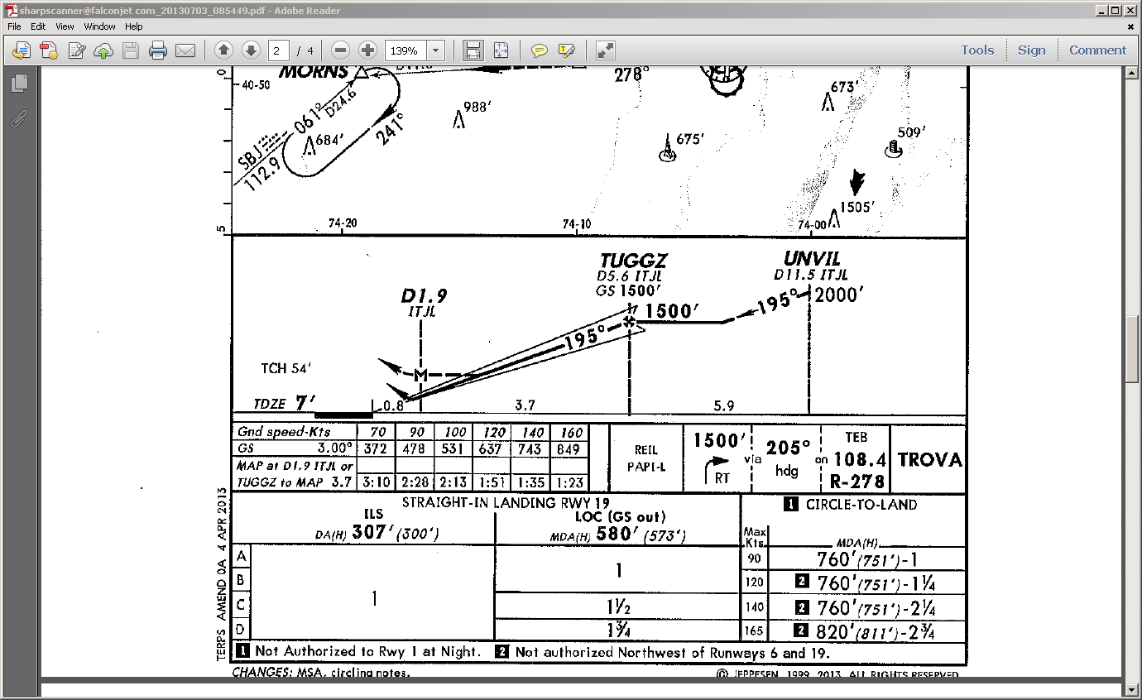

Interference issue with the ILS 19 at Teterboro

Slide 29
AIM Caution on ILS in VMC
1-1-9k-2b Weather Conditions. At or above ceiling 800 feet and/or visibility 2 miles.
(1) No critical area protective action is provided under these conditions.
(2) A flight crew, under these conditions, should advise the tower that it will conduct an AUTOLAND or COUPLED approach to ensure that the ILS critical areas are protected when the aircraft is inside the ILS MM.
Pilots are cautioned that vehicular traffic not subject to ATC may cause momentary deviation to ILS course or glide slope signals. Also, critical areas are not protected at uncontrolled airports or at airports with an operating control tower when weather or visibility conditions are above those requiring protective measures. Aircraft conducting coupled or autoland operations should be especially alert in monitoring automatic flight control systems.

Slide 30
Issue exists even in IMC !
..Further RADAR analysis showed that even if the WX was below 800 and 2 the critical area at the time of anomaly would not have been protected.
The aircraft was well outside TUGGZ and there was no one on the approach ahead,
inside of TUGGZ.
ATC is only required to protect the ILS Critical Area from the FAF inbound. This issue occurs not only at KTEB but at KLGA and many other airports around the country.

Slide 31
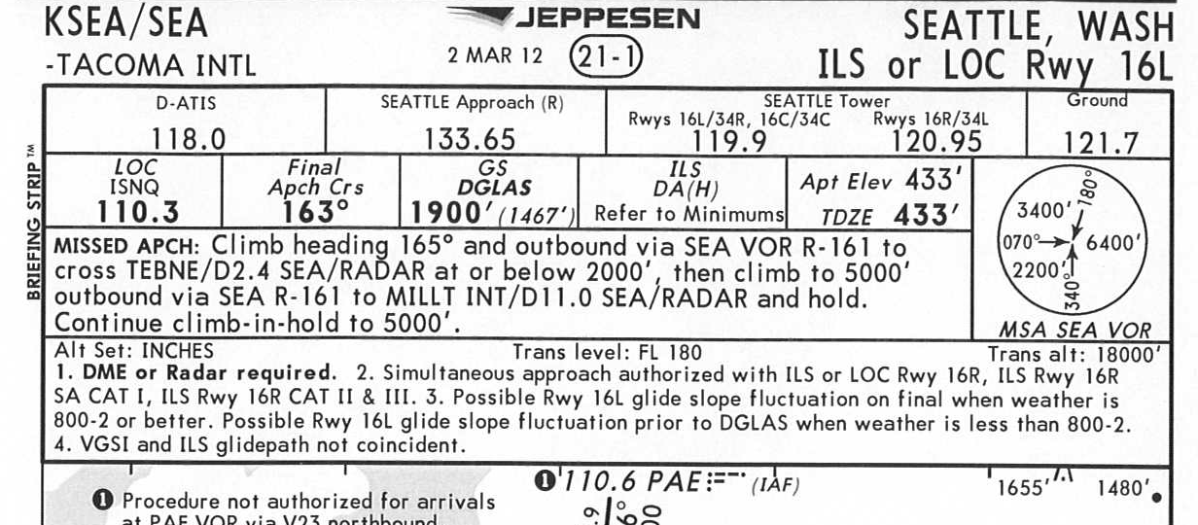
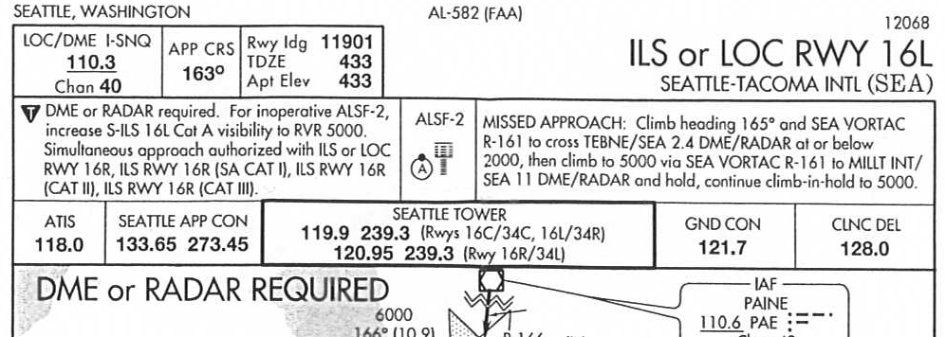
Jepp can put a warning on the chart
Jepp.
Gov.
Doesn’t seem like the Government charts do the same….

Slide 32
How to fly the ILS 19 Knowing this issue ??
Maybe stay in LNAV until TUGGZ …. Then hit APP
Or…. Wait for an LPV approach to 19

Slide 33
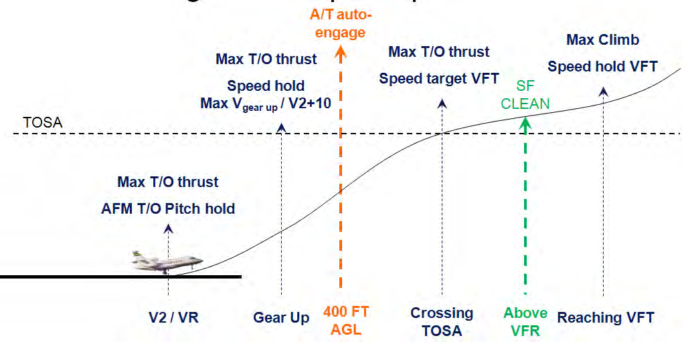
A/T Auto mode issue on departures at KTEB
TO mode is de-selected when a new vertical mode is selected, when the crew
members manually change the vertical guidance mode, or automatically if the airplane
reaches the ASEL………. OR……. When the vertical mode leaves TO for ASEL capture…..

Slide 34

Safety by Design
The Falcon EASy Flightdeck
Woody Saland, PhD
Director, Avionics Programs and Pilot Training

Slide 35
Today let’s talk about three issues in flying:
1. Crew CRM
(how to work together as a team)
2. Flying Blind - Seeing your trajectory
(path / track vs. pitch / heading)
3. Situational Awareness
(where am I ?)

Slide 36
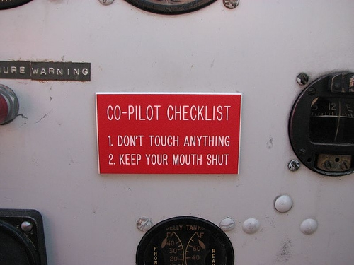
CRM: Cockpit Resource Management
Flying is hard enough, but getting rid of the left seat master Captain mentality was tougher…. CRM is about …. How do you get two pilots to work together as a team
August 2012 NCBAA

Slide 37


CRM and VNAV in the Olde Days
The problem is how to introduce something new without re-training

Slide 38
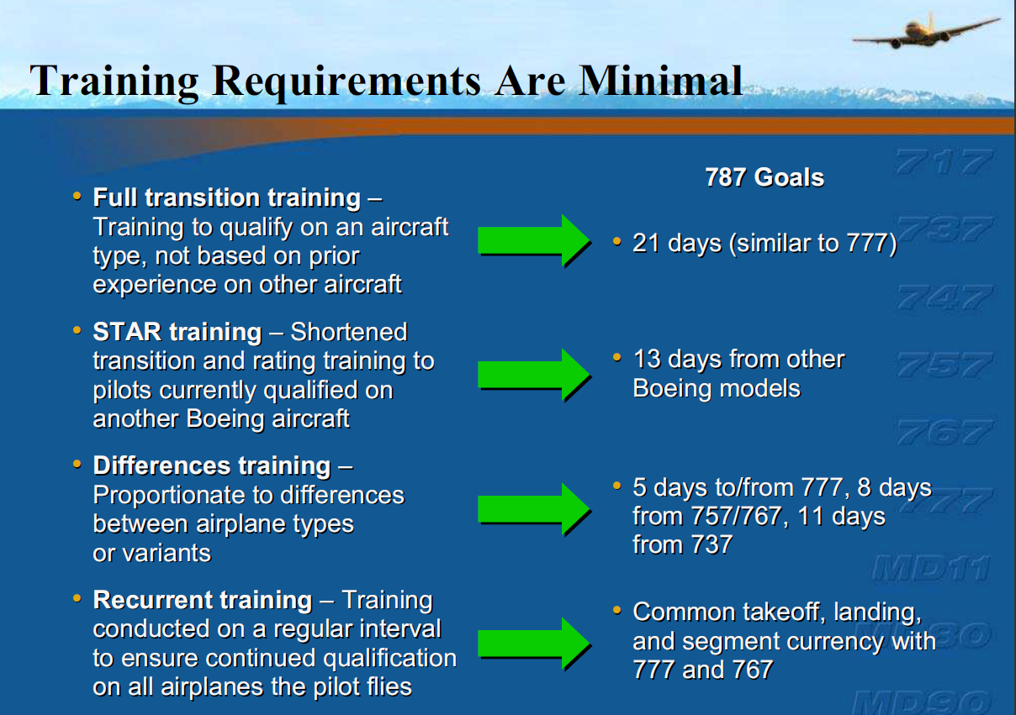
The Issue: The cost to re-train a pilot

Slide 39

The EASy Philosophy
Tactical Information.
Tactical Information
Shared Displays
Strategic Information

Slide 40
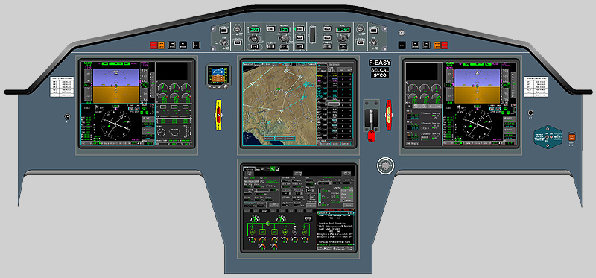

Deliberately Limited Display Options
ADI
ENG
CAS
ENG
CAS
ADI
HSI
HSI
ECL
Electronic Checklist
Sharing the center allows both pilots to be on the same “page” and to work together by design not by edict

Slide 41
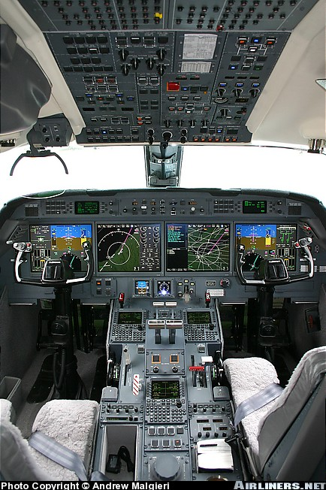

CRM by Design
Common, Strategic items are handled together as a team

Slide 42
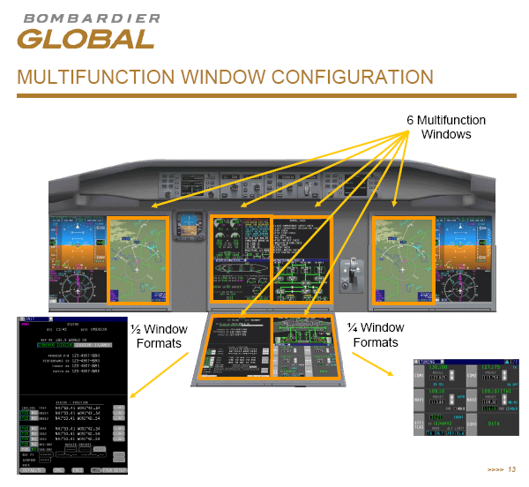
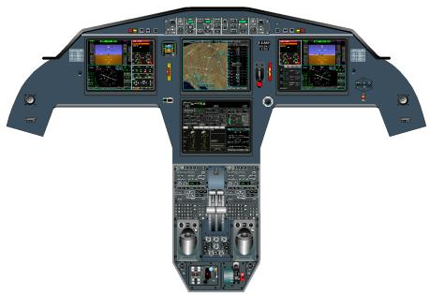
No other flightdeck has the crew working together in the middle on shared tasks….
every other company has left / right sides to the cockpit
Falcons

Slide 43

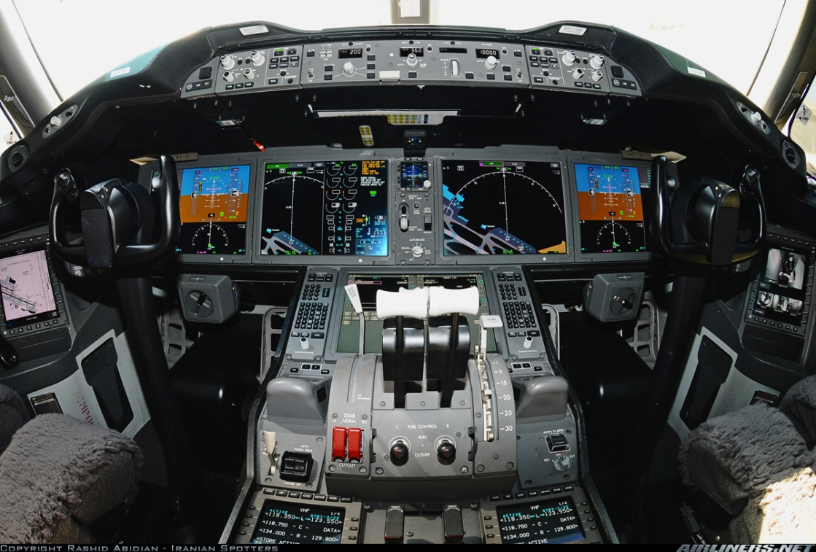
Here’s the two latest airline flightdecks…. Note the duplication of map / double cue flight directors
Airbus A380
Boeing B787 Dreamliner
Two sides to the flight deck…. Not common ground in the middle

Slide 44

Flying Blind
The Skill of Instrument Flying
Pitch/Hdg vs. Path/Track

Slide 45

Interpreting your Instruments

Slide 46

Up until 1929, no instrument flying
Charles Lindbergh’s flight to Paris: May 20–21, 1927
August 2012 NCBAA

Slide 47



September 24th, 1929 Jimmy Doolittle Proves you can fly “blind”
Sperry Gyroscope Company, developed what is now called an "attitude indicator.“
NY-2 airplane- Mitchell Field, NY
Airplane Centric: No one instrument to show your relationship with the ground

Slide 48


Since 1929, most airplanes fly “instruments” using pitch and heading
The more or less standard
“6 pack” of flight instruments
Most “glass” cockpits duplicate the
“6 pack” round dial concept

Slide 49


The Problem ?
Not only was this not “easy”, but a good scan takes work and practice

Slide 50

No wonder pilots need to constantly practice their “instrument scan”
Using a simulator, researchers at the University of Illinois conducted a study with 20 pilots who had no instrument training to see the survivability of an encounter with IMC conditions. All of them lost control, and the only variable was how long it took. The range was as short as 20 seconds to as long as 480 seconds with the average being 178 seconds.
There needs to be a better way to fly…. And there is: PATH not Pitch

Slide 51

Our goal in flying is to fly a certain trajectory, regardless of the wind or conditions
We don’t really care where the nose is pointed (pitch & heading) we care about the trajectory (path and track) … we now have the tools to show that to a pilot…. It started with the military…..

Slide 52


The Value of a Heads’ Up Display
Rafale Cockpit
F7X SideStick
Dassault is the only Business Jet manufacturer to build military jets side by side
The use of Side Stick Fly by Wire, Head’s Up Displays and Moving Maps has been well proven by years of experience in the Mirage and Rafale fighters..

Slide 53

Why not fly by PATH…. Like a HUD
Aircraft Symbol
Fixed in center
Flight Director
Flight Path Symbol
Acceleration
Chevron

Slide 54


The EASy cockpit revolutionized business Jet flightdecks with the integration of Heads Up technologies with Flight Deck displays….
1st Generation EASy
EASy II with Synthetic Vision

Slide 55

We now have a day time HUD like view for both pilots…. No more flying “blind”

Slide 56


With Path I can see where I’m going
Small x-wind, HDG centered … like HUD

Slide 57


Visualizing the Vertical Trajectory
Flying an approach with Path, both pilots see the trajectory

Slide 58



Contrast EASy with a traditional flight director in the latest Boeing Dreamliner…..
Falcon EASy II
New B787 Dreamliner

Slide 59



Situational Awareness is giving pilots the vision to see where they are and where they are going……
Let’s look at three CFIT* accidents…..
* CFIT: Controlled Flight Into Terrain….. That is, flying a perfectly good airplane into a mountain
Hendrick
Sukhoi Superjet
Cali
Dec. 20th, 1995
Oct. 24th, 2004
May 9th , 2012

Slide 60


American Airlines B757
Cali, Columbia
Crash site
Crew was unaware
they were descending
into the mountains
with their
airbrakes on !
Cali
Airport

Slide 61



EASy: better visualization tools
B757
EASy

Slide 62


Hendrick Racing Crash (10-24-04)
1981 Beech 200 King Air
10 Fatalities
The crew improperly read instruments and missed a landing approach to Blue Ridge Airport in Martinsville, Va., the NTSB said in a report synopsis e-mailed to The Associated Press. The Beech King Air 200 crashed into fog-shrouded Bull Mountain in the foothills of the Appalachians on Oct. 24, 2004.

Slide 63


EASy CFIT Avoidance
With Terrain Alert:
ADI: Pull Up
Audible “Pull Up Terrain”
Pop Up of 1/6 Terrain Window on Pilot Flying
Main I-Nav map converts to HDG Up and shows Interactive Terrain “flashing”

Slide 64


May 9th, 2012 Sukhoi Superjet 100 Crash
Jakarta, Indonesia
2,211 m (7,254 ft)
Salak Volcano

Slide 65

This is the captain and flightdeck of the airplane that crashed…. Where’s the big picture map showing the terrain or trajectory ?

Slide 66



The Sukhoi accident was similar to the Cali crash….. Only 17 years later… with a brand new design that was / is to be the future of Russian Commercial Jets…
It’s hard to believe you could have a CFIT in a Falcon !
EASy gives a complete picture of the outside world– Heading Up, either along the flightplan route or straight ahead of the plane - Automatically

Slide 67
And finally some illustrations of lack of situational awareness:
an accident involving taking off on the wrong runway
and three cases of landing on the wrong runway….

Slide 68



Comair Flight 5191- August 2006
CRJ-100ER
Acknowledged Runway 22, departed Runway 27
Only 1 survived, (FO lost leg, brain damage), 47 Pax and 2 out of 3 crew died

Slide 69


July 20th, 2012: Air Force officials are trying to figure out why an Air Force C-17 Globemaster III cargo jet heading to MacDill Air Force Base instead landed at Peter O. Knight Airport this afternoon.
This is the second time this has happened," said spectator Gary Garrett, 71, who has a real estate office on Davis Islands.
"The last time, it was a 727 in the 80s," he recalled, "and they took that plane apart to get it out of here."
3,500’ long
11,500’ long

Slide 70


August 9,2012

Slide 71

Oct. 28th, 2006: The National Transportation Safety Board is investigating the landing of Continental Flight 1883, which was carrying 154 people from Orlando, Fla. Both pilots were grounded by the airline.
"Being cleared to land on a different runway than the one you are flying the approach to introduces a whole new set of complexities to the pilots at a very critical time, especially when the landing runway does not have a precision approach," said Capt. Denis Breslin, an American Airlines pilot and spokesman for the Allied Pilots Association, the airline pilots union. "Trying to make those decisions in dusk or poor visibility without benefit of course guidance increases the chance for error," he added.
ILS 22L

Slide 72




Safety by Design – Showing the Pilots where they are !

Slide 73

Questions ?

