Slide 1


Sleep Matters for Aviation
TUG March 19, 2014
Dr. Carol Ash
Corporate Director Sleep Medicine Meridian Health

Slide 2

Make a difference.
What would you do?
Notes:
Steven Taylor is a well known psychologist and a researcher on what transforms us. What makes a difference. One of his interests are what he calls “awakening experiences” or moments when our normal awareness intensifies and we feel a sense of connection, meaning, and purpose.
If I asked you to do something for the community what would you give? What would be the most you would be willing to write the check for?

Slide 3

What did I do?
A story of
Purpose
Corey and Jennifer Briest
? Bravest Family in America - YouTube
Notes:
Several years ago while I was in the Today Show green room I had one of those transformational moments. I was waiting to go on air when they wheeled in a young man. With him was his mother, who sat next to me, and a young women. She sat across from me. The young man was parked between us. He didn’t say much, or even lift his head. It was obvious that he had experienced head trauma. A producer came rushing in and addressed him. He said “Corey Mr. Brokaw will be down shortly.” He continued “Mr. Brokaw is sorry he couldn’t make it to the event last night. He is so grateful you came so he could meet you and say thank you”. The young man raised his head. Despite his head trauma he understood the significance of the name Brokaw. Barely audible he said “Tom Brokaw? Why? What did I do?” The producer replied “Corey, you are an American hero.”
At that time I was dealing with my own struggles and deciding what I should do. We all have those moments when we can decide to leave it to someone else, or try to make a difference. Sitting next to Corey made the decision easy. As hard as it might be I would try to make a difference. You see Corey was an American soldier. And the blank check, the amount Corey was willing to give? Himself, all of it. He had hopes and dreams. He wanted to have a career in healthcare. Now he struggles just to tell his daughter a bed time story. Sitting next to Corey I knew I owed it to him to never have to ask myself “What did I do”. That moment transformed me. Tonight my purpose is to make a difference for you. It is a very small sum on a blank check. I owe it to Corey.

Slide 4
Sleep Apnea FAA Proposal
FAA proposal
  Pilots with a body mass index (BMI) of 40 or greater would have been required to undergo testing for sleep apnea.
  The FAA said it planned to expand the policy to include all pilots with a BMI of 30 or greater.
  The FAA later stepped back from that proposal, the general aviation community was disturbed that stakeholder input had not been sought in crafting the plan.
  No fatal aviation accident has ever been attributed to sleep apnea.
  http://www.aopa.org/News-and-Video/All-News/2014/March/05/Aviation-associations-ask-Senate-to-pass-sleep-apnea-bill.aspx

Slide 5
Aviation Sleep Bill
Nine aviation organizations, including Aircraft Owners and Pilots Association (AOPA), have joined forces to express support for a Senate bill that would compel the FAA to use the rulemaking process before enacting any new policies regarding sleep disorders. An identical measure passed last month in the House.
FAA’s original proposal would have been costly and delivered no clear safety benefits

Slide 6
Fatigue FAA
Operational Standpoint
“Fatigue is a condition characterized by increased discomfort with lessened capacity for work, reduced efficiency of accomplishment, loss of power or capacity to respond to stimulation, and is usually accompanied by a feeling of weariness and tiredness.” http://www.faa.gov/pilots/safety/pilotsafetybrochures/media/Fatigue_Aviation.pdf

Slide 7

Sleep 101
The basics,
Amount and Timing
Notes:
Sleep is a complex process of distinctive physiologic and behavioral changes. We are designed to be awake during daylight and asleep at night. When we transition from wake to sleep our mind is in a reversible state where it is disengaged from and unresponsiveness to the environment. To the observer, we appear asleep when our eyes are closed, we are recumbent, and appear in a state of quiet. Despite this restful appearance, the brain is very active during sleep. During sleep, the brain consumes as much energy as it does during wakefulness as neurons fire alternating between two states, Non REM and REM, which are identified by their distinctive EEG and muscle activity patterns. New theories suggest this activity is a reset process where our brain reorganizes neural connections and restores our physiology strengthening mental abilities and daytime function. Sleep ensures we are healthy and surviving, and living to our peak potential, ready to learn and adapt during wakefulness.
The system that ensures the right amount and timing needed to have flexibility. Daylight hours fluctuate with the seasons. When our survival depended on it, we needed to finish what we were doing before drifting into a state where we were disengaged from our environment. There is no pause button for survival. The system had to allow for this flexibility, while at the same time ensuring a balance so our brains could reset for optimum function. The circadian clock and sleep homeostasis serve that purpose. The circadian clock creates the timing, and sleep homeostasis creates the drive for sleep.
For your brain to do it’s job there are two basic components we need to properly control. The amount and timing.

Slide 8
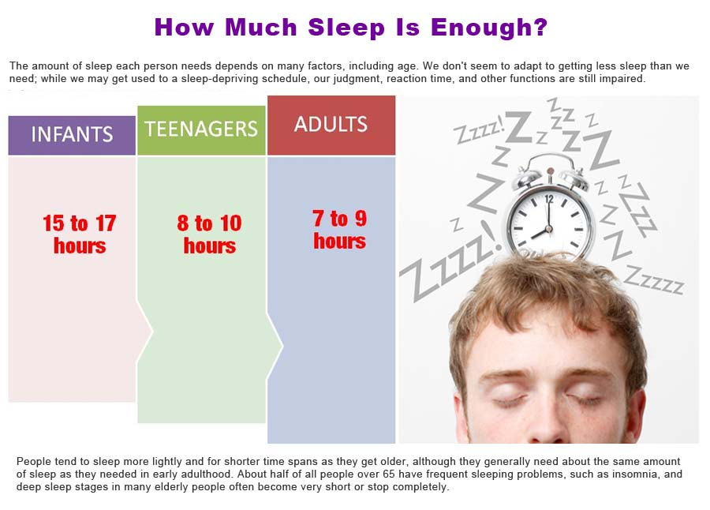
How much sleep do we need?
Notes:
Research shows that the amount of sleep that an adult needs is dependent on many factors with the range being 7.5 - 8.5 hours (7-9 hours). The average is 8 hours. Children need more. When we get less than that waking deficits begin to accumulate. The exact amount varies from person to person and depends on factors such as genetics, and prior sleep debt. Many believe they can get much less and still function. They can’t. After 18 hours of consecutive wakefulness your brains starts to deteriorate. Eventually sleep will overtake you and intrude into wakefulness without warning. We call that micro sleep.

Slide 9
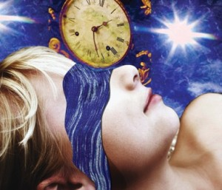
The Internal Clock
The Internal Clock
Notes:
The timing of sleep also matters.
The circadian clock in your brain regulates the timing of sleep and many biorhythms. Light is the strongest setter of that clock. When you open your eyes in the morning and expose yourself to light, the brain perceives this as sunrise. The clock then orchestrates rhythms that synchronize your internal environment with the external light. It also regulates rhythms that help you fall asleep at the right nighttime so you get the sleep you need. These include release of melatonin and changes in body temperature. It also control rhythms that help wake you up such as elevating cortisol, an alerting hormone. Irregular sleep patterns, sleeping in on weekends, and jet travel, disrupts this process. It can take several days for all the rhythms to realign once disrupted. We routinely create sleep debt during the week to cope with demands and expectation. Then we sleep in to offset the sleep loss. This is stressful to the human body. Studies show the Monday after DST there is an 8% increase in heart attacks. We also see increased accidents due to the stress from the shift of just one hour.

Slide 10
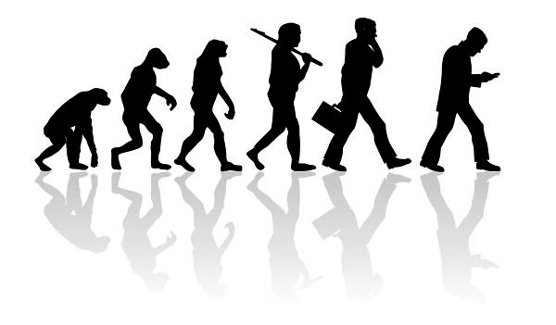
Notes:
So if sleep is so important for our survival why is it so easy to manipulate? The system needed to have flexibility. Daylight hours fluctuate with the seasons. When our survival depended on it, we needed to finish what we were doing before drifting into a state where we were disengaged from our environment. There is no pause button for survival. The system had to allow for this flexibility, while at the same time ensuring a balance, so we would get the amount of sleep we need and reset for optimum function. The circadian clock and sleep homeostasis serve that purpose. The circadian clock creates the timing, and sleep homeostasis creates the drive for sleep.
Unfortunately we were not designed with modern technology in mind.

Slide 11

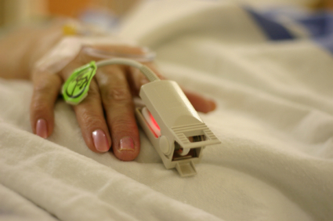
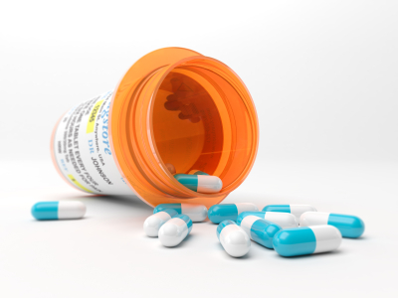
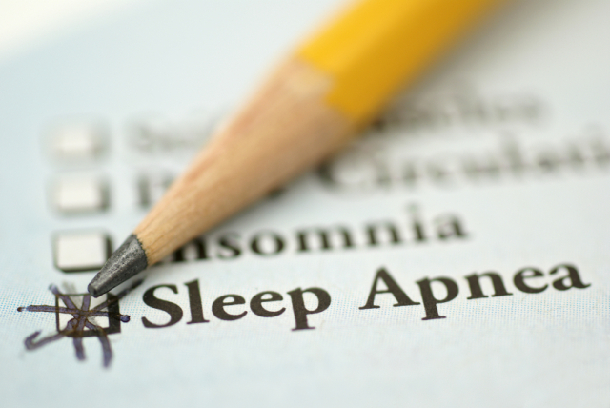
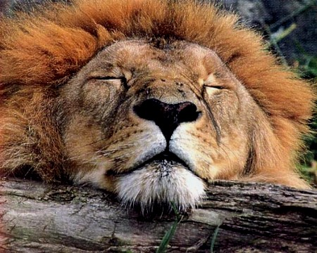
Illness Medication
Lifestyle
Lion
Notes:
Why am I not sleeping?
Technology redefined our day with the clock and globalization. That changed the patterns of light and dark. Technology changed the definition of success. We no longer need to extend the day to find food or avoid threats to our survival. We extend the day for accomplishments. But our biology was not designed with technology in mind. We didn’t get the sleep rule book. We don’t see the down side of missing out on sleep or the importance of that reset process for our health. We think sleep is for wimps, and not for those who want to maintain the competitive edge.
We fail to understand sleep can be broken and miss read the cues of poor sleep and sleep disorders. Illness, medications and over 80 sleep disorders can impair our sleep.
We don’t understand our own emptions and struggle with perceived lions at night.
Your mother didn’t get the rule book and your physician is trained to manage acute disease. Few received training in sleep. That is part of the gap in healthcare. When was the last time your doctor asked you what time did you go to bed? When was the last time a teacher stopped to ask a sleeping student about their sleep habits or suggested they need a sleep assessment? Do we just assume these are people with emotional issues?
Insufficient and poor quality sleep impairs critical thinking, performance, and will cause fragile emotions. It will cause most of the common disorders we hope to prevent and treat, and even premature death.
1. Lifestyle choices, sleep habits
2. Health problems, medications
3. Sleep disorders
4. The perceived lion

Slide 12
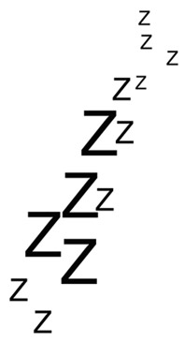

Survey results
How is this group doing?
Do you consider yourself a good sleeper? No = 1 point
Do you get 7-9 hours of sleep? No = 1 point
Do you sleep in on weekends? Yes = 1 point
Trouble falling asleep or wake up frequently? Yes = 1 point
Do you feel rested? ESS < 10? No = 1 point
Next Stop Bang

Slide 13
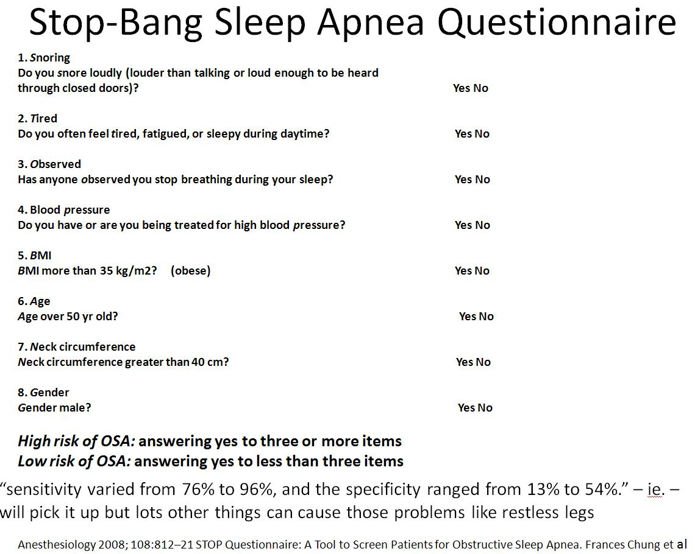

Slide 14
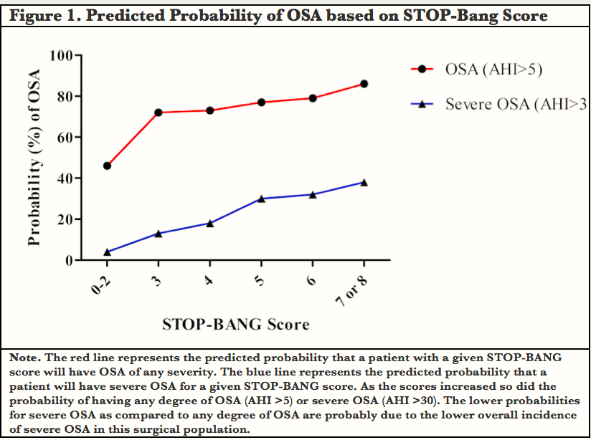

Slide 15
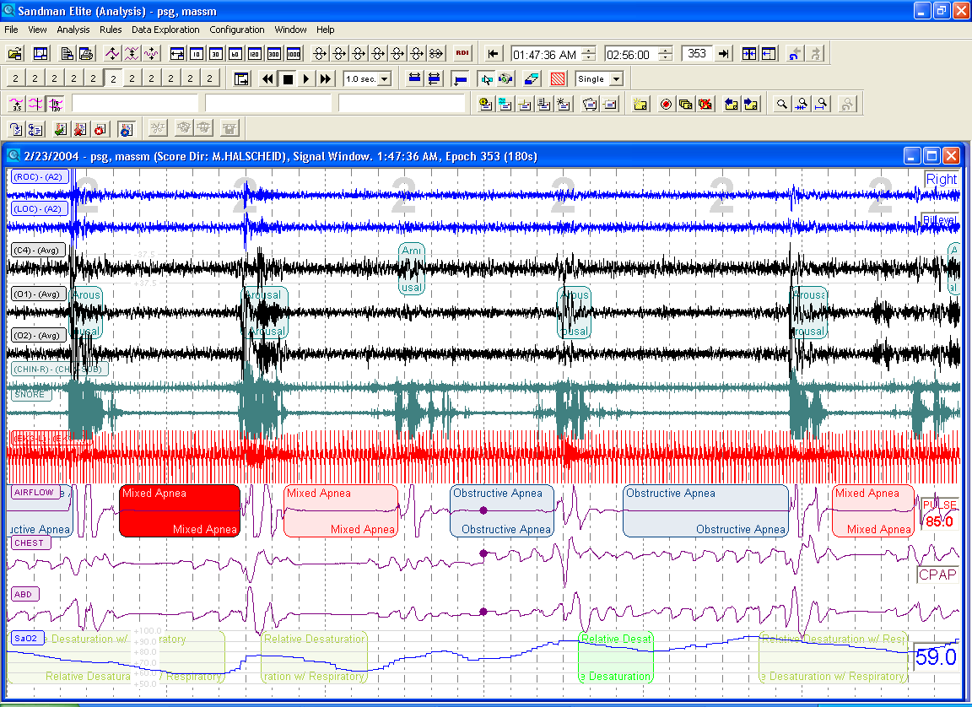
We talk about the benefits of breathing and look at this. This will kill you.

Slide 16
Sleep Apnea Prevalence in CVD Patients
Logan et al.
J. Hypertension 2001
Javaheri et al.
Circulation 1999
Somers et al.
Circulation 2004
Sjostrom et al.
Thorax 2002
Schafer et al.
Cardiology 1999
Sanner et al.
Clin Cardiology 2001
Notes:
Within your patient population the literature demonstrates that SDB can induce CVD
Definition Hypertension - laboratory-measured blood pressure of at least 140/90 mm Hg or the use of antihypertensive medications. Treating hypertension reduces the risk of premature cardiovascular disability and death and end-stage renal disease.
Logan Study – N=41 used AHI>10. Pts were taking 3 or more drugs. 83% of people with drug-resistant hypertension have SDB.
Javaheri Study – Prospective study: 81 males with HF and EF <45%, 51% suffered from SDB, 40% Central 11% Obstructive with high prevalence of atrial fib/ventricular arrhythmias
Somers et al. presentation ATS, 2004, published in circulation 2004 - Prevalence of obstructive sleep apnea in atrial fibrillation patients undergoing cardioversion is approximately 50%. Cardioverted patients with OSA who are treated have a 42% recurrence rate over one year, about half the recurrence rate of 82% in those OSA patients who are not treated with CPAP
Sjostrom et al. – 102 hypertensives and 102 non-hypertensive controls. Hypertensives had a higher correlation of SDB than non-hypertensives. SDB is more prevalent in men with hypertension than in the control group. Conclusion: Influence of SDB more pronounced in younger and middle age men than those>60.
Schafer Study – N=289. Prevalence OSA in pts with symptomatic angina and angiographically verified CAD. Analyzed association of OSA and other coronary risk factors with CAD and MI. CAD pts found to have OSA in 30.5%, OSA found in 19.7% of control group.
Sanner Study – n=68. Determine prevalence of SDB in pts referred for angina evaluation. Coronary angiogram, selective left venticulography and full night PSG was used to reevaluate pts with AHI>10. Found 30.9% of patients diagnosed with SDB.

Slide 17

Independent Predictors of MI

Slide 18
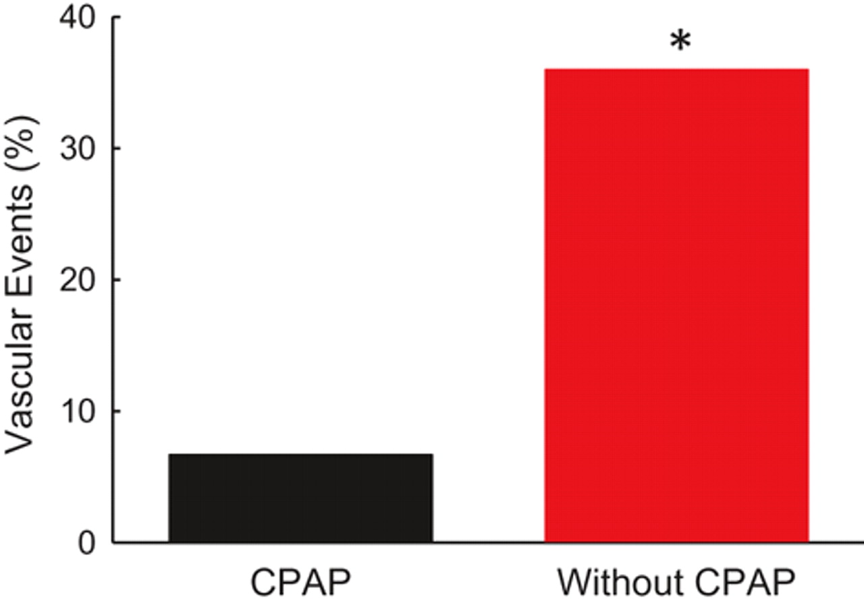

Incidence of vascular events over an 18-month period after stroke in CPAP users (n=15) and those who discontinued the use of CPAP (n=36).
Notes:
Incidence of vascular events over an 18-month period after stroke in CPAP users (n=15) and those who discontinued the use of CPAP (n=36). All patients in the study had an AHI ≥20. *P=0.03. Created with data from Martinez-Garcia et al.⁵⁶

Slide 19
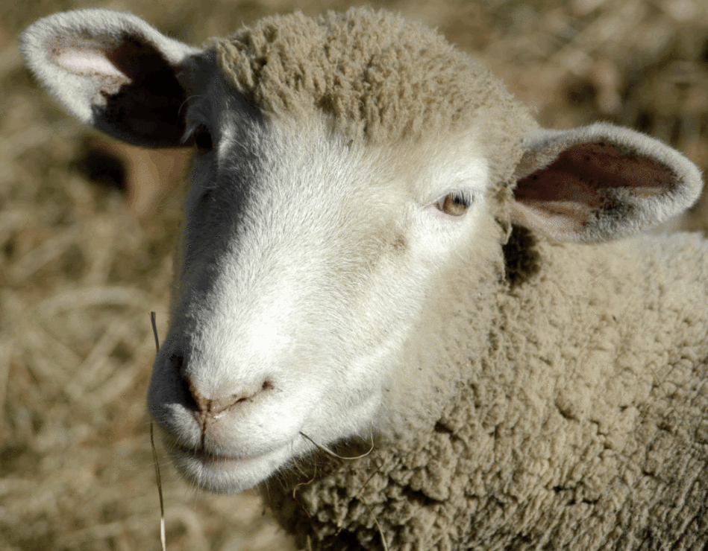
Sleep disorders
80 of them
Is snoring really all that bad?
  Causes deafness
  OSHA violation
  Causes increased thickness of carotid artery
Restless legs - disrupts sleep
Sleep apnea- you are not fixing it alone

Slide 20

Consequences
When sleep isn’t just right
Those sleeping <6 hours per night
66% more likely to have hypertension
Increased risk for cardiovascular disease
Impaired glucose tolerance, diabetes
Short sleep and insomnia linked to 4 x higher risk early death in men
Weight gain
Alters activity of 700 genes that code for stress, metabolism, immunity
Poor performance. Executive brain functions impaired. Fragile emotions.
ADHD - Children who do not get enough sleep may display symptoms including moodiness, tantrums and hyperactive behavior
Quality sleep is the competitive edge
  Prog Cardiovasc Dis. 2009 Jan-Feb; 51(4): 294–302.
  "Insomnia with Short Sleep Duration and Mortality: The Penn State Cohort.“ Vgontzas et al; Sleep, September 2010.

Slide 21
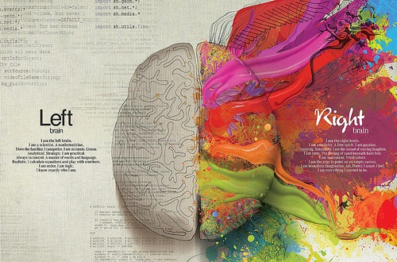
You have two separate operating systems
Prefrontal cortex must disengage to allow
Right brain to fire up.
Meditation, breathing facilitate this process.
Racing thoughts. You are stuck in the loop.
Left Brain
Convergent thinking
Detail oriented
Analytical
Math
Language
Logic
Music musicians
Right Brain
Divergent thinking
Intuition
Holistic
Spatial
Pattern Recognition
Art symbolism
Music nonmusicians
Self
Relate
Sex
Threat
Status
Quiet Racing Thoughts

Slide 22

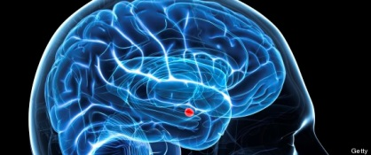
Racing thoughts
Taming the lion in the room
Name it to tame it – Reality check
Identify sympathetic activation shut it down
Just breath

Slide 23
Mindfulness focus on the present
To use the skilled focus of attention to change the mind—enables us to amplify the activity of certain pathways and inhibit others. Without this refined inner view of the mind itself, such discrimination among specific patterns of neural firing is not possible.

Slide 24
Focus Really Matters
Why would the way we focus our attention matter for the quality of our lives?
When we refine the way in which we see the fabric of the mind itself it becomes possible to intentionally alter the way information flows through it.
Seeing the mind with more depth and clarity allows the mind to regulate the flow of energy (pattern of neural firing) and information in it (neural connections)
Allows you to be transformed
Sleep deprivation impairs this process
http://scan.oxfordjournals.org/content/2/4/259.full

Slide 25

Omega 3
Higher levels of omega-3 DHA, fatty acids found in algae and seafood, are associated with better sleep
Study by the University of Oxford due to be published in the Journal of Sleep Research
16 weeks of daily 600 mg supplements of algal sources would improve the sleep of 362 children
Not selected for sleep problems, but were all struggling readers at a mainstream primary school
http://www.sleepreviewmag.com/2014/03/omega-3-better-sleep/#sthash.6t5yD6fo.dpuf

Slide 26
NSF Sleep In America Poll 2013
Vigorous exercisers almost twice as likely to have good sleep every night
They also are the least likely to report sleep problems.
More than two-thirds of vigorous exercisers rarely or never (in the past 2 weeks) had insomnia symptoms insomnia. NO difficulty with
  72 % , waking up too early and not being able to get back to sleep
  69% difficulty falling asleep
In contrast, one-half (50%) of non-exercisers say they woke up during the night and nearly one-fourth (24%) had difficulty falling asleep every night or almost every night
http://sleepfoundation.org/sleep-news/national-sleep-foundation-poll-finds-exercise-key-good-sleep/page/0%2C1/

Slide 27
Non exercisers
Have the highest risk for sleep apnea
Are more excessively sleepy than exercisers
Nearly one-fourth of non-exercisers (24%) qualify as “sleepy” using a standard excessive sleepiness clinical screening measure.
Six in ten of non-exercisers (61%) say they rarely or never have a good night’s sleep on work nights

Slide 28
Things you can do
Sleep habits
  Set rules
    Quiet, dark and cool
    White noise machines
    No electronics
    Optimize the room temperature 65-72. Wear socks.
    Comfortable mattress, pillow, calm colors
  Diet, Exercise
  Just breath, resiliency, shut down racing thoughts

Slide 29

Reality Check
Recognize the threat
Competence
Autonomy
Relatedness
Basic human needs
Perceived threats activate fight or flight
Recognize sympathetic systems

Slide 30
Refocus and Do
Having recognized the problem for what it is and why it’s occurring, you now have to replace the old behavior with new things to do
This is where the change in brain chemistry occurs, because you are creating new patterns, new mindsets. By refusing to be misled by the old messages, by understanding they aren’t what they tell you they are, your mind is now the one in charge of your brain.
It is in the doing you rewire

Slide 31
Revalue and find Purpose
The need for purpose is one the defining characteristics of human beings
Purpose calms racing thoughts.
Focuses our attention externally
Gives us a constant source of activity to channel our mental energies
Spend less immersed in chatter of our minds
Makes us less self-centered.
We feel a part of something bigger,
Outside ourselves, and this makes us less focused on our own worries and anxieties.

Slide 32
Purpose
When we don’t have a sense of purpose in our lives. It makes us more vulnerable to boredom, anxiety you never get up in the morning wondering what you’re going to do with yourself. When you’re ‘in purpose’ - that is, engaged with and working towards your purpose - life becomes easier, less complicated and stressful. You become more focused, like an arrow flying towards its target. There is less space for negativity.
Notes:
So what about the Power of purpose?

Slide 33
Healthy Sleep Advice
Eat Mediterranean diet high in omega three
Exercise regularly. Any time of day.
Create a sleep environment. That is quiet, dark and cool with a comfortable mattress and pillows.
Practice a relaxing bedtime ritual
Go to sleep and wake at the same time every day, and avoid spending more time in bed than needed.
Use bright light to help manage your "body clock." Avoid bright light in the evening and expose yourself to sunlight in the morning.
Use your bedroom only for sleep
Remove work materials, computers and televisions from your bedroom.
Save your worries for the daytime.
If you can't sleep, go into another room and do something relaxing until you feel tired.
If you are experiencing excessive daytime sleepiness, snoring, or “stop breathing” episodes in your sleep, contact your health care professional for a sleep apnea screening

Slide 34

Wake up the day to take back the night.
And…
Find Purpose

Slide 35

Seize
Life
Experience
Everything
Purpose
with

Slide 36
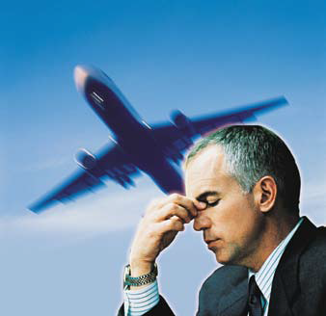
Q & A

