Slide 1
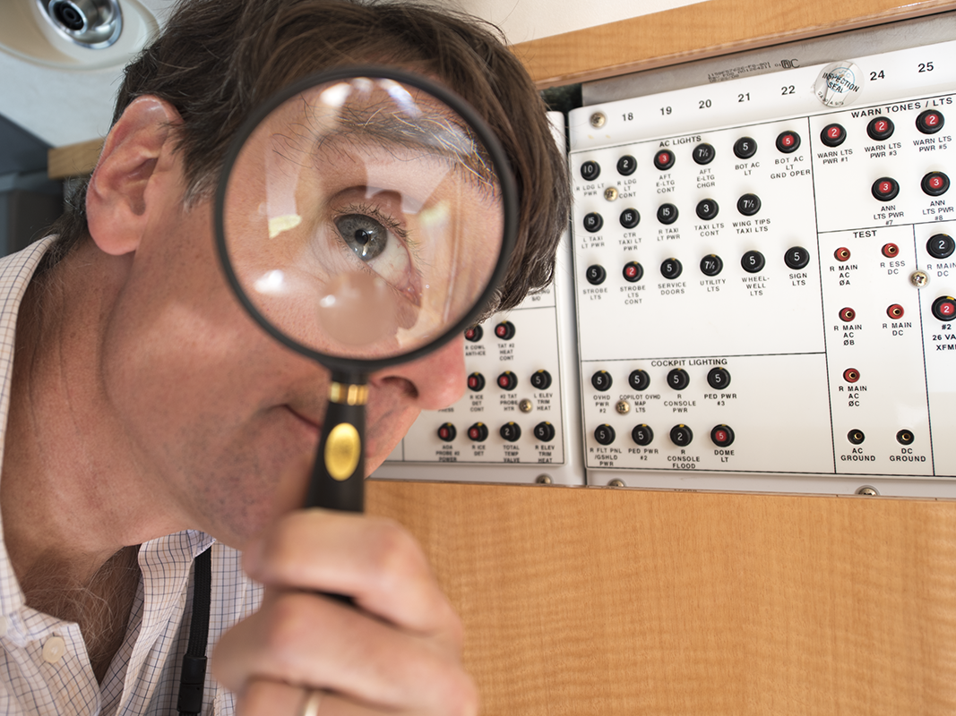
PRE-Accident Investigator
Notes:
DISADVANTAGE – One of the disadvantages of being in a flight department with me is that I often show up with a camera and a prop and say, “Here, hold this.”
GRAMAR – The title seems to have a grammar problem at best, a logic problem at worst
How can you investigate an accident before it happens?
But if you could, wouldn’t that be the best way to prevent an accident from happening in the first place?

Slide 2
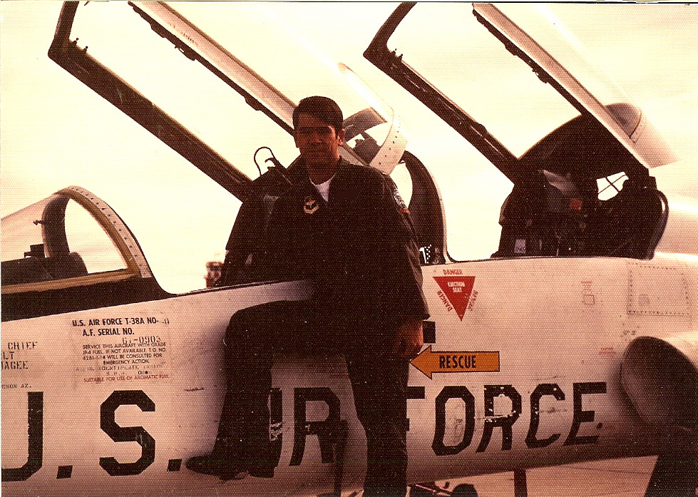
Notes:
FIRST THOUGHT – of this when I was 22-years old when I started flying jets and in that year I learned to respect what can happen in a T-38 if you don’t pay attention.
LIST OF THINGS – I compiled a list of all the things in that jet that could kill me. Am I that paranoid? Yes. I think the list had 20 items on it. That year we lost four T-38s. The AF had lost 154 since the aircraft came on active duty in 1960, about 6.5 destroyed per year, so we were getting better.
OVER THE YEARS – I’ve come up with new lists with each new airplane and the lists got smaller and smaller.

Slide 3
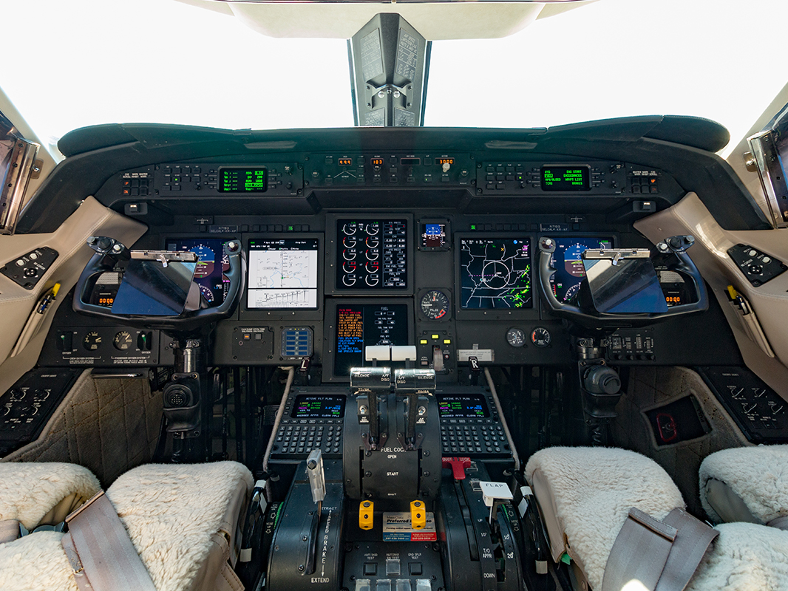
Notes:
I’VE FLOWN ALL MANNER OF GULFSTREAMS SINCE 1991 – while each generation of Gulfstreams gets safer, the one that seems to keep crashing is this one.
ANY GUESSES – as to which model of Gulfstream this is?
After reading ONE ACCIDENT REPORT AFTER ANOTHER it struck me that these reports could have been written before the accidents.
The reports were POST accident reports – they did a good job of telling us what to do again.
But they could have been PRE-accident reports – they could have predicted the accident in question and could have warned the pilots before hand.

Slide 4
GIV Accidents:
Seem to lead the fleet (more of them)
Getting worse, not better (filtering down in market)
Good case studies (Usually pilot error, predictable, and misunderstood)
Notes:
Compared to the Gulfstreams before and after, the GIV SEEMS TO HAVE THE WORST REPUTATION FOR ACCIDENTS.
THIS MIGHT BE UNFAIR: There are a lot of GIVs flying out there (528+ over 4 million hours over 2 million cycles over 31 years)
BUT IT IS GOING TO GET WORSE: The airplane is getting old and prices have plummeted, you can pick one up these days for less than 5 million
Cheap airplanes are bought by cheap operators who don’t always invest in the best pilots, maintenance, or training
LET’S LOOK AT THREE EXAMPLES. Now these are GIVs, but the lessons here apply to all airplanes

Slide 5
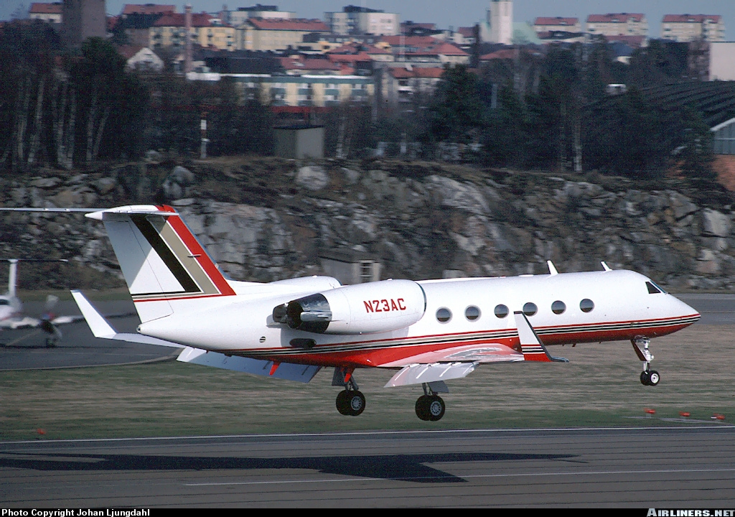
N23AC, 30 Oct 96, KPWK:
Conventional wisdom?
Really?
Notes:
IF YOU MENTION GULFSTREAM AND PALWAUKEE to most corporate aviation pilots you are going to hear the same thing:
The accident was cause by _____?

Slide 6
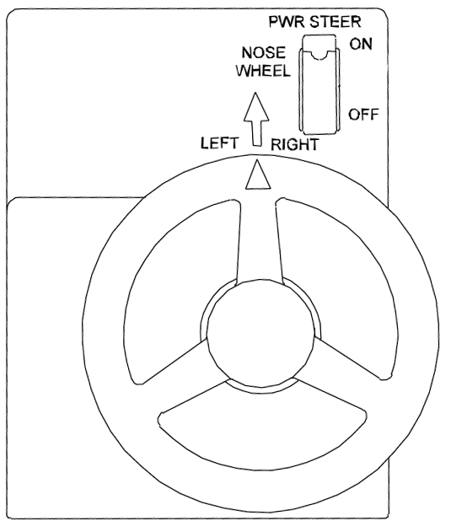
Notes:
NOSE WHEEL STEERING? You would be led to believe that from the NTSB REPORT
Early Gulfstreams did not CONNECT THE RUDDER PEDALS TO THE NOSE WHEEL STEERING SYSTEM . . . the nose wheel was steered with a tiller only
THE GIV GAVE LIMITED CONTROL OF THE NOSE WHEEL TO THE RUDDER PEDALS . . . Old school GIII pilots hated this so . . .

Slide 7
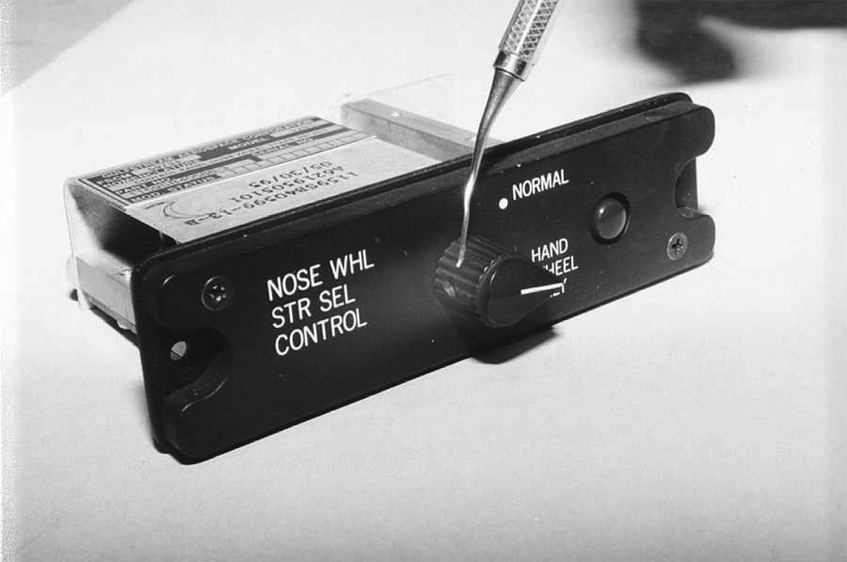
Notes:
THE SWITCH simply rotated between “hand wheel only” and “normal” – the only light is blue and is located by the pilots left knee (it is easy to miss)
On 30 Oct 96 this airplane was flown by two pilots from two different flight departments with an INTER-FLY AGREEMENT
THE CAPTAIN WASN’T AWARE the switch was set to “hand wheel only,” he normally flew with it in “Normal”
The CAPTAIN LOST CONTROL OF THE AIRPLANE DURING THE CROSSWIND TAKEOFF and they never made it off the ground, everyone on board perished
ALL THAT IS TRUE, BUT IT ISN’T WHAT CAUSED THE CRASH . . .

Slide 8
“The PIC tended to unload the nose wheel on the G-IV during takeoff to make it easier on the airplane on rough runways.”
Notes:
BURIED IN THE MIDDLE OF THE NTSB REPORT is this.
Does Palwaukee have a rough runway? They were using Runway 34, which is the airport’s longest and widest runway.
HE DIDN’T UNDERSTAND that the airplane’s huge vertical fin acted as a weather vane and the rudder wasn’t effective enough until rotation and he needed to keep his airplane in a three point attitude until then
OTHER PILOTS NOTICED his tendency to do that but never corrected him, perhaps they didn’t realize just how dangerous a technique this is in a large jet
HAD JUST ONE SPOKEN UP, this accident could have been prevented

Slide 9
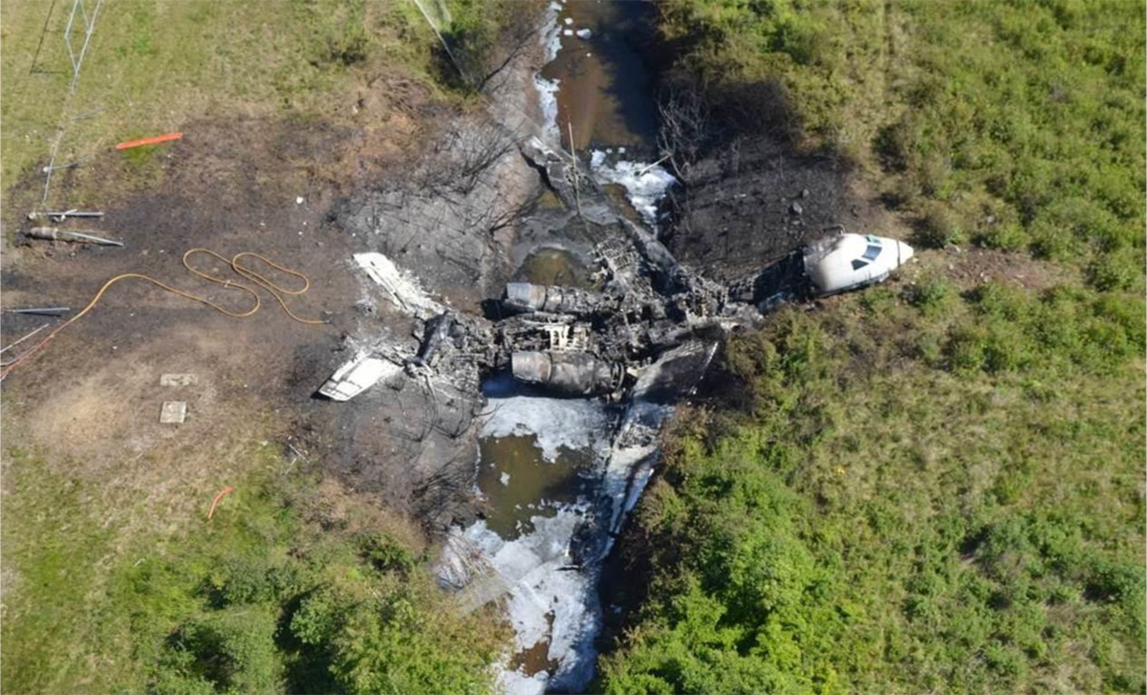
N121JM, 31 May 13, KBED:
Conventional wisdom?
Really?
Notes:
Probably the MOST INFAMOUS GULFSTREAM CRASH ever was just two years ago at Bedford
Just about anyone you ask will tell you the same thing, this crash was caused by ______?

Slide 10
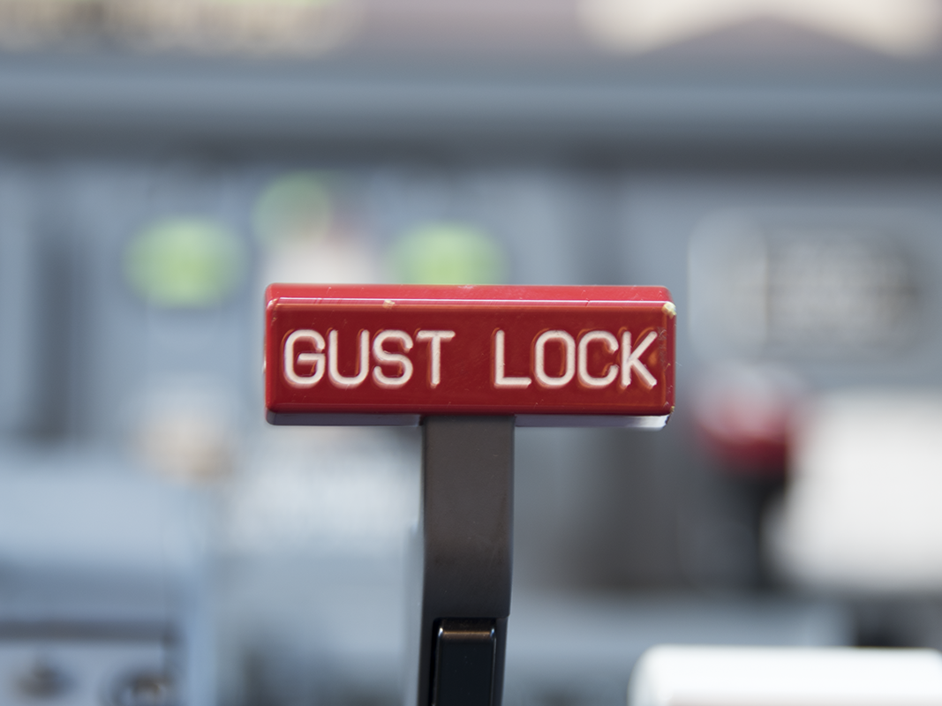
Notes:
THIS CRASH WAS CAUSED BY TWO PILOTS – who failed to use checklists, to follow proper abort procedures, to understand aircraft systems, in short, they failed to display any level of airmanship
WE KNOW ABOUT THIS – Because of the FDR and interviews with contract pilots they had flown with
HAD ANY OF THEIR GUEST PILOTS SPOKEN UP – had they been good PRE-accident investigators, this accident could have been prevented
I realize contract pilots are in a precarious position, how do you correct someone who signs your paycheck?

Slide 11
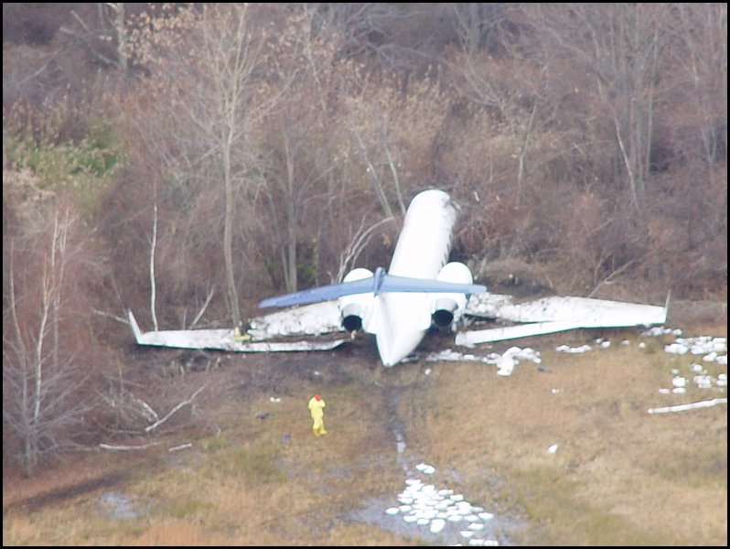
G-GMAC, 1 Dec 04, KTEB:
Conventional wisdom?
Really?
Notes:
THE CRASH THAT GOT ME THINKING about the concept of pre-accident investigation was this one
This GIV shot the Teterboro ILS 19, CIRCLE 24 in a gusty crosswind. The pilot put the airplane down on speed, on centerline, in the touchdown zone
But he COULDN’T GET THE REVERSERS OUT, he thought the brakes were unresponsive, and he was too aggressive with the emergency brakes
The airplane was destroyed but there were no fatalities
This crash was caused by _______

Slide 12
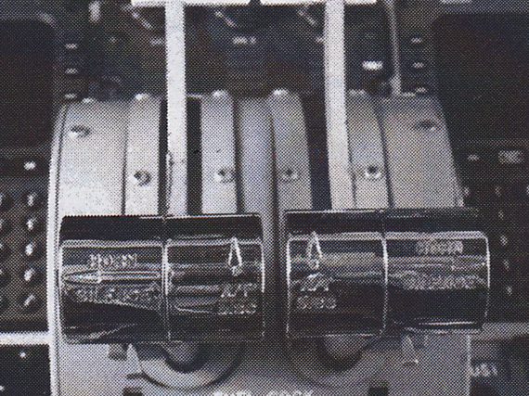
Notes:
THE AUTOTHROTTLES?
The NTSB BLAMED THE CRASH on the pilot’s inadvertent re-activation of the auto-throttles during the landing
That is true, but is that really what caused the crash?

Slide 13
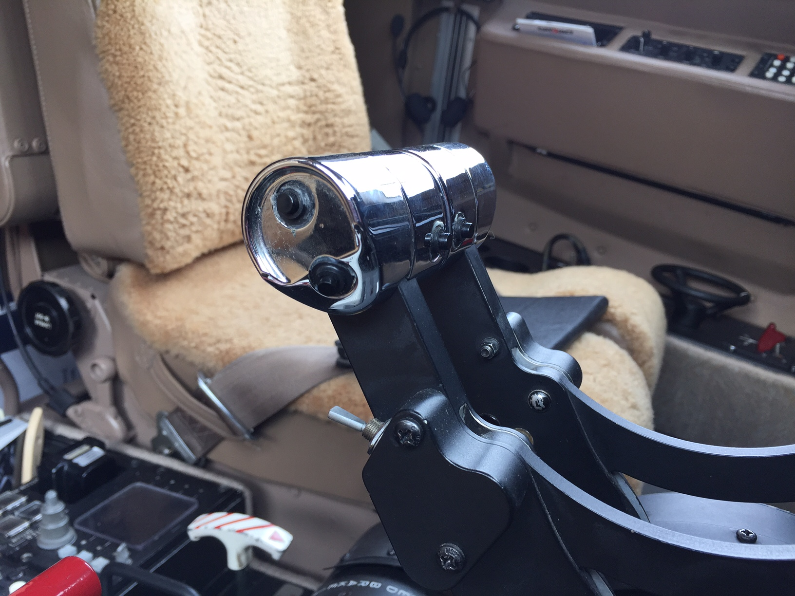
Disengage
only
Engage
or
Disengage
Notes:
The GIV-SP HAD THE FIRST SET OF AUTO-THROTTLES OFFERED BY GULFSTREAM -- usable from takeoff until before landing -- had to be disengaged prior to landing
ONE WAY TO ENGAGE -- TWO WAYS TO DISENGAGE
MANY GULFSTREAM PILOTS believed it best to use the aft switches to disengage
SOME GULFSTREAM PILOTS warned that it might be possible to re-engaging them prior to landing by hitting one of the aft switches twice
Gulfstream, to this day, does not mandate a procedure

Slide 14
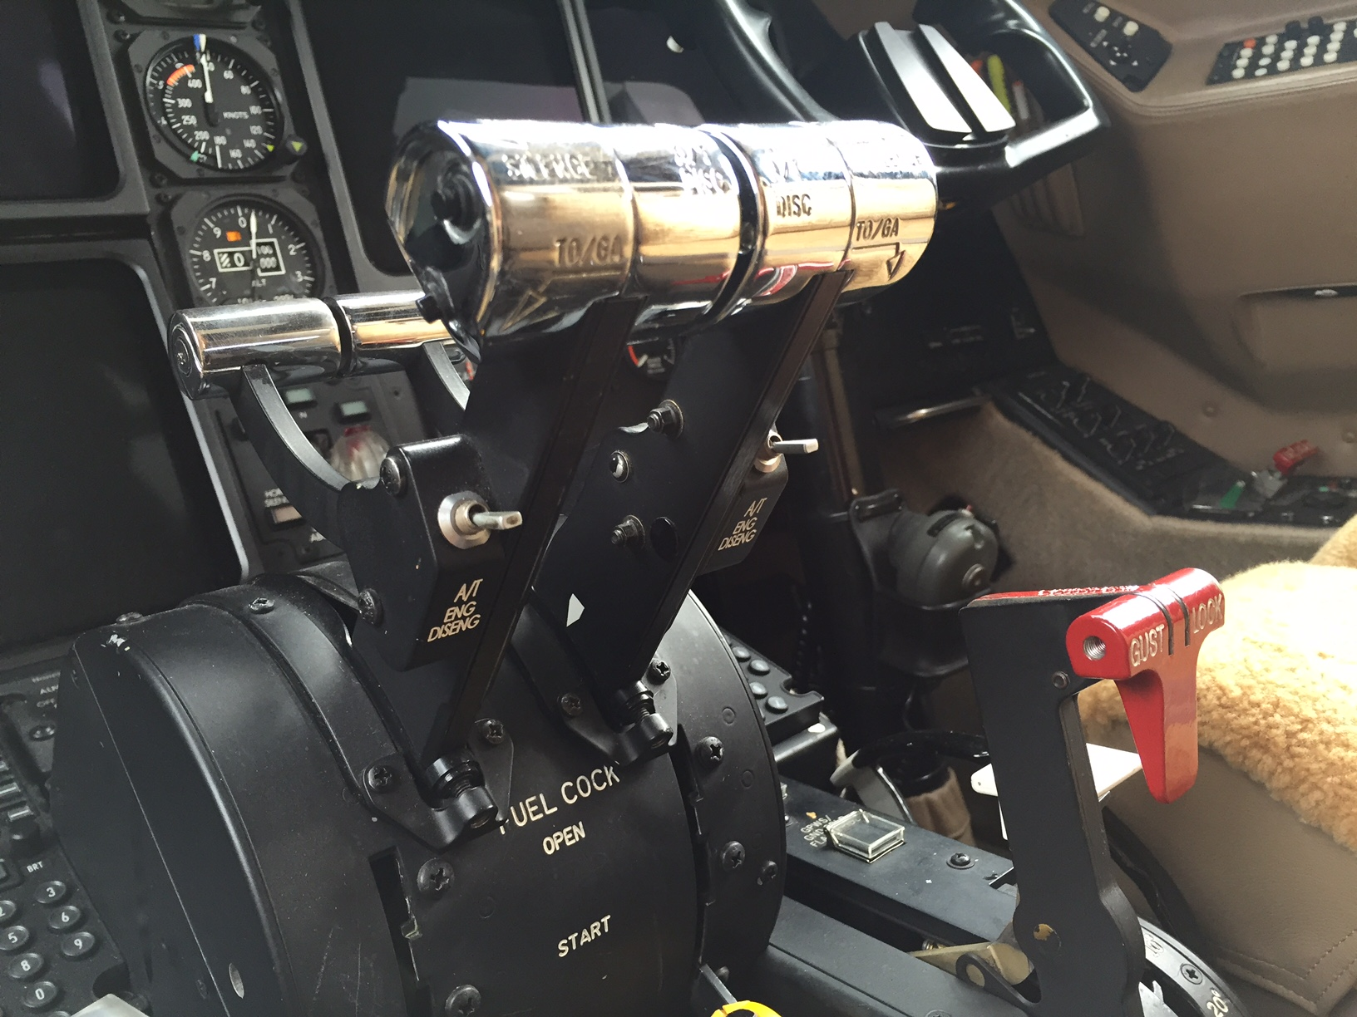
Notes:
THOSE OF US WHO WARNED AGAINST THE “DOUBLE CLICK” had assumed the role of PRE-accident investigators, we predicted what happened on December 1st, 2004
Imagine having to hit one of those switches just once on gusty day while maneuvering for the circle
The pilot disengaged and reengaged the auto-throttles, neither pilot noticed
After touch down as the speed decayed the auto-throttles pushed forward to maintain VREF
SO THIS WAS A CRASH CAUSED BY POOR PILOT TECHNIQUE AND A LACK OF SITUATIONAL AWARENESS
And it was preventable

Slide 15
Each accident:
Could have been predicted by a knowledgeable outsider
We should investigate these kinds of circumstances before they become accidents
Notes:
THIS SOUNDS LIKE A LOT OF MONDAY MORNING QUARTERBACKING BUT IT ISN’T
And it isn’t isolated to the Gulfstream IV
YOU CAN APPLY THIS THOUGHT PROCESS TO A VAST MAJORITY OF AIRCRAFT ACCIDENTS THESE DAYS
Why is that?

Slide 16
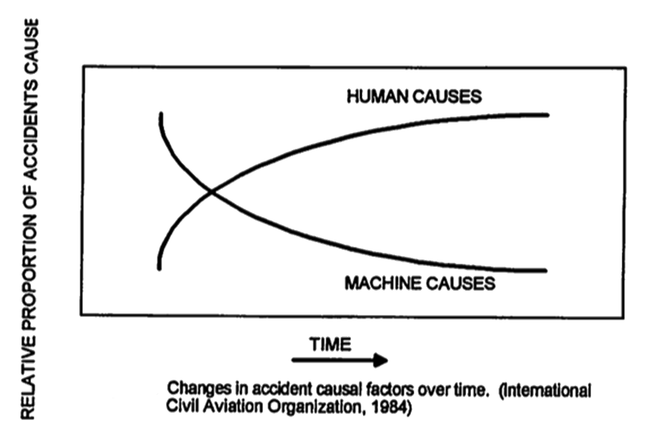
Notes:
You often hear, in fact you will see this in a few FAA publications, that THE MACHINE IS GETTING BETTER AND THE HUMAN IS GETTING WORSE
This comes from an ICAO study in 1984 and is often quoted by textbooks
Looking at this slide, doesn’t it say accidents caused by human causes is going up?
THE KEY WORD HERE IS THE WORD PROPORTION
The graph isn’t so much a lie as a trick
I think we can redraw it

Slide 17
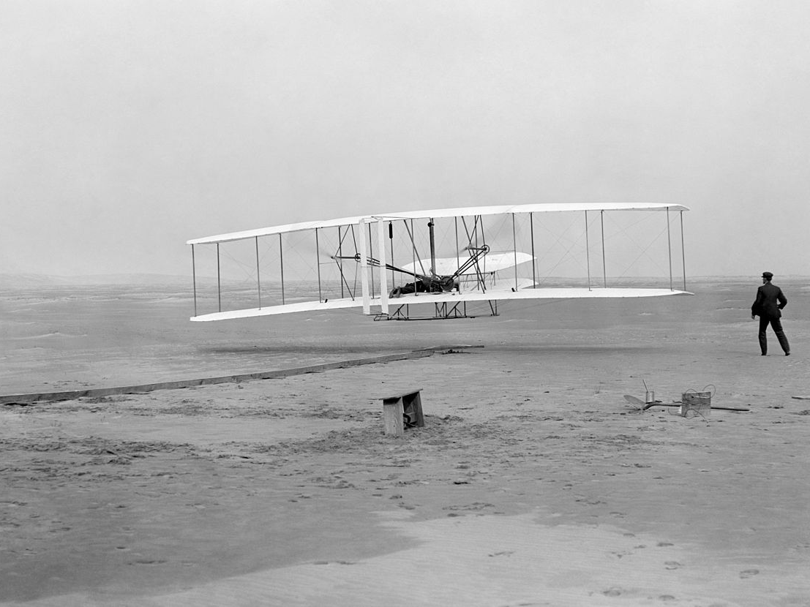
Accidents
Pilot
Airplane
1903
2016
Notes:
THE HUMAN HAS GOTTEN BETTER, but the machine has gotten much, much better
Jet Engine, GPWS, GPS, SVS
CRM, CDFA
It is getting harder and harder to buy an electronic gizmo to fix what’s left
IT IS UP TO US PILOTS TO BECOME HUMAN FACTORS ENGINEERS, TO BE PRE-ACCIDENT INVESTIGATORS
Unfortunately there are no formal schools for PRE-accident investigation
We do have more than a few, however, for POST-accident investigation

Slide 18
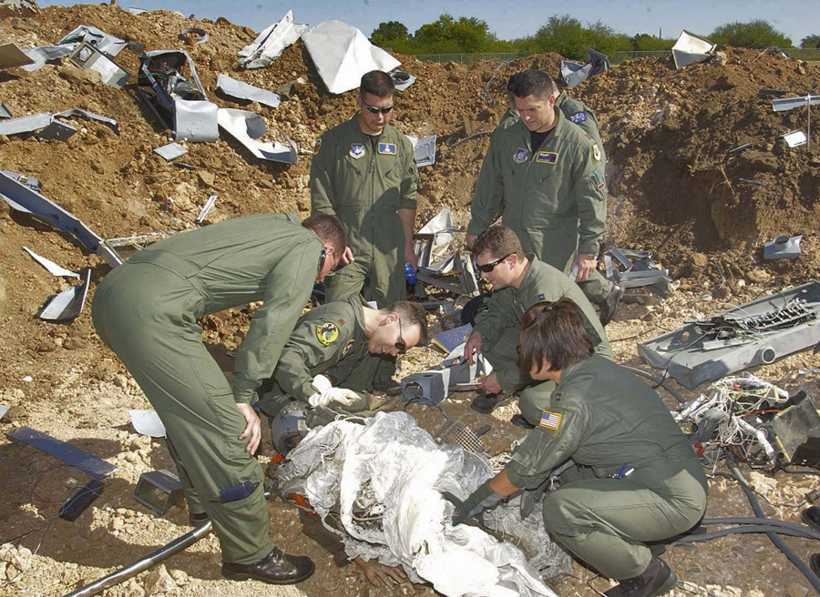
Notes:
I ATTENDED THE AIR FORCE FLIGHT SAFETY OFFICER COURSE IN 1985 and learned how to be a POST-accident investigator
Over the years I only wrote two accident investigation reports and I would like to say they both broke new ground in the annals of aircraft mishap prevention, that years later safety officers worldwide were still using these reports as the template on how to investigate an accident and prevent recurrence
Alas, I cannot. One of the reports was quite good and changed the way the Air Force does things. That’s not the one I want to talk about.

Slide 19
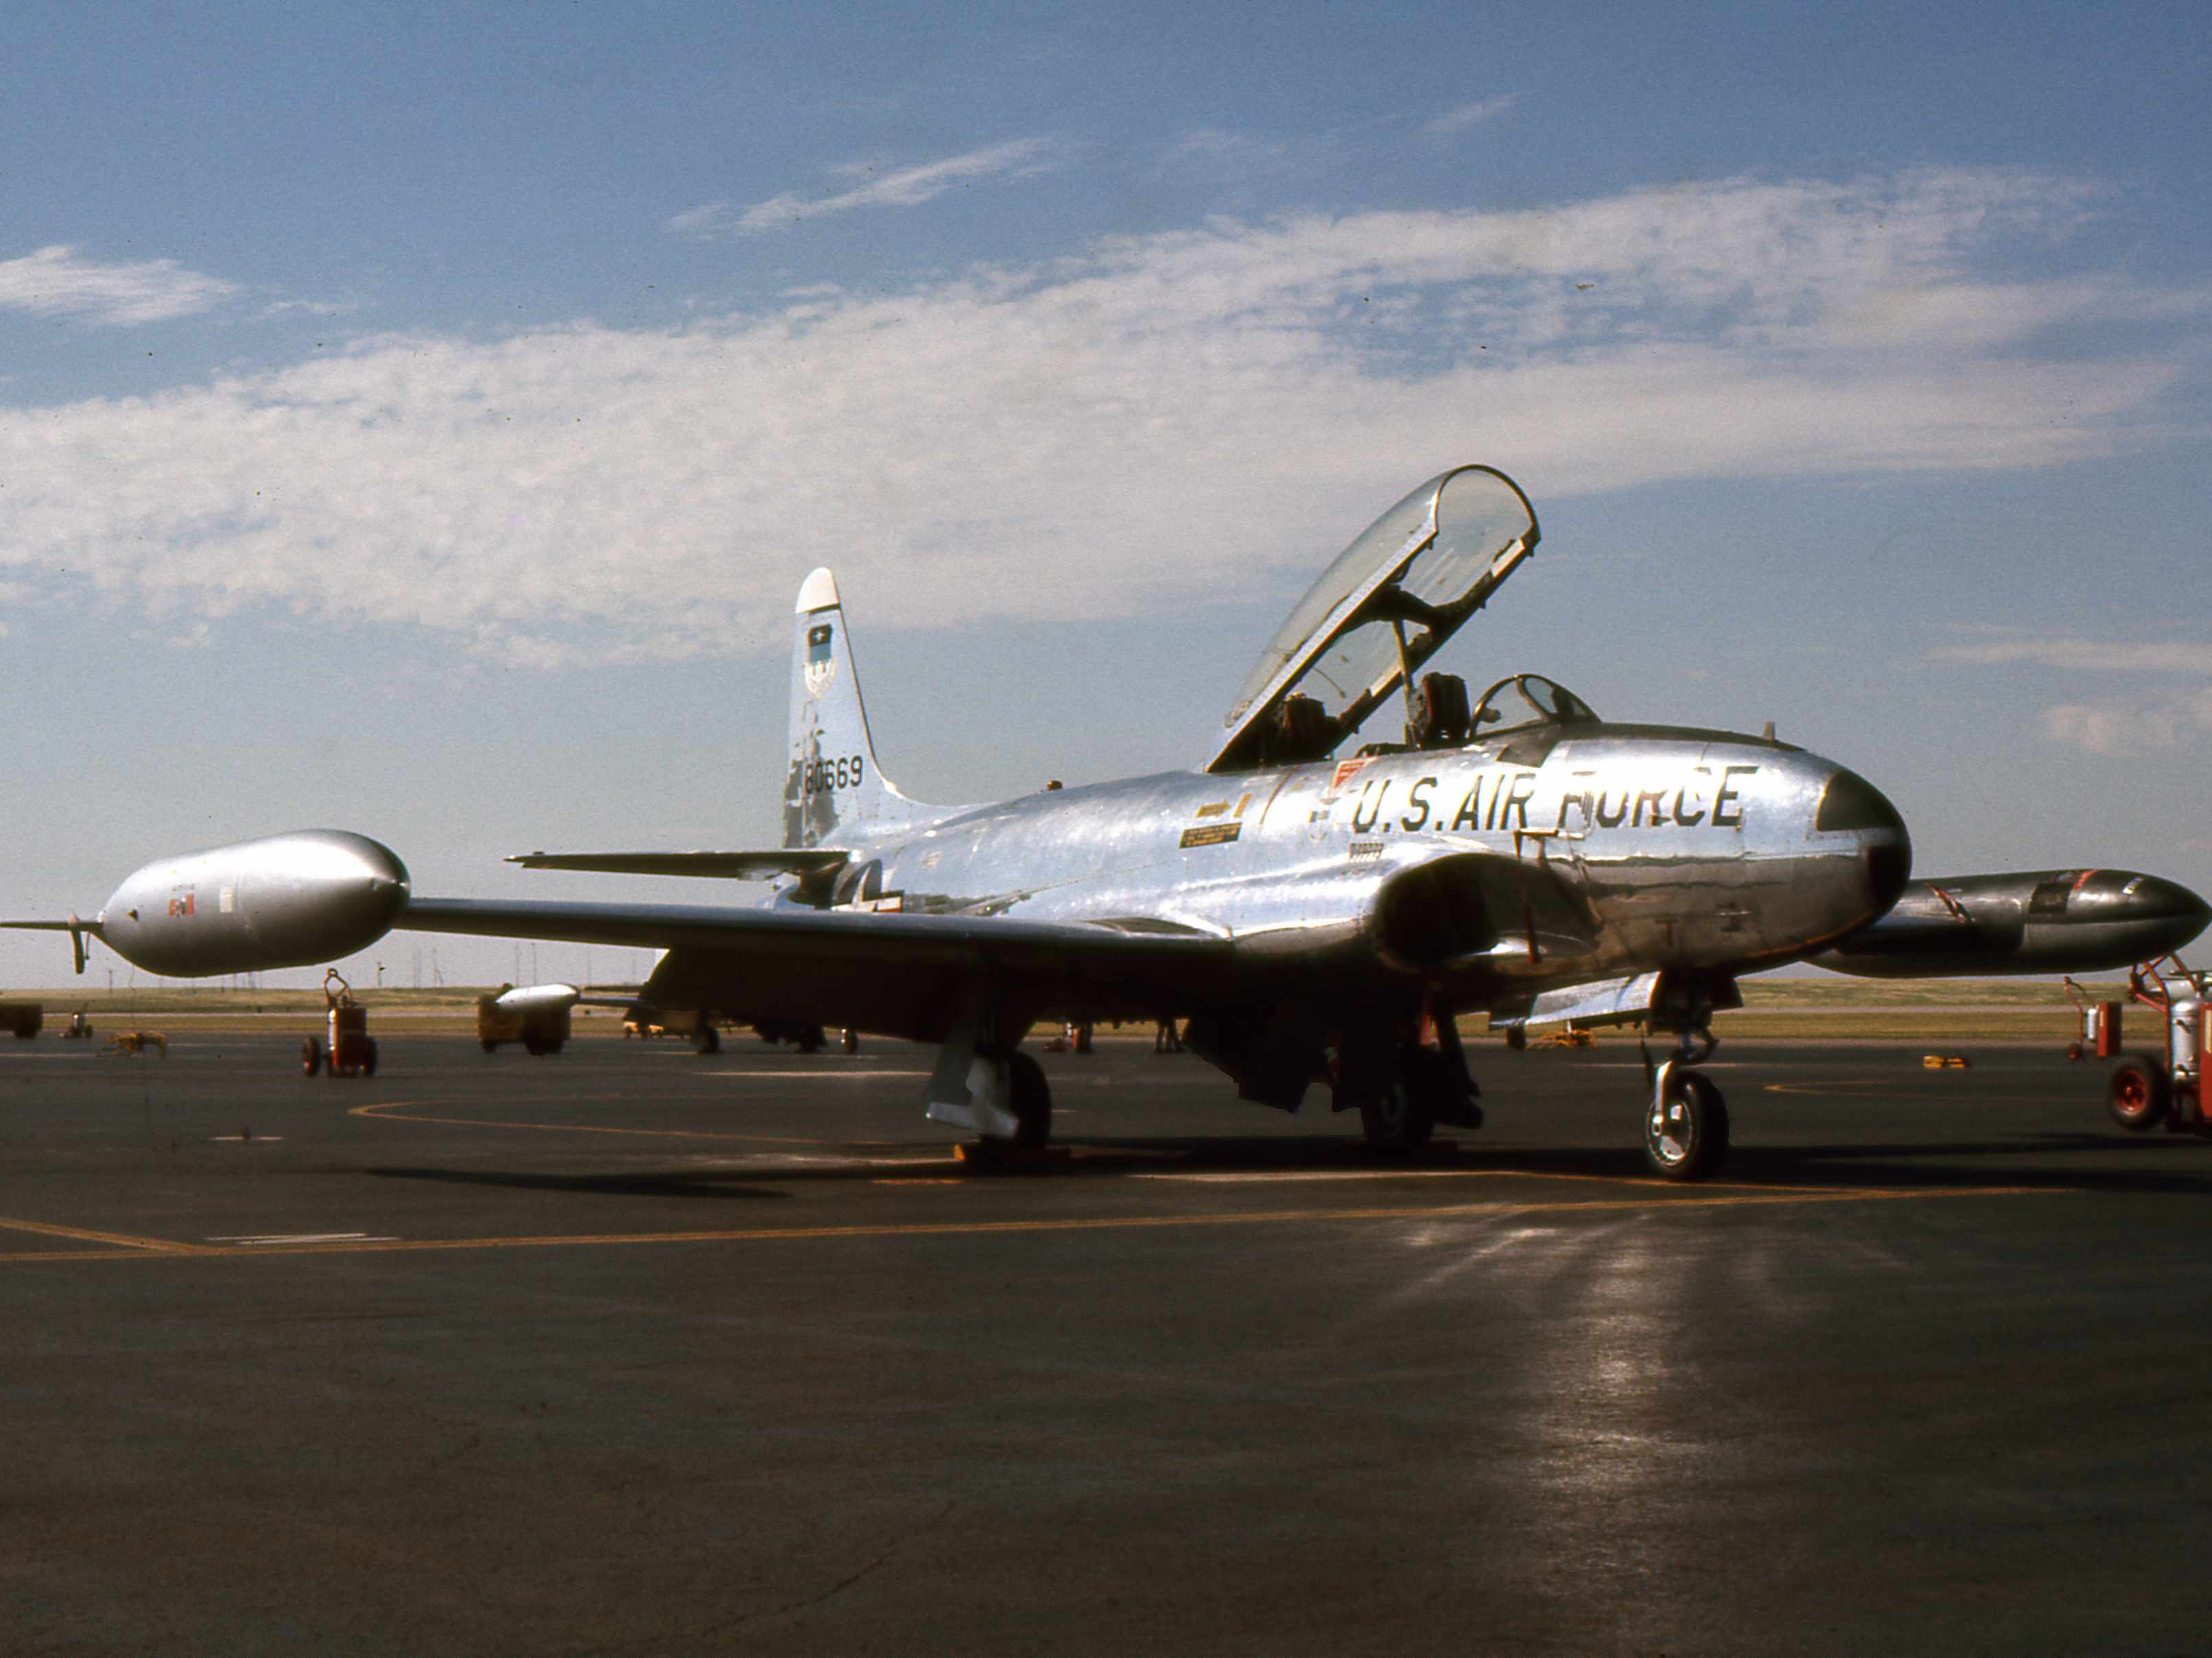
. . . One PRE-Accident Investigator’s Story
Notes:
As a flight safety officer for Hickam Air Force Base in Hawaii my first real investigation was in 1985
I was on duty when my portable radio came to life and told me there was an emergency aircraft coming in for landing on the reef runway
I rushed out there, switching to tower frequency
A T-33 pilot declared a physiological emergency, asked and was cleared for an immediate landing on the reef runway
A Japan Airlines 747 held short of the runway

Slide 20
Notes:
THE T-33 LANDED, the pilot pulled off on the RM taxiway, shut down the airplane, popped the canopy, ran out of the airplane, pulled off his flight suit, and relieved himself of his physiological distress in front of a plane load of Japanese tourists sitting from their elevated perches on RB
It wasn’t the proudest day in United States Air Force history
They say you can learn more from an accident report reading the recommendations than the list of causes
My report recommended that in the future, T-33 pilots should not consume three polish sausages with extra mustard and sour kraut prior to strapping into an ejection seat and flying single pilot
I could have written the report that morning, watching the pilot eat lunch

Slide 21
PRE-Accident Investigator Skills
Curiosity
Skepticism
Empathy
Passion
Notes:
Don’t get me wrong, THE POST-ACCIDENT INVESTIGATOR HAS A VITAL ROLE TO PLAY . . We need to fully investigate what happened to understand why and to prevent it from happening again. The NTSB and other agencies do a great job at this
BUT WHAT CAN WE DO TO PREVENT ACCIDENTS FROM HAPPENING?
We can learn to spot the circumstances for that next accident before they evolve into that next accident. We can become PRE-accident investigators
So welcome to the inaugural class of PRE-accident investigators
You need to have each of these skills to become a good PRE-Accident investigator. So let’s get started

Slide 22
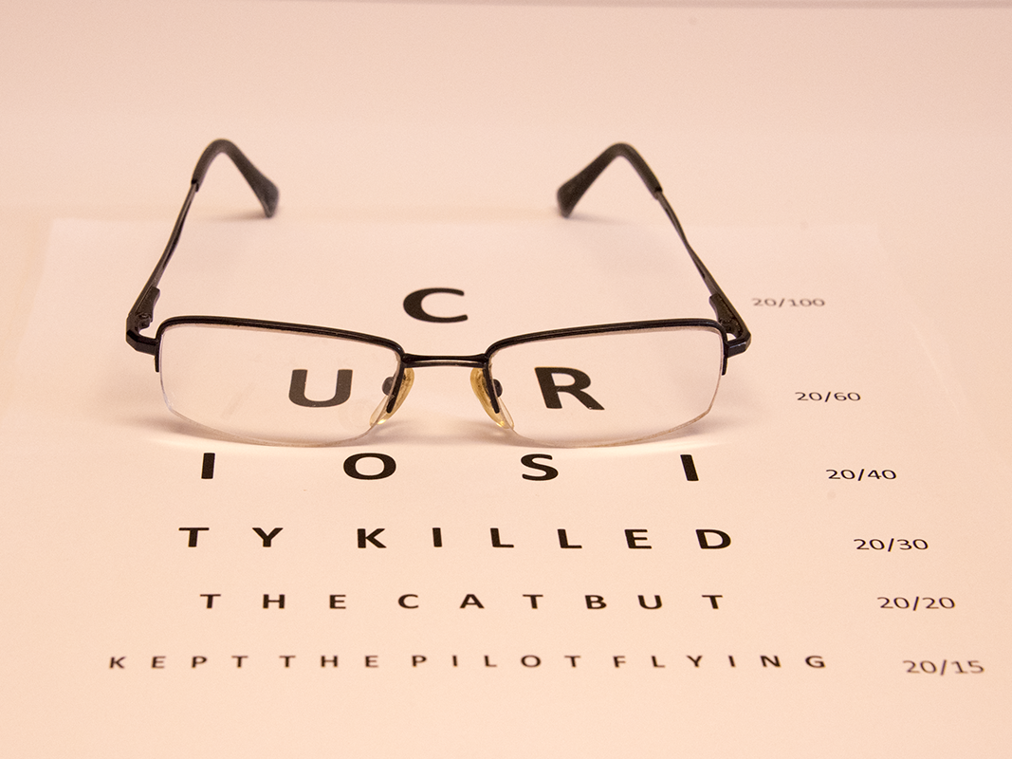
Notes:
I used to fly with a former airline pilot who said if it wasn’t taught at initial or recurrent, he didn’t need to know it.
BEING A PROFESSIONAL PILOT REQUIRES MORE THAN DUTY ON TO DUTY OFF TIME involvement.
Let me give you a quiz to illustrate my point.
This will be like an eye test.
I am going to show you two representations of a radar display. Neither shows any hazardous weather, but are set to anticipate convective activity ahead. The range is set to 100 nm, the gain is auto, everything is the same except the tilt. So in which display is the tilt set correctly?

Slide 23
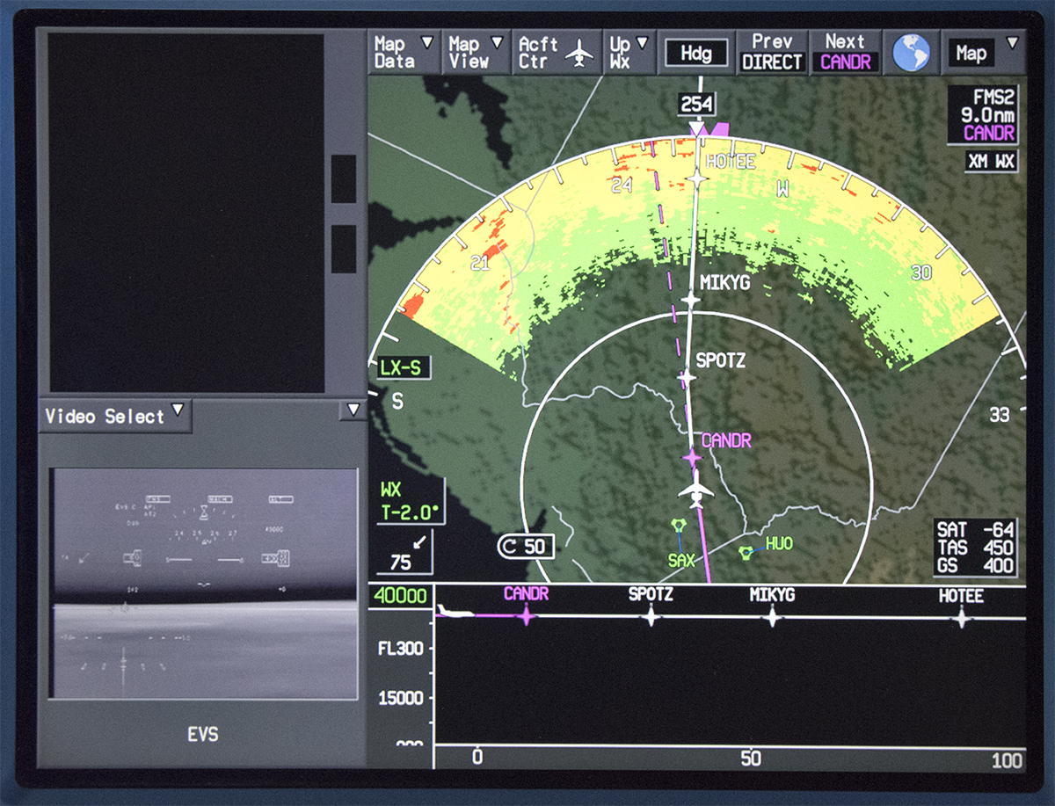
Notes:
Slide A?

Slide 24
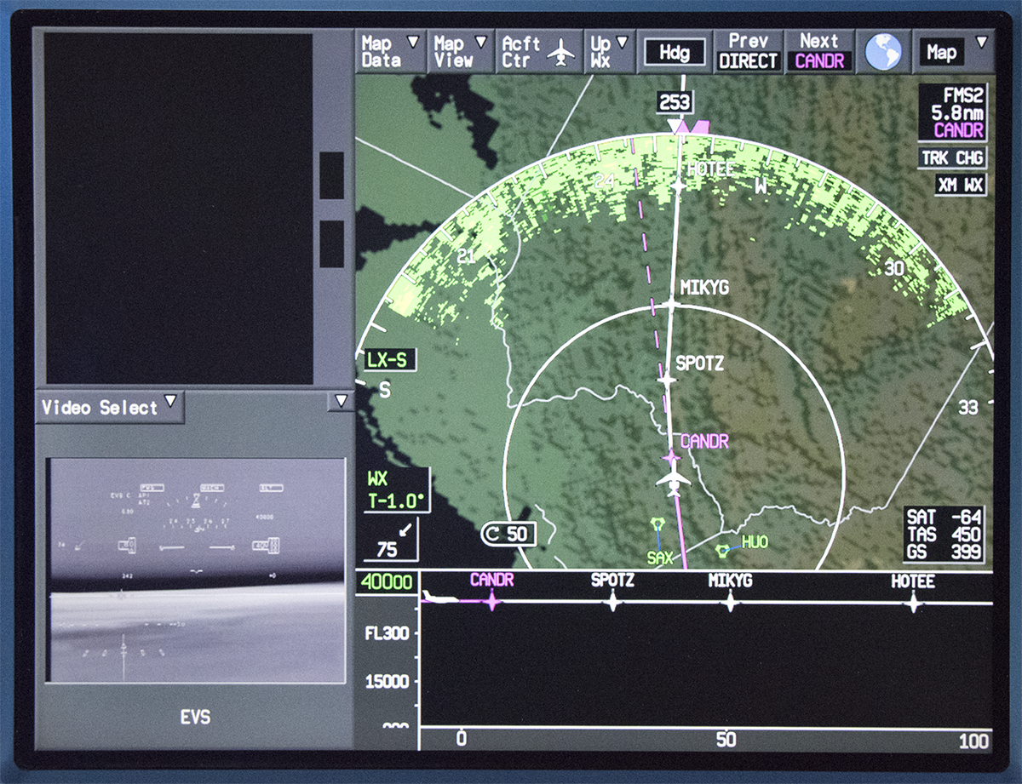
Notes:
Slide B?
Let’s go back. Slide A? Slide B?

Slide 25
Notes:
IF YOU SAID SLIDE A, YOU ARE RIGHT.
I am betting most pilots will set the tilt to as to minimize ground clutter. But you can’t detect shadows that way and if you want to differentiate between hazardous convective activity and ground objects, you need to see shadows.
IF YOU WANT MORE INFORMATION ABOUT THIS, I WILL HAVE A SHAMELESS PLUG AT THE END FOR YOU.
But if you did know this, congratulations. You knew something that no aircraft manufacturer wants to publish and few training vendors can be bothered to teach.
YOU HAD THE INTELLECTUAL CURIOSITY TO DISCOVER THIS ON YOUR OWN.

Slide 26

PRE-Accident Investigator Skills
Curiosity → Knowledge
Skepticism
Empathy
Passion
Notes:
As good PRE-accident investigators, WE NEED ALWAYS BE IN THE LEARN MODE
This intellectual curiosity is the first step to increase our knowledge as aviators
BUT YOU HAVE TO MAKE SURE THE KNOWLEDGE IS ACCURATE

Slide 27
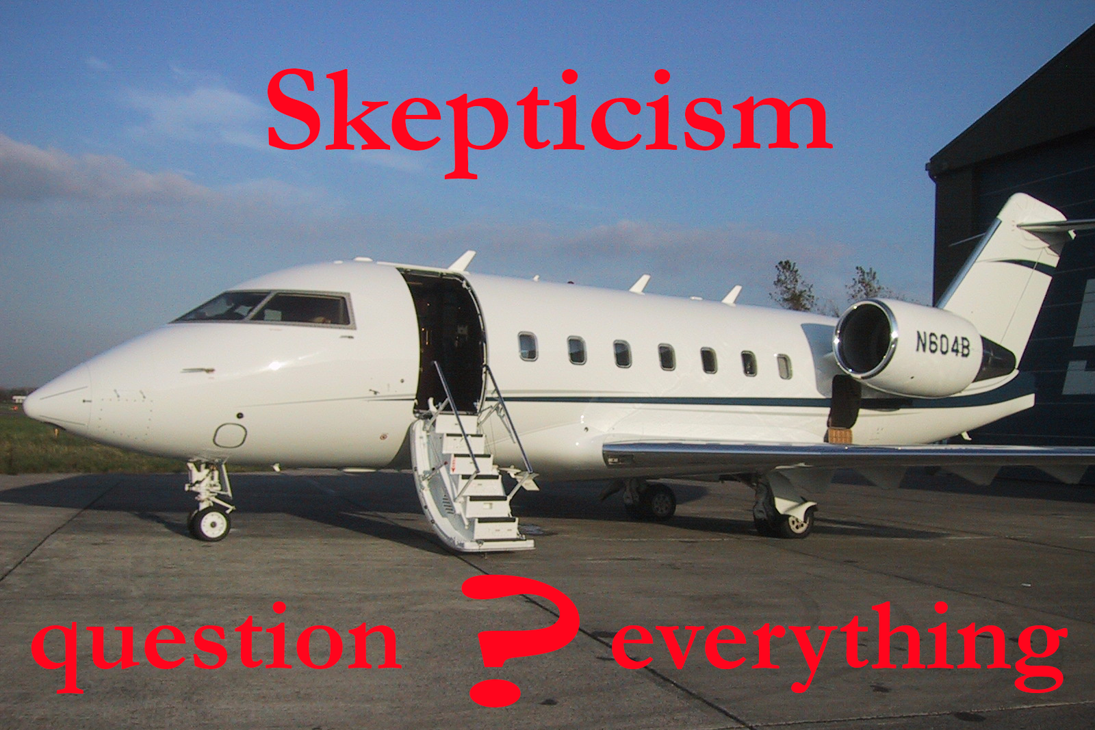
Notes:
BACK IN 2004 I WAS FLYING THIS AIRPLANE FROM SARASOTA TO BEDFORD, MASSACHUSETTS.
I was in the left seat. My boss, the chief pilot, was in the right seat. He had twice my flying time, twice my experience in Challengers, and about 10 more years as a pilot. That made what happened next so surprising.
JUST AS WE LEVELED OFF we got the dreaded bong, bong, bong and a CAS message saying we had lost a hydraulic system.
Well we had three systems to start with so losing one isn’t a big deal, right?
He just sat there in the right seat, staring at the CAS message.
Bong, bong, bong. I selected the hydraulic system synoptic page

Slide 28
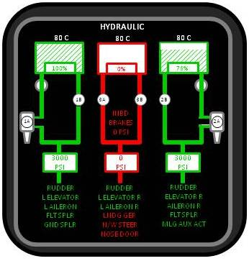
Notes:
This is what we saw.
He still sat there, motionless. I thought maybe he had a mental lock up.
So I gave him some tasks. “Hand me the checklist, declare an emergency with center, tell them we want direct Charleston and about a 20 mile final so we can use the alternate system to extend the gear.
He was happy to do all that and when he got done, there we sat at altitude with nothing to do for a few minutes. So he called the CEO, our passenger, to the cockpit
The CEO showed up and the right seater, my boss, started the horror story. “We’ve got an emergency!” “We lost our most important hydraulic system!” “We have to do an emergency landing!” “We have to emergency extend the landing gear!” “We aren’t sure that’s going to work!” “You and the misses had better strap in tight!”
As you can imagine the CEO looked visibly shaken.
I just couldn’t let that stand. I pointed at the synoptic page and told the CEO, “It isn’t really a big deal. We’ve got three systems, we only lost one, we still have two left. We are just landing as a precaution just in case we lose another one. We’ll call ahead to make sure you have alternate transportation home.”
That seemed to make the CEO happy, but it also seem to calm the right seater
And that’s pretty much what happened. As it turns out we didn’t need the 20 mile final and the CEO actually thought the sight of the fire trucks around the airplane was fun.

Slide 29
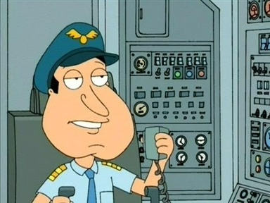
Notes:
So the first takeaway from this is this: not all pilots are created equal.
As we sat in Charleston for a few nights while the mechanics fixed the airplane, I asked the chief pilot why he got so frantic.
“Don’t you know,” he said, “nobody’s ever emergency extended the landing gear on a Challenger 604 in real world conditions!”
Of course that isn’t true, how could the airplane get an airworthiness certificate if such an important system didn’t work?
I don’t think he was persuaded and I just logged it away to one pilot’s poor systems knowledge.
Two weeks later I was attending recurrent when the ground instructor said, guess what? “There has never been a successful emergency landing gear extension in the history of the Challenger 600-series!”
So not all ground instructors are created equal either.
And that’s the second takeaway: you cannot accept all knowledge headed your way without questions.

Slide 30
cyn·i·cism
[ˈsinəˌsizəm]
NOUN: an inclination to believe that people are motivated purely by self-interest.
skep·ti·cism
[ˈskeptəˌsizəm]
NOUN: a skeptical attitude; doubt as to the truth of something:
Notes:
I’m not saying to suspect the motives of anyone sending that knowledge your way
That ground instructor, for some reason, believed what he was telling my chief pilot about the Challenger landing gear system
Good intentions or not, he was passing along bad information
I am saying you should not accept information from any source without some kind of verification or common sense check

Slide 31
PRE-Accident Investigator Skills
Curiosity → Knowledge
Skepticism → Expertise
Empathy
Passion
Notes:
THERE IS AN OLD SAYING THAT YOU CAN TELL WHO THE EXPERT at a meeting is, he or she is the one with the PowerPoint Slides
I suppose you can update that to say the expert is the one with the website
Having been on the expert side of both of those things, I can tell you that isn’t right
EXPERTISE IS DEVELOPED BY CONSTANTLY QUESTIONING ALL INFORMATION
A good PRE-Accident investigator adds a healthy dose of skepticism to all knowledge
SO WHILE WE’RE ON THE SUBJECT OF NOT ALL PILOTS BEING EQUAL, HOW ABOUT YOU?

Slide 32

“Who’s the best pilot you ever saw?”
Notes:
WHO HERE DOESN’T HAVE AN EGO?
How is that possible when you routinely fly a hollow aluminum tube at speeds no other earthly being has achieved, at temperatures that will freeze blood, and altitudes that cannot sustain human life?
How does one stay humble with all that?
This is an important question because when one of your peers crashes an airplane do you think, “I would never have done that?” or do you think “That could have been me!”
I think the ability to empathize with these pilots is key to really learning from their experiences.

Slide 33
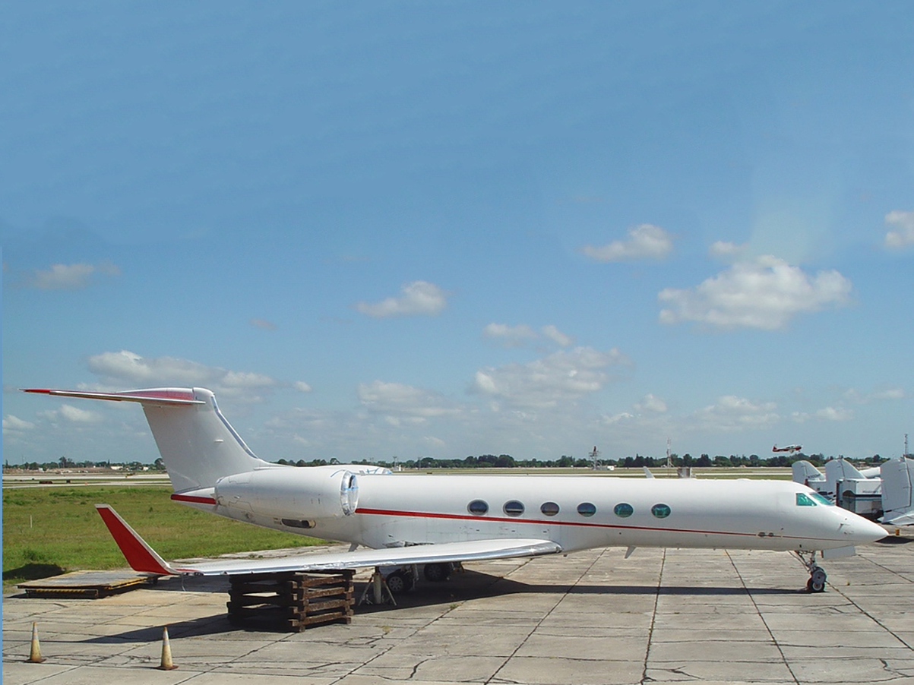
Empathy:
It could happen to you
Notes:
TAKE THE INFAMOUS GV POPSICLE CASE
Back in 2002 they didn’t let just anyone fly a GV, you had to be a pretty good pilot to earn the right to fly one these beautiful aircraft
So here’s what happened
The airplane was at the West Palm Gulfstream service center to troubleshoot a faulty “overspeed” warning
On the last day the airplane was on jacks for a tire change
The mechanic needed the airplane to think it was on the ground to complete the maintenance checks, what to do?

Slide 34
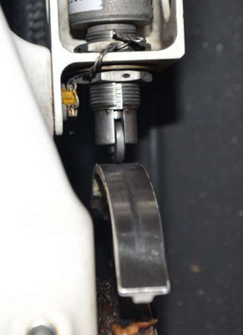
Notes:
EACH LANDING GEAR STRUT HAS A WEIGHT ON WHEELS SWITCH on the GV, this is the left main gear shown while on the ground
In the air that bottom cam rolls to a smaller radius area as well as extends away so there is a gap, and the airplane then thinks that strut is in the air
WHY IS THIS IMPORTANT?
Well you don’t want to retract the gear when you are on the ground, for example. There are lots of reasons but perhaps one of the more important reasons is the ground spoilers

Slide 35
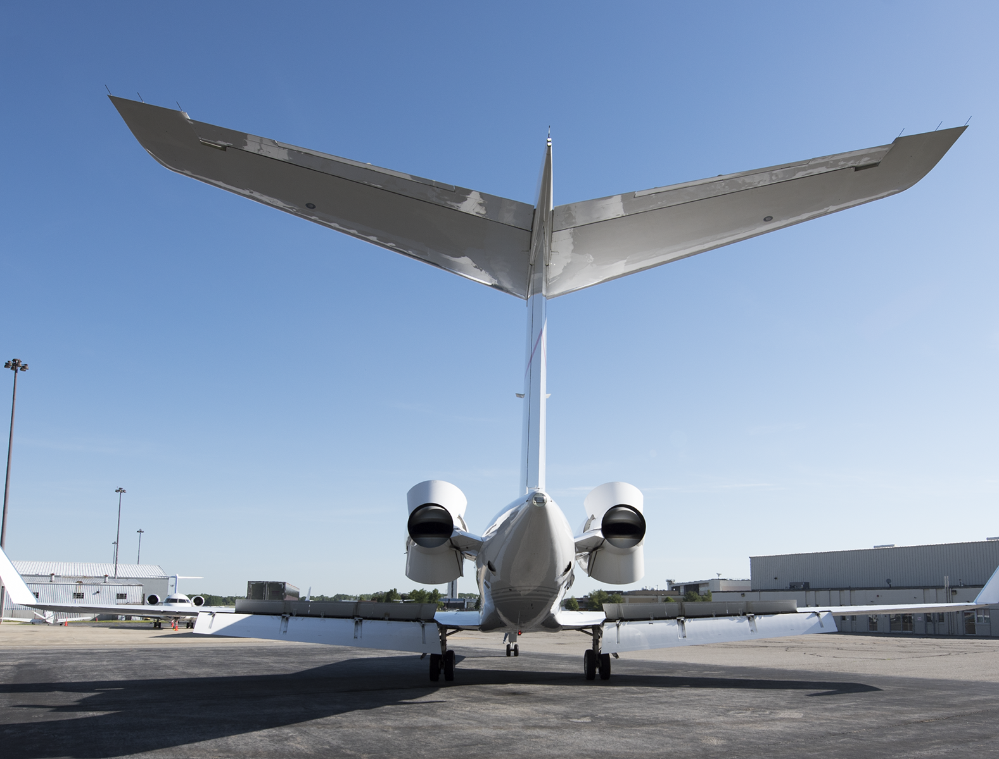
Notes:
There are three panels on top of each wing – the two outboard panels are used separately to assist in rolling the airplane or together to act as speed brakes, generally around 28 degrees or so.
On the ground, all six panels can automatically deploy to 55 degrees as ground spoilers. They spoil the lift of the wing.
WHEN DO THEY DEPLOY? If both main gear weight on wheel switches say they are on the ground, if the airplane’s ground spoilers are armed, and if the throttles are brought to idle, the ground spoilers will deploy
ON A GV IF THAT HAPPENS IN FLIGHT, THE AIRPLANE WILL CEASE TO FLY.

Slide 36
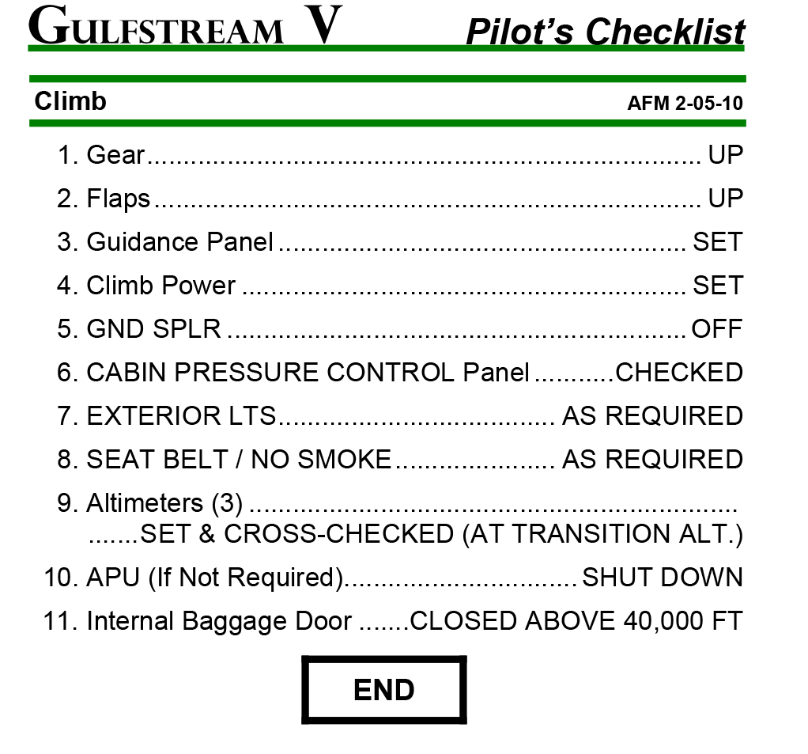
(As written)
Notes:
LET’S SAY YOU TAKEOFF AND BY SOME WEIRD COINCIDENCE BOTH MAIN LANDING GEAR WEIGHT ON WHEEL SWITCHES FAILED. The airplane will think it is still on the ground and the gear handle will not come up. Now you decide to return for landing and get cleared to level off at just 2,000. Well you are blasting through the altitude and pull the throttles to idle. Now the spoilers pop up and you cease to be an airplane.
Here is the GV pilot’s checklist, as written. Notice we don’t get to the ground spoilers until Step 5.

Slide 37
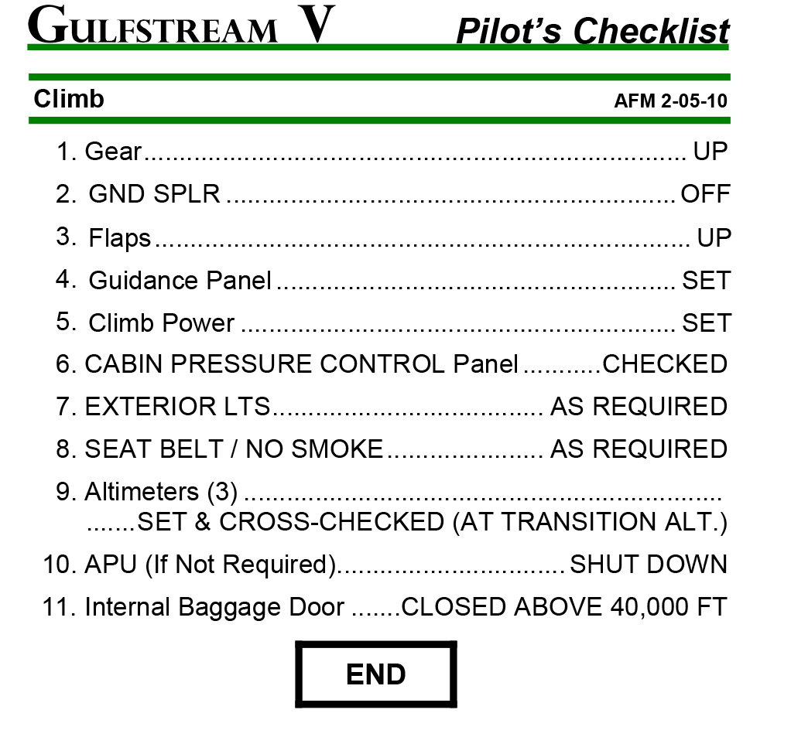
(As most pilots execute)
Notes:
So here’s what we did. This has been drilled into Gulfstream pilots for decades: GEAR, SPOILERS, FLAPS. In that order. Gear, spoilers, flaps.
We were convinced this would prevent that weight on wheels switch failure from ending up with an airplane falling out of the sky.
FAST FORWARD TO 2002.
The mechanics wanted to fool the airplane into thinking it was on the ground. The accepted practice back then was to wedge a popsicle stick between that switch and the roller. No expensive Gulfstream part and, more importantly, no “Remove before flight” flags.
THE PILOTS MADE SEVERAL MISTAKES, no doubt about it. They failed to notice the popsicle sticks during the preflight. They failed to run the climb checklist, which would have turned the ground spoilers off. They said they ran the correct checklists for the failure, but that would have turned the switches off. They even confirmed the ground spoilers were armed, showing a lack of understanding of the systems.
Of course the gear handle would not come up so they turned back to land. They chopped the power at 57 feet – a very poor technique in this airplane – and the ground spoilers popped up. Nobody was hurt but the airplane has never flown again.

Slide 38
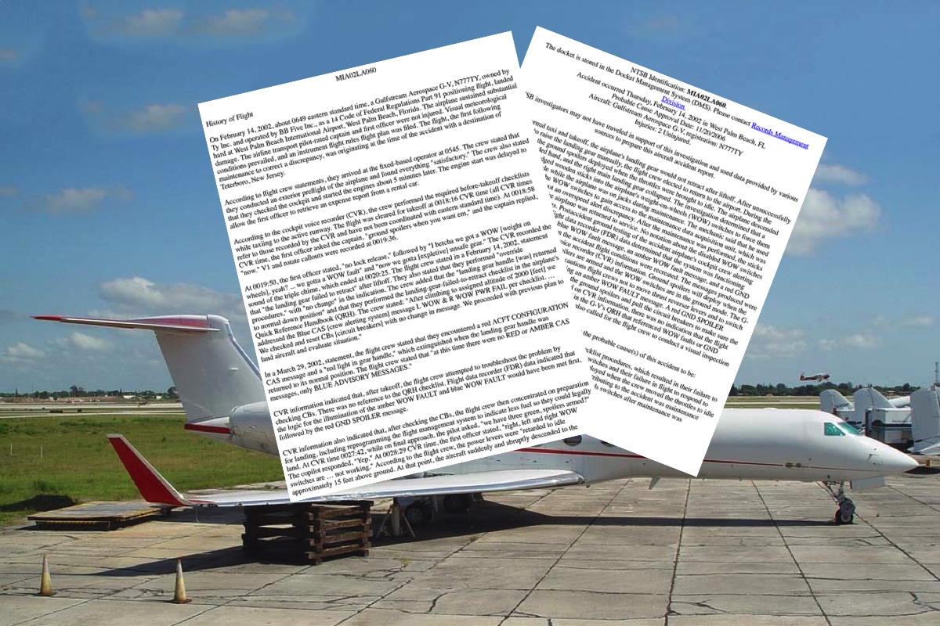
Notes:
THOSE OF US WHO USED THE “GEAR, GROUND SPOILERS, FLAPS” TECHNIQUE WERE STUNNED. How could this happen?
THE NTSB DIDN’T DEEM THIS WORTHY of a full blown accident report since nobody was killed or injured.
You may say to yourself, “I would have never done that,” and moved on to the next case study.
BUT CONSIDER THIS, NO PILOT BEGINS THE DAY with the thought, “Today I will ignore SOPs,” or “Today I shall crash an airplane”
You need to put yourselves into their shoes to really come up with the “Why”
So let’s do that.

Slide 39
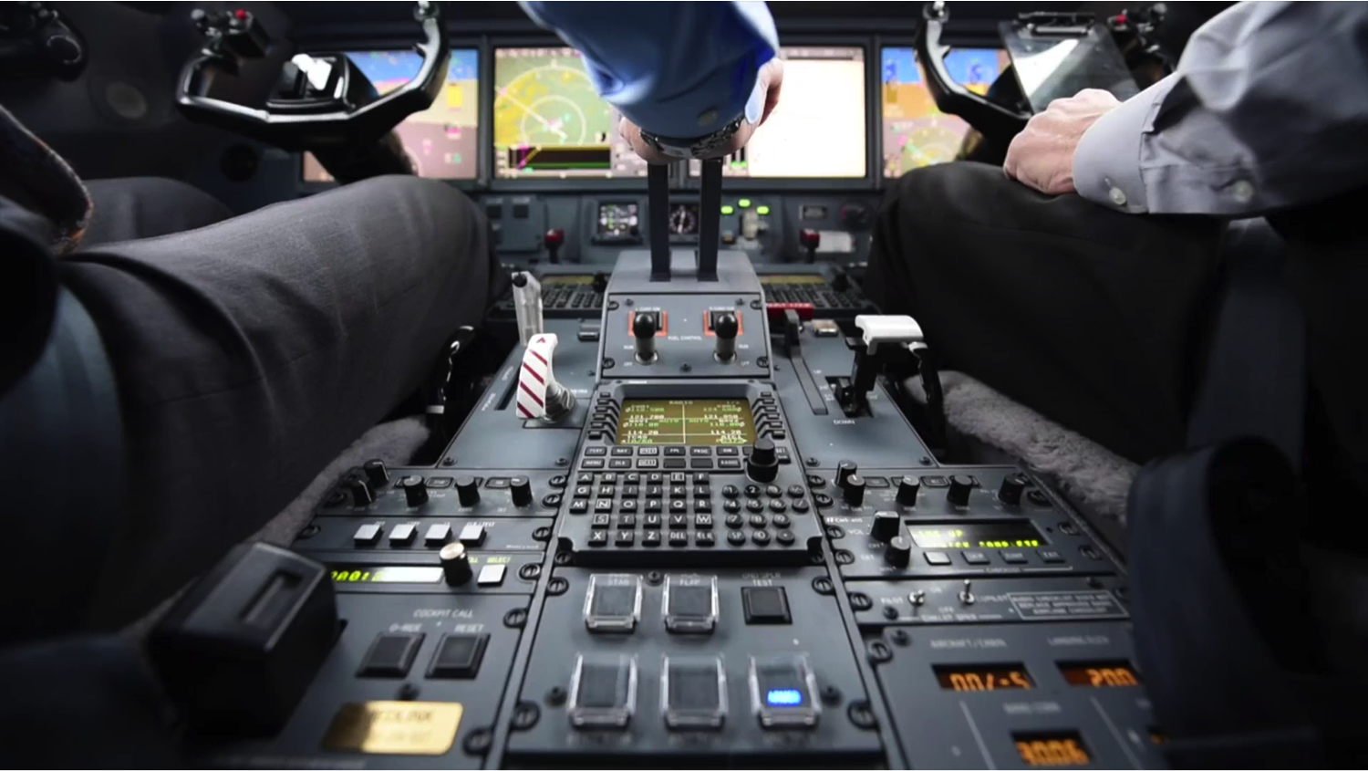
Notes:
YOU ARE IN THE RIGHT SEAT, you call “positive rate,” the left seater says “gear up,” you lift the handle but it doesn’t budge.
What do you do now? I might have the presence of mind to look at the weight on wheels indicators available in the GV series, but maybe not. So the left seater realizes you need to return and pulls the throttles back. You are now set up to fail.
THE “GEAR, GROUND SPOILERS, FLAPS” ROUTINE HAS FAILED.
Realizing we could be bitten, we thought about a solution.
See if you can spot how we changed our takeoff procedure.

Slide 40

Notes:
(Play)

Slide 41
Notes:
We now get the spoilers first.
If the weight on wheels switch fail, the spoilers will already be off when we attempt the gear handle.

Slide 42
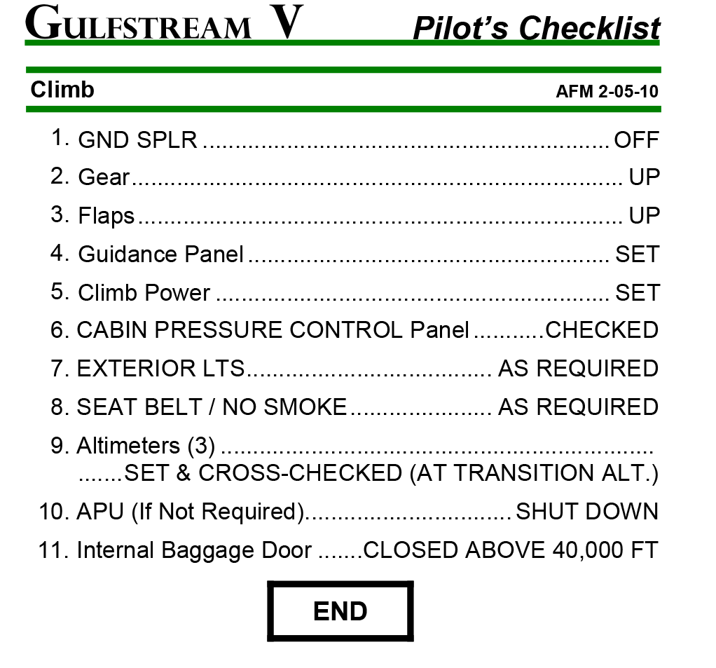
(As we do it)
Notes:
WE NOW TURN THE GROUND SPOILER SYSTEM BEFORE RETRACTING THE LANDING GEAR.
Now you might say the odds of having both main landing gear weight on wheels switches fail is very small. True.
You can also say the odds of that happening and the pilot failing to remember to get the ground spoilers immediately is pretty small. Okay.
And then you can say the pilot would be unlikely to pull the throttles to idle under these circumstances. Good point, well made.
BUT THERE ARE SO MANY THINGS WE DO TO ELIMINATE SMALL POSSIBILITIES BECAUSE – remember that slide with the mechanical versus human elements? – that’s what we have to do to attack those issues that remain.
There are at least two GV pilots who could have benefitted from this technique.

Slide 43
PRE-Accident Investigator Skills
Curiosity → Knowledge
Skepticism → Expertise
Empathy → Understanding
Passion
Notes:
YOU NEED THE EMPATHIZE WITH THOSE WHO CAME BEFORE YOU. With this understanding you can identify and attack the problems that remain
So these three items – curiosity, skepticism, empathy – they will give you the skills to become a better pilot, engineer, flight attendant, mechanic, dispatcher; anyone in our business who deal with airplanes
But you need one more thing to have an impact outside just yourself, YOU NEED A PASSION FOR MAKING THINGS SAFER FOR EVERYONE
So how do you do that?

Slide 44
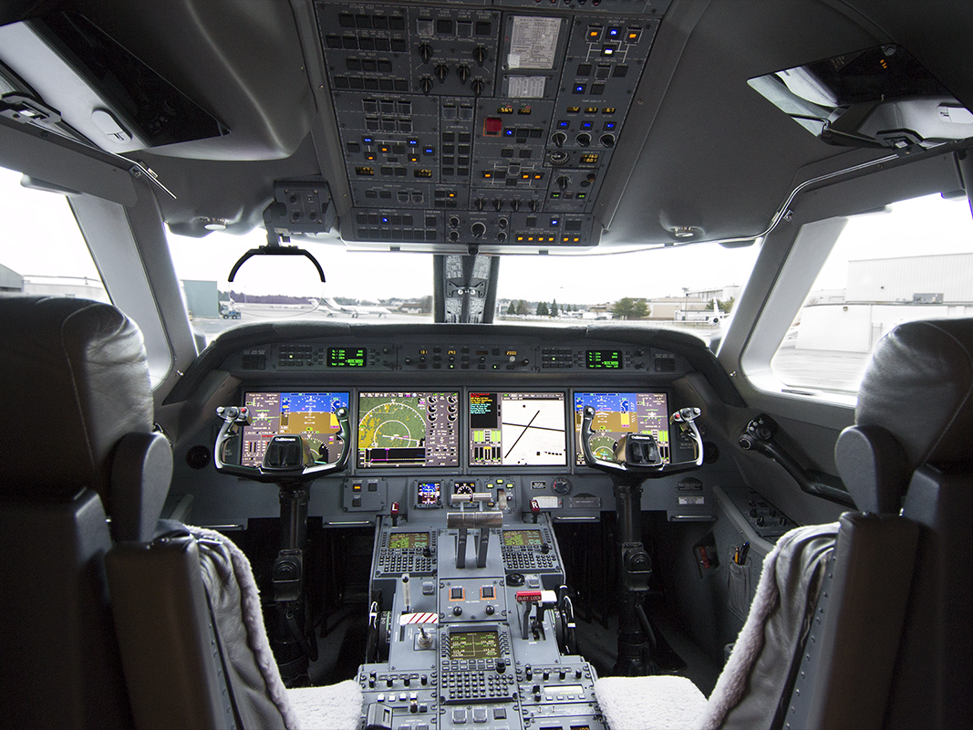
Notes:
THE PROCESS IS THE SAME IN EVERY AIRCRAFT I’VE EVER FLOWN AND I SUSPECT IT WILL BE THE SAME FOR YOUR AIRCRAFT
Gulfstream rarely makes a “clean sheet” aircraft, each generation takes what works from the previous model and improves what doesn’t
So with each generation we are WORKING ON SMALLER AND SMALLER ISSUES WHEN IT COMES TO THE AIRPLANE ITSELF
And we are getting better as humans, so we look for smaller and smaller issues when it comes to pilot procedures

Slide 45
Identify a problem
Notes:
THE FIRST STEP IS TO IDENTIFY A PROBLEM
Remember that list of things that could kill me? My first Gulfstream, the GIII, had about 7 items. My current Gulfstream, the G450, has 2
We’ve already talked about the ground spoilers, but my flight department has the solution to that one, I’ll talk about the second one in a minute
I ENCOURAGE YOU TO DEVELOP YOUR OWN LIST
If you are flying a very well designed airplane, perhaps there is nothing out there that can kill you
I doubt that, but then narrow your gaze, perhaps things that can hurt you, or things that can cost you your license

Slide 46
Identify a problem
Curiosity: get smart about it
Notes:
Step two is to GATHER AS MUCH KNOWLEDGE ABOUT THE PROBLEM AS IS POSSIBLE
In the case of an aircraft problem you should obviously look at everything the manufacturer has on the problem
But go beyond that, look at similar issues with other aircraft
Talk to knowledgeable people
CAST A WIDE NET AT THIS STAGE

Slide 47
Identify a problem
Curiosity: get smart about it
Skepticism: don’t accept conventional wisdom
Notes:
NOW YOU NEED TO LOOK AT WHAT EVERYONE SAYS ABOUT A PROBLEM AND GIVE IT A COMMON SENSE CHECK
This is where we often miss a chance to spot an accident before it happens.

Slide 48
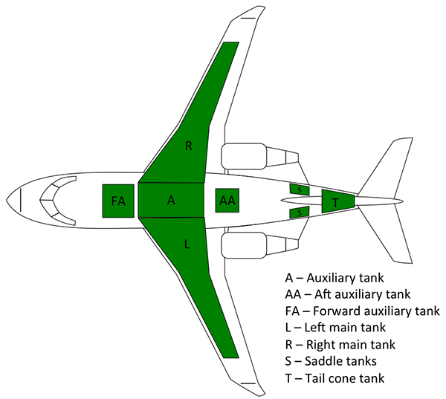
Notes:
JUST BECAUSE THE MANUFACTURER SAYS IT IS SO, DOESN’T MEAN IT IS
Canadair claimed a Challenger 604 crash in 2000 was caused by fuel migration during takeoff
Transport Canada published that in the official report
Everyone who flew the 604 knew the fuel migration was (A) impossible and (B) unlikely to cause a takeoff over-rotation leading to loss of control
The US NTSB investigated and Canadair finally admitted it was caused their company pilots tendency to snatch the elevator during takeoff rotation
WHY IS THIS SUCH AN IMPORTANT DISTINCTION? If you bought the fuel migration story, you may have missed just how critical rotation rate is in this airplane.

Slide 49
Identify a problem
Curiosity: get smart about it
Skepticism: don’t accept conventional wisdom
Empathy: understand what can go wrong, devise a solution
Notes:
Now you need to GET INTO THE HEADS OF ANYONE WHO HAS FALLEN UNDER THIS PROBLEM BEFORE
If the problem hasn’t claimed any victims yet, you need to put yourself mentally into the situation to understand what can go wrong
Only by really understanding can you come up with a solution
IF YOU FOLLOW THESE FOUR STEPS YOU WILL HAVE MADE YOURSELF SAFER. BUT THAT’S NOT ENOUGH.

Slide 50
Identify a problem
Curiosity: get smart about it
Skepticism: don’t accept conventional wisdom
Empathy: understand what can go wrong, devise a solution
Passion: spread the word
Notes:
THE PASSION NEEDED TO BE A GOOD PRE-ACCIDENT INVESTIGATOR MANDATES THAT YOU MAKE EVERYONE AROUND YOU SAFER TOO
I’ll have a few ways you can do that shortly,
But let me talk about the second item on my list of things that can kill me in my current operation as an example of this process. We’ve already talked about the ground spoilers and I think we’ve come up with a solution.
THE SECOND ITEM ON MY LIST APPLIES TO ALL AIRCRAFT THAT FLY ABOVE 10,000 FEET.

Slide 51
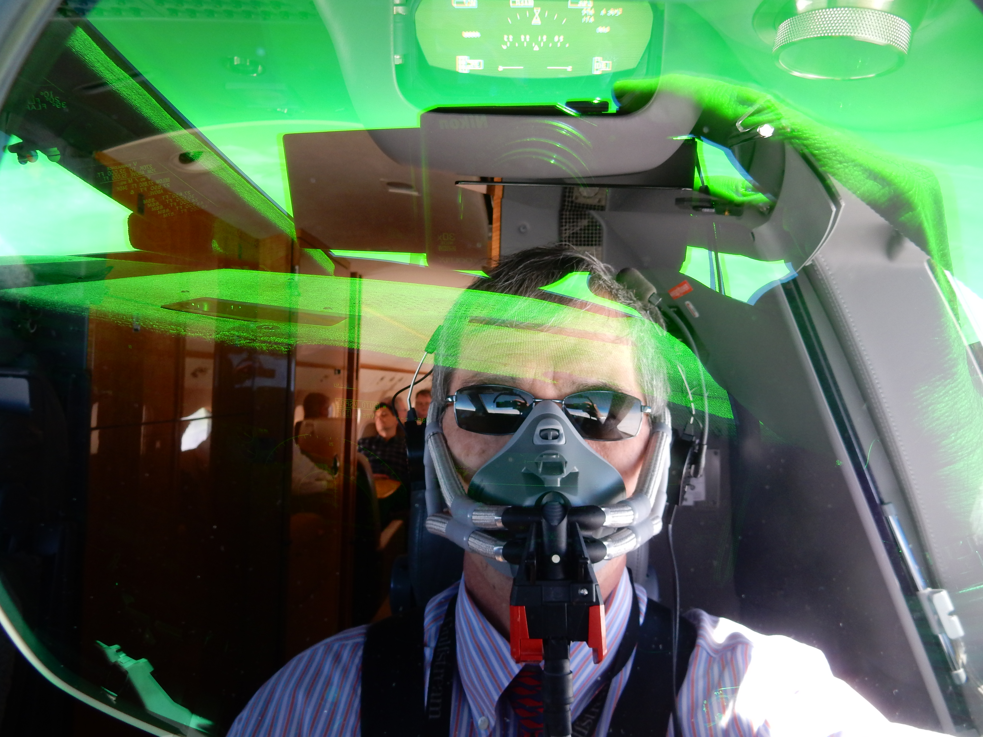
Passion
Notes:
WHAT WE WORRY ABOUT MOST NOW IS SLOW ONSET HYPOXIA
Yes we have warning systems but they don’t activate until 8,000 feet cabin altitude.
There have been a few losses in other airplane types that provide a warning at 10,000 feet that went unheeded because such a loss can be so gradual that when you do get the warning it could be too late.
So now we announce CABIN altitude at 10,000’ AIRCRAFT altitude, at level off, and every hour after that.
If this seems like a minor change, let me ask you this: WHAT IS YOUR NORMAL CABIN ALTITUDE AT 10,000’ AIRCRAFT ALTITUDE ON A NORMAL CLIMB?

Slide 52
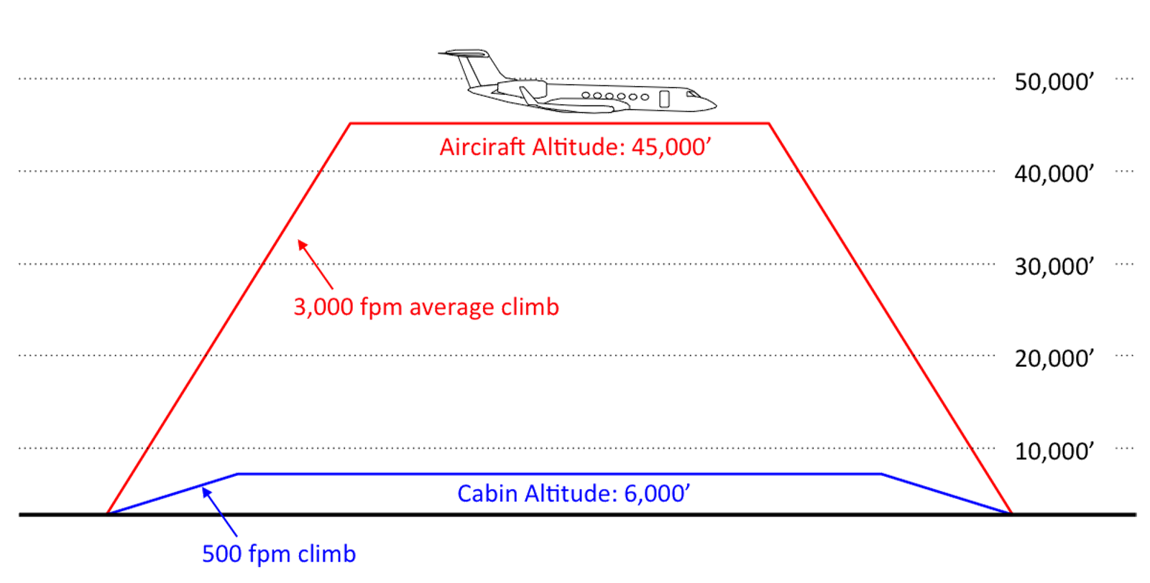
Notes:
FOR US THE ANSWER IS ABOUT 500’
IF YOU ARE FLYING AT 25,000 FEET ON AN AIRPLANE WITH A 45,000 FOOT CEILING, WHAT CABIN ALTITUDE DO YOU EXPECT? (us, 2,000’ can set SL)
IF YOU KNOW THE ANSWERS TO THESE QUESTIONS, you can avoid the fate of at least five transport category airplanes since 1999, all lost due to slow onset hypoxia
SO IN MY FLIGHT DEPARTMENT ARE INNOCULATED AGAINST SLOW ONSET HYPOXIA. We know what to look for and we have added the necessary checks to our normal procedures.
HOW DO WE TAKE THIS TO THE NEXT LEVEL?

Slide 53
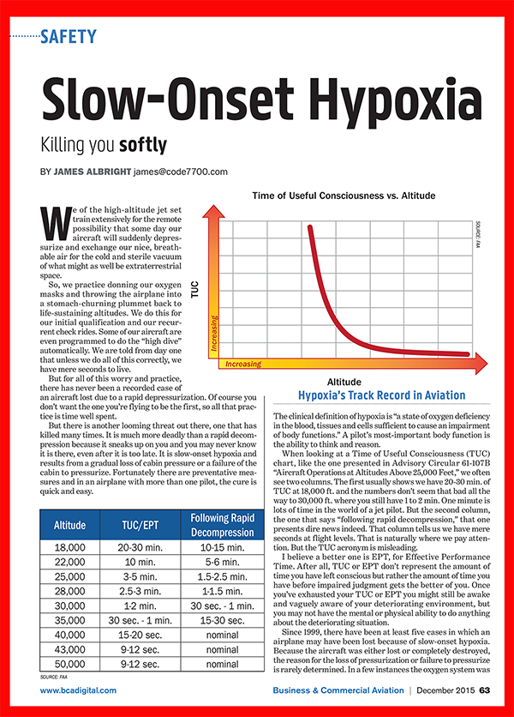
Notes:
I WROTE ABOUT THIS for Business & Commercial Aviation magazine last year
I write about it on my website
But you don’t need a public forum to express your passion for the latest great idea or technique
YOU CAN ADVOCATE YOUR PASSION IN MONTHLY SAFETY MEETING
YOU CAN BRING THESE THINGS UP DURING YOUR RECURRENT TRAINING

Slide 54
PRE-Accident Investigator Skills
Curiosity → Knowledge
Skepticism → Expertise
Empathy → Understanding
Passion → Ability
Notes:
But the best way is to lead by example, let everyone you know about the discoveries you’ve made and that gives you the ability to make aviation safety for more than just your cockpit
So let me close with a few more elements of my passion

Slide 55
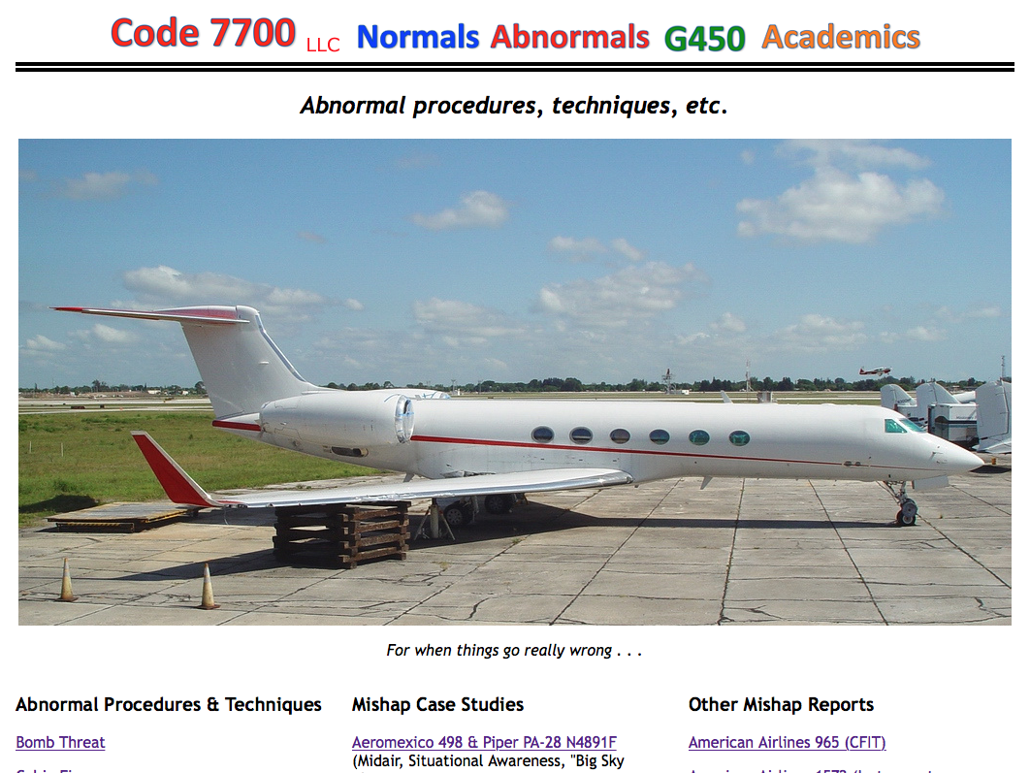
Notes:
I am often asked why I offer www.code7700.com free of charge
There is no fee
You don’t even have to sign in
Here you will find an exhaustive list of articles, over a thousand, on how to fly instrument procedures, how to fly internationally, how to avoid obstacles, how to understand avionics mandates, on and on and on. There are over a hundred accident case studies. The website averages over a million and a half hits every month from all over the world. And the readers go beyond corporate pilots. I get emails daily from airline pilots and military pilots. My favorite is from a member of the Polish Air Force who began, “you and I were enemies not too many years ago.” I get emails from airline manufacturers, government agencies, academia, and even school children.
I also get emails, letters, and phone calls from companies who want to advertise and even from companies who want to buy the website. But it isn’t for sale.
My passion is making aviation safer and the website is my primary means to do that.
Can you tell? I recommend you take a look.
How many here are regular visitors?
Do you agree?

Slide 56
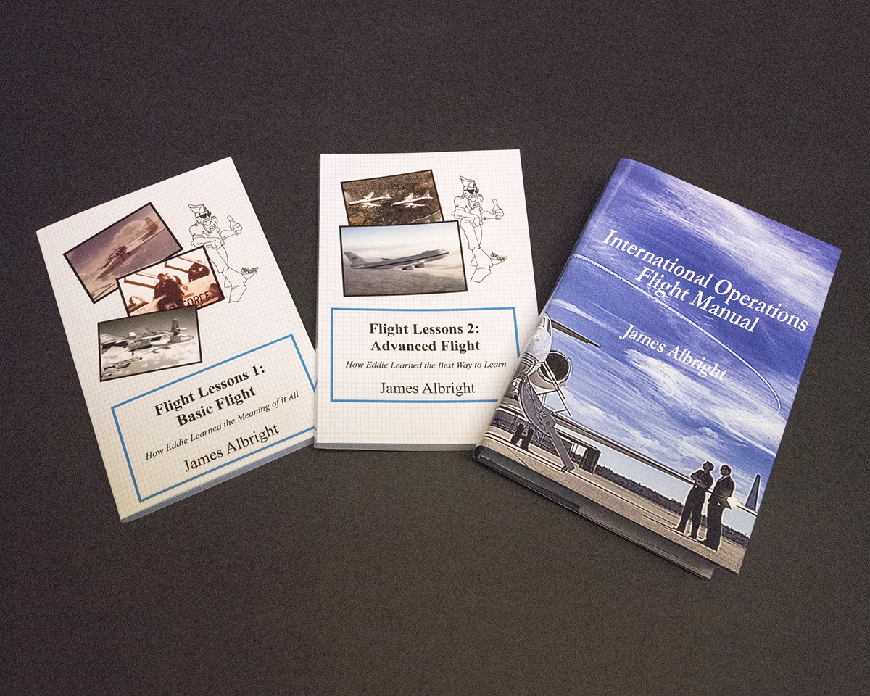
Notes:
I don’t make a dime off www.code7700.com so I put that on the previous slide
Why? Because I call this slide “My shameless plug”
These three books are available now on Amazon.com and a few other fine online book sellers
I mentioned radar procedures earlier, you will find those in Chapter 28 of Flight Lessons 1: Basic Flight
Each chapter starts with a story about my progress from Air Force ROTC cadet to KC-135A copilot
Each chapter ends with a technical lesson on graph paper, things that I think you as high performance turbine pilots can benefit from
I mentioned a need for skepticism, that is pretty much the bottom line to Flight Lessons 2: Advanced Flight
Like the first book, each lesson starts with a story and ends with a technical lesson
This books traces my progress from copilot to pilot to instructor pilot to examiner in the Boeing 707 and then the Boeing 747
The third book is the most complete international operations flight manual I’ve ever seen
I brought a case of each with me tonight, the first two are on sale for $15 at Amazon and we can match that price here
I didn’t bring a lot of the international manuals with me, it is quite a bit more expensive just because of its sheer size
It is on sale at Amazon for $75 a copy, but I brought 12 copies we can let sell for $50 a copy
So that’s my shameless plug. I would be happy to answer any shameless questions about anything we’ve talked about today, anything on the website, the books, the magazine articles, or even about the Eddie Haskel persona. In case I forget, thank you for the invitation. Every chance to talk aviation feeds that passion I talk about. And for that, thank you.

