Slide 1
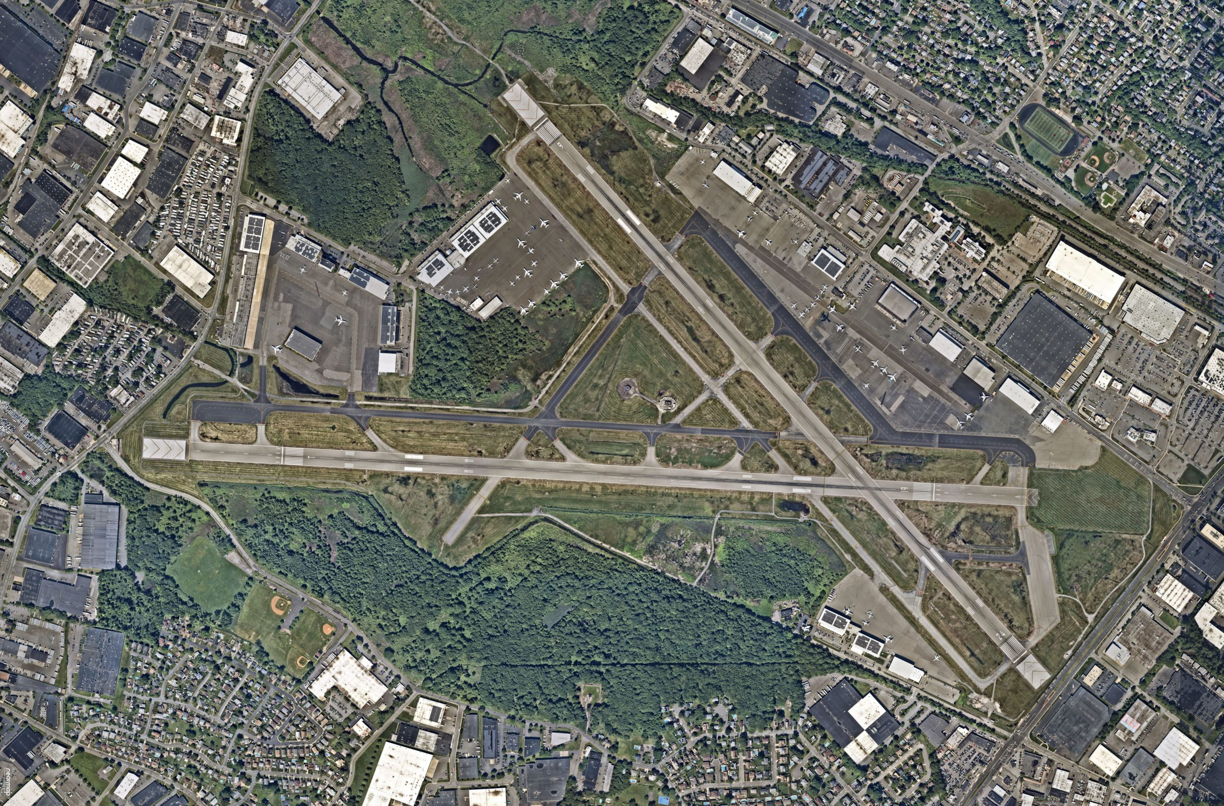
Teterboro Airport Questionnaire Summary
Conducted: October 15-31
196 Respondents

