Slide 1
TEB Noise Office Update
Teterboro Users Group
December 21, 2012

Slide 2
RNAV (GPS) X RWY 19 Approach
RNAV (GPS) X RWY 19 was published in December 2020 and made available July 1, 2021
The procedure was created in response to a TANAAC/PANYNJ request for an alternate approach to RWY 19
Approach follows NJ Rt. 17 corridor and has an offset final approach course to minimize noise impacts
Approach is available upon request, though availability is subject to traffic volume/complexity, controller workload and weather conditions
Currently the approach is most likely to be available/in-use during nighttime hours
Procedure is typically advertised on ATIS between 22:00 and 07:00

Slide 3
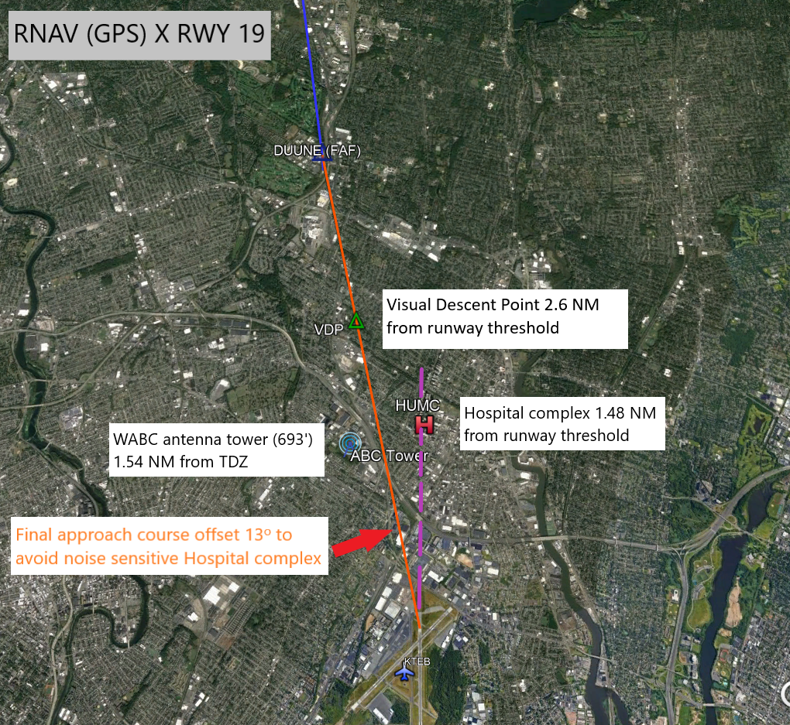

Slide 4
Approach Usage - 2022
Since inception, the RNAV (GPS) X RWY 19 approach has been used primarily during nighttime hours (22:00 – 07:00)
Approach usage increased significantly in the 2nd half of 2022, with 34% of nighttime RWY 19 arrivals utilizing the new approach

Slide 5
RWY 24 Departure Noise Violations
Maximum Noise Limits apply to all TEB departures
RWY 24 is designated as a noise sensitive runway
Max noise limit 22:00 – 07:00 80 dB
Max noise limit all other hours 90 dB
Most noise limit exceedances occur during night hours
Recommended departure noise abatement practices:
Request RWY 19 departure during nighttime hours
Utilize noise abatement departure procedure for RWY 24
Manufacturer recommended or NBAA “High Traffic Density Airport” NADP

Slide 6
TEB Departure Noise Violations
Noise Violations 2012 - 2022
*2022 includes data through 12/20/22

Slide 7
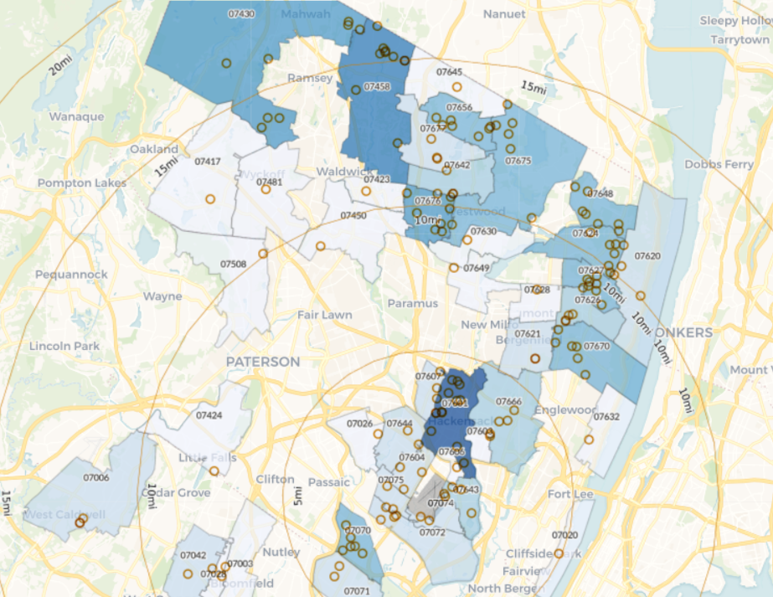
TEB Noise Complaints
November 2022

Slide 8
Fly Quiet Program
The Port Authority is developing a formal Fly Quiet Program for JFK/LGA/EWR and TEB
TEB has a long-standing Noise Abatement/Fly Quiet program, so this effort will look to enhance what is already in place
The main components of the current TEB noise program (noise limits, voluntary curfew, preferred runways/procedures) will remain the same
Program is currently under development and more information will be available in early 2023

