Slide 1
Aviation Career Opportunities Presented by Michael Burger Center Manager / Teterboro Learning Center

Slide 2
Introduction Michael Burger
© FlightSafety International / Publication and Distribution not allowed

Slide 3
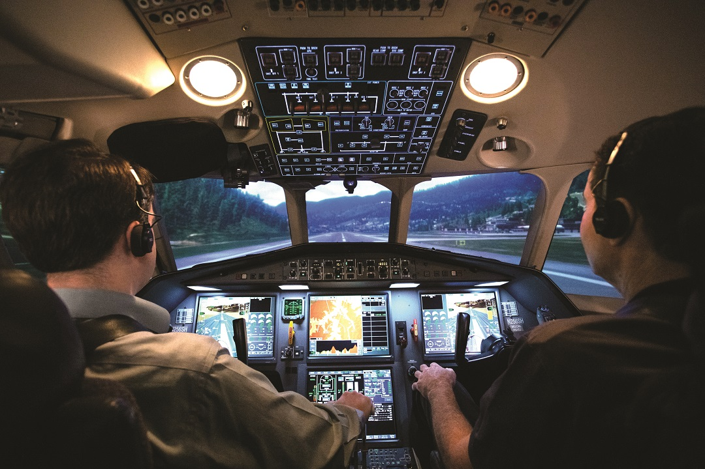
Business Overview
Corporate and Civil Operations
Corporate consists of administrative (shared) services, finance, sales and marketing
Civil operations includes our learning centers, which total over 30 globally
Civil operations conduct ground and simulation training working with pilots, maintenance technicians, cabin attendants, and instructors
Corporate HQ is Columbus, OH
© FlightSafety International / Publication and Distribution not allowed

Slide 4
Business Overview
Simulation Systems
Designs, manufactures, and integrates the highest quality and most advanced simulation products in the world
Located in Broken Arrow, Oklahoma & Hazelwood, MO
© FlightSafety International / Publication and Distribution not allowed

Slide 5
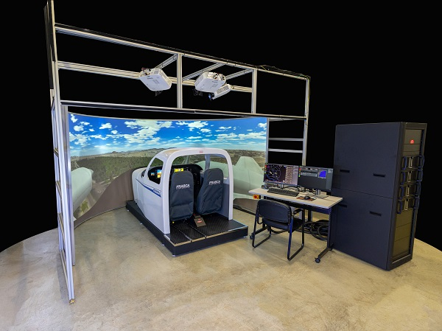
Business Overview
Manufactures AATDs, CPTS, FSTDs and FFSs used by flight training organizations worldwide
Enables realistic simulated learning environments for basic and complex mission training
Located in Urbana, IL
© FlightSafety International / Publication and Distribution not allowed

Slide 6
Business Overview
Support for U.S. Department of Defense
Operations at 15 U.S. military bases
Provides mission-critical training programs and equipment to military and government flight crews
Defense HQ is Dallas, TX
© FlightSafety International / Publication and Distribution not allowed

Slide 7
Learning Center Opportunities
Flight Instructors
Second in Command
Simulator Technicians
Delivers ground and flight instruction
Unrestricted ATP certificate, or an ICAO member state Airline Transport Pilot License
Responsible for maintaining currency in assigned programs
Commercial Pilot Certificate with appropriate category, class and instrument ratings
Minimum of 450 hours
Maintains and repairs flight training devices (FTDs)
Makes mechanical modifications, updates and repairs
1-3 years’ experience, including civilian/military electronics, or related technical experience
Aviation Career Opportunities
Courseware
Customer Support
IT / Admin
Creating, developing, enhancing interactive products and programs for FlightSafety training
Field of study in graphic design/layout, multimedia, video production, 3D and/or multimedia preferred
Proactive problem solvers who ensure FlightSafety International customers and clients receive the very best service
One to two (1-2) years related experience in related field such as customer service, hospitality or administration
Simulator software and computer specialists developing and maintain IT infrastructure
Admin/HR/Sales/Marketing specialist supporting the training business
© FlightSafety International / Publication and Distribution not allowed

Slide 8
Simulation Opportunities
Software Engineers
Field Service Technicians
Simulator Maintenance Technicians
Provides software solution for navigation and visual systems for use in pilot training.
Basic high level programming skills required
Knowledge of operating systems such as UNIX, Linux, and Concurrent OS/32 are a plus.
Plans and coordinates in-house and customer-based field installation and integration of flight simulation PC windows
Ensuring system functionality through execution of documented test procedures meets program specifications.
Associates Degree in Computer Science, Computer Networking preferred
Troubleshoots, repairs and modifies production electronic components, parts, equipment, and systems in aircraft flight simulators.
Associates Degree in Electronic Technology or equivalent Military training
Aviation Career Opportunities
© FlightSafety International / Publication and Distribution not allowed

Slide 9
Question
Contact:
Michael.burger@flightsafety.com
Phone #: +1 201 528 0100
© FlightSafety International / Publication and Distribution not allowed

